Slide 1
High-Performance Computing (HPC) at CSU
Shawn Ryan
Department of Mathematics and Statistics; ADAM Co-Director
Thijs Heus
Department of Physics; ADAM Co-Director

Slide 2
HPC Computing Options Available to Faculty
Viking Cluster (CPU/GPU) – housed in Rhodes Tower
MRI HPC Cluster (GPU) – housed in College of Engineering
Ohio Supercomputing Center (OSC) – housed in Columbus

Slide 3
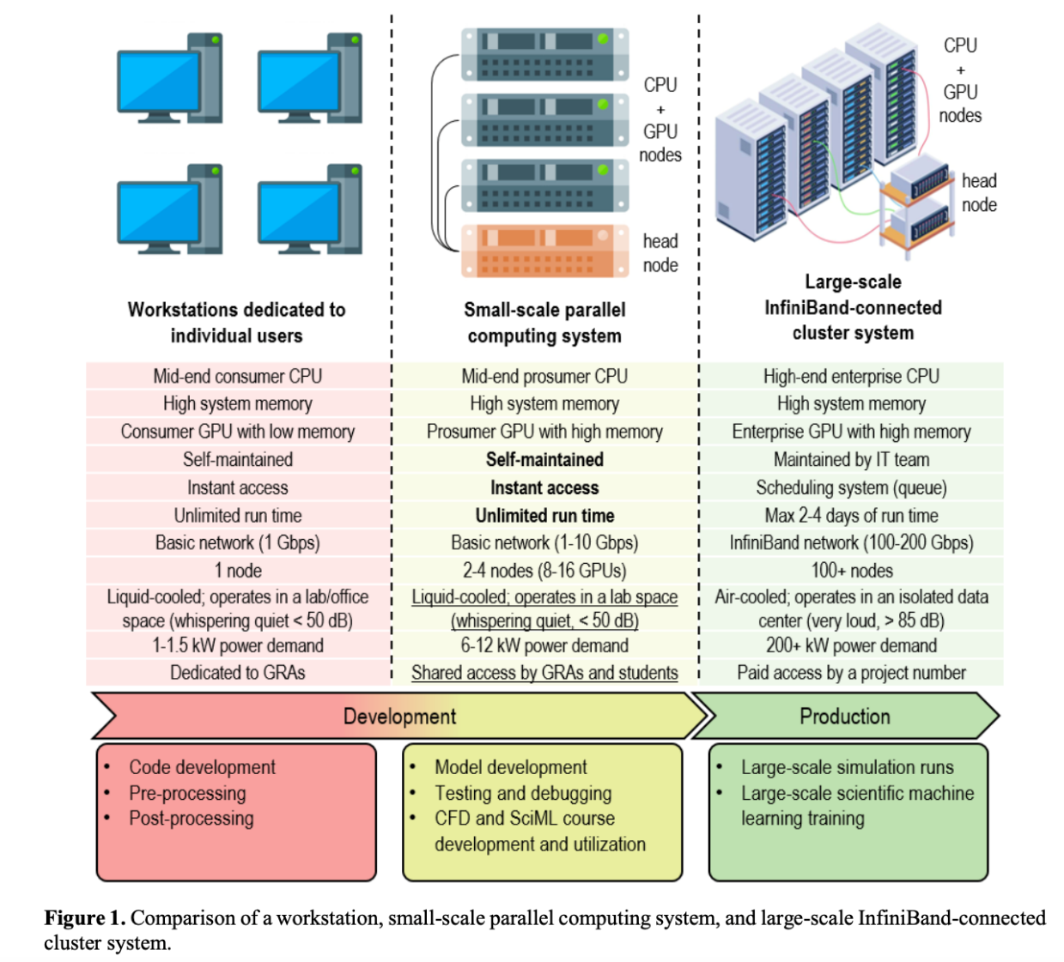
Motivation for Viking Cluster
Many recent new faculty have strong computational needs
Previously, everyone built their own compute cluster
Inefficient, because:
  Many underused clusters
  Costs Faculty time to administer
  Limited space in the Data Center (RT) to host all of those

Slide 4
Features of Viking Cluster
Open to all CSU Faculty
Students can gain access through advisors
Data is completely backed up on the cluster and sharable among users
Maintenance/downtime/… done as a group; some help from IS&T (Ranga Balimidi – HPC Architect)
Faculty who contribute through startup or grants have priority in the queue, but currently very minimal waits

Slide 5
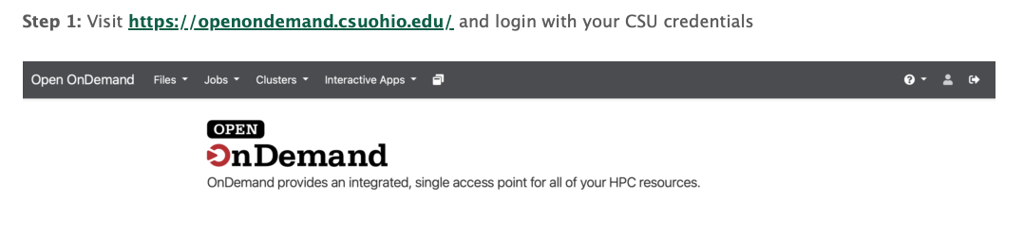
How to Access the Viking Cluster
Directions on the ADAM Center Webpage (academic.csuohio.edu/ADAM)
First time users can sign-up there for an account.
Note: Student users should go through their advisor
How to Access:
Option 1: Use Open OnDemand and launch a Virtual Desktop
Option 2: (Advanced Users) SSH
To setup your directory initially you will need to ssh to yourCSUID#@hpc-stor-01.csuohio.edu. then you can securely transfer files via sftp to your home directory on the Viking Cluster.

Slide 6
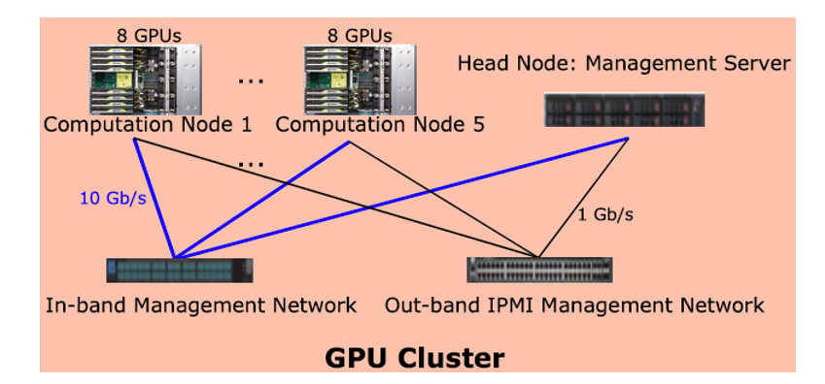
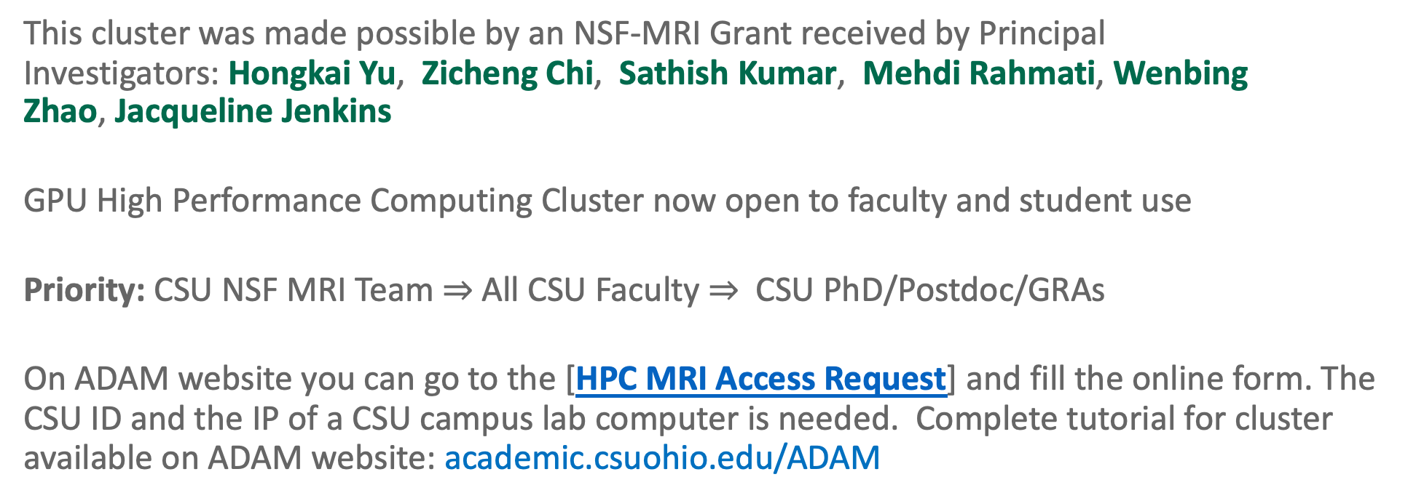
MRI HPC Cluster (GPU)
This cluster was made possible by an NSF-MRI Grant received by Principal Investigators: Hongkai Yu, Zicheng Chi, Sathish Kumar, Mehdi Rahmati, Wenbing Zhao, Jacqueline Jenkins
GPU High Performance Computing Cluster now open to faculty and student use
Priority: CSU NSF MRI Team $⇒$ All CSU Faculty $⇒$ CSU PhD/Postdoc/GRAs
On ADAM website you can go to the [HPC MRI Access Request] and fill the online form. The CSU ID and the IP of a CSU campus lab computer is needed. Complete tutorial for cluster available on ADAM website: academic.csuohio.edu/ADAM

Slide 7


Ohio Supercomputing Center also has Online Classrooms
Controllable environment
Easily and securely accessible from around the world
Large compute capacity if need be – and no problem if not
Classroom projects are free for Ohio Colleges Setup at my.osc.edu
Great and responsive helpdesk; little overhead

Slide 8
Ohio Supercomputing Center
All faculty at Ohio’s public Universities have access to $1000 worth of computing each year at OSC. Get setup at osc.edu and ADAM faculty can help.
CSU Office of Research will cover overages within reason pending prior approval
OSC is a large scale HPC Facility that offers access to up-to-date hardware and over 200 software licenses.
Cons: Waiting in Queue with other researchers, hard to trouble-shoot on the fly. Not feasible for grant work requiring secured, anonymous, or sensitive data

Slide 9
Conclusions: HPC Computing Options Available to Faculty
Viking Cluster (CPU/GPU) – housed in Rhodes Tower
MRI HPC Cluster (GPU) – housed in College of Engineering
Ohio Supercomputing Center (OSC) – housed in Columbus
ADAM is here to help you get started

