Slide 1
COM 631/731
Levels of Measurement
Notes:
From Text:
Every time you begin to review or design a research study, you will have to answer two questions: (1) What do the main concepts mean in this research? (2) How are the main concepts measured?
This presentation focuses on how concepts are measured. Specifically, we will examine how variables differ in levels of measurement.

Slide 2
Variable vs. Attribute
Variable
Attribute
Attribute

Slide 3
Variable vs. Attribute
Variable
Gender
Attribute 1
Attribute 2
1 = Female
2 = Male

Slide 4
Levels of Measurement
There are two main types of level of measurement:
The nominal level of measurement, which is qualitative, has no mathematical interpretation. (e.g., “2” does not mean 2 of something)
The quantitative levels of measurement are progressively more “demanding” mathematically – ordinal, interval, ratio.
Notes:
From Text:
{T}here are many ways of collecting information, or different operations for gathering data: asking questions, using previously gathered data, analyzing texts, and so on. Some of this data contains mathematically detailed information; it represents a higher level of measurement.

Slide 5
The Hierarchy of Levels
Ratio
Absolute zero
Interval
Distance is meaningful
Ordinal
Attributes can be ordered
Nominal
Attributes are only given labels/numbers

Slide 6
Nominal Measures
The nominal level of measurement labels attributes with no mathematical interpretation; they vary in kind or quality but not in amount.
≠
1 = Terrier
2 = German Shepherd
In terms of the variable “Dog Breed”, you can say that the German Shepherd is not equal to (or not the same as) the Terrier, but you cannot say that the “German Shepherd” is greater than (“dog breedier”) or less than (“less dog breedy”) than the Terrier.
Notes:
From Text:
The nominal level of measurement identifies variables whose values have no mathematical interpretation; they vary in kind or quality but not in amount. “State” (referring to the United States) is one example. The variable has 50 attributes (or categories or qualities), but none of them is more “state” than another.
Here’s another example: dogs. German Shepherds, Terriers, Great Danes, etc., are different types of dogs. Although they vary in size (size is a separate variable), they do not vary in “dogginess”. Terriers are not more doggy than the German Shepherds. They are different in quality, but not quantity.
From Text:
Although the attributes of nominal variables do not have a mathematical meaning, they must be assigned to cases with great care. The attributes we use to measure, or categorize, cases must be mutually exclusive and exhaustive:
n A variable’s attributes or values are mutually exclusive if every case can have only one attribute.
n A variable’s attributes or values are exhaustive when every case can be classified into one of the categories.
When a variable’s attributes are mutually exclusive and exhaustive, every case corresponds to one, and only one, attribute.

Slide 7
Ordinal Measures
At this level, you specify only the order of the attributes of the variable in “greater than” and “less than” distinctions. At the coffee shop, for example, you might choose between a small, medium, or large cup of decaf—that’s ordinal measurement.
You can tell that each cup contains more than the previous cup, but you don’t know exactly how much more there is in each larger cup.
Notes:
From Text:
The first of the three quantitative levels is the ordinal level of measurement. At this level, you specify only the order of the cases, in “greater than” and “less than” distinctions. At the coffee shop, for example, you might choose between a small, medium, or large cup of decaf—that’s ordinal measurement.
The small might be an 8 oz. Cup. The medium might have 12 oz., and the large might have 20 oz. The intervals separating the sizes of cups of coffee are not equal, but they can be ordered.

Slide 8

Interval Measures
At the interval level of measurement of attributes of a variable, numbers represent fixed measurement units but have no absolute zero point. There are standard (or known) distances between each point.
Sunrise: 8:05 am UV Index: 1, Minimal Sunset: 5:12 pm
Moonrise: 7:56 pm Phase: Waning Gibbous Moonset: 9:53 am
Averages and Records for Jan 20
Monday:
Mainly sunny. High 4F. Winds NW at 10 to 15 mph.
Monday night:
Clear to partly cloudy skies. Low -12F. Winds WSW at 5 to 10 mph.
4 ^{°F}
-12 ^{°F}
-16^{°C}
-25^{°C}
For example, the Fahrenheit and Celsius scales have fixed units (degrees), but no absolute zero point. The temperature can definitely go below zero, as indicated in this weather forecast for Fargo, ND.
Notes:
This level of measurement is represented by the difference between two Fahrenheit temperatures. Note, for example, that 60 degrees is 30 degrees higher than 30 degrees; but 60 is not “twice as hot” as 30. Why not? Because heat does not “begin” at 0 degrees on the Fahrenheit scale.

Slide 9
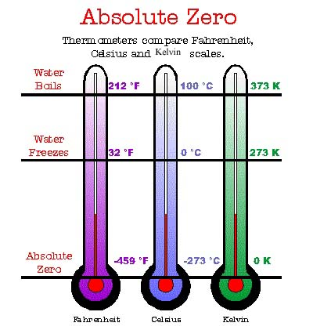
Here’s a comparison between the two interval level temperature scales (Farenheit and Celsius). There’s another scale, the Kelvin scale, which is different, in that it DOES have an absolute zero point.
?????The vast majority of social scientific variables that have standard differences between points also have true zero points and are ratio level.

Slide 10
Ratio Measures
A ratio level of measurement represents fixed measurement units with an absolute zero point.
Zero, in this situation, means absolutely no amount of whatever the variable indicates (e.g., zero heat on the Kelvin scale, zero years of formal education).
Because the numbers begin at an absolute zero point, they can be multiplied and divided (so ratios can be formed between the numbers).
On a ratio scale from 0 to 10, 10 is five points higher than 5 and is also two times greater than 5.
Notes:
From Text:
For example, people’s ages can be represented by values ranging from 0 years (or some fraction of a year) to 120 or more. A person who is 30 years old is 15 years older than someone who is 15 years old (30 – 15 = 15) and is also twice as old as that person (30/15 = 2). Of course, the numbers also are mutually exclusive and exhaustive, so that every case can be assigned one and only one value. Age (in years) is clearly a ratio-level measure.

Slide 11
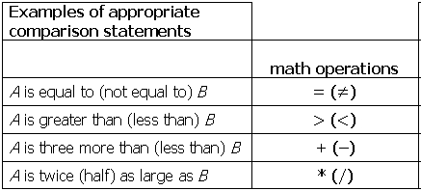
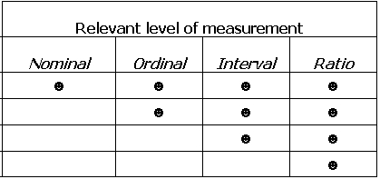
Different types of comparisons of units of analysis can be conducted using different levels of measurement

Slide 12
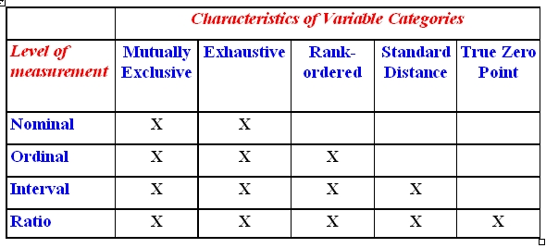
Another way to think the characteristics of measurement levels
Mutually exclusive – variable’s categories classify each unit of analysis into one and only one category
Exhaustive – variable’s categories must permit the classification of every unit of analysis
Rank-ordered – variable’s categories can be ranked from low to high or vice versa
Standard distance – fixed measurement units between variable’s categories
True zero point – point at which variable has no measurable quantity or magnitude

Slide 13
Implications of Measurement Levels
Certain quantitative analysis techniques require measurement at a minimum level.
Variables measured at a higher level can be transformed to a lower level, but not the reverse.
The level of measurement you choose will be influenced by your data analysis plans.
If your data analysis techniques can’t be determined in advance, choose the highest possible level of measurement.

Slide 14
Levels of Measurement
Short quiz – Answer is presented on the slide after the question.
Notes:
The following slides allow you to quiz your students with different examples. With each slide, the answer is indicated with a second click. So if you want to

Slide 15
What is the level of measurement for the the variable, “Number of Presidential Elections In Which Respondent Voted in Entire Life,” measured by the number the respondent reports?
Nominal
Ordinal
Interval
Ratio
Notes:
The answer is ratio.

Slide 16
What is the level of measurement for the the variable, “Number of Presidential Elections In Which Respondent Voted in Entire Life,” measured by the number the respondent reports?
Nominal
Ordinal
Interval
Ratio
*
Notes:
The answer is ratio.

Slide 17
What is the level of measurement for the variable, “political ideology”, measured as 1 = “Very Conservative,” 2 = “Conservative,” 3 = “Moderate,” 4 = “Liberal,” and 5 = “Very Liberal”?
Nominal
Ordinal
Interval
Ratio
Notes:
The answer is ordinal. This is a Likert Scale.

Slide 18
What is the level of measurement for the variable, “political ideology”, measured as 1 = “Very Conservative,” 2 = “Conservative,” 3 = “Moderate,” 4 = “Liberal,” and 5 = “Very Liberal”?
Nominal
Ordinal
Interval
Ratio
*
Notes:
The answer is ordinal. This is a Likert Scale.

Slide 19
What is level of measurement for the variable “political party affiliation,” with values 1 = “Democrat,” 2 = “Independent,” 3 = “Republican,” or 4 = “Green”?
Nominal
Ordinal
Interval
Ratio
Notes:
This is a good one with which to stump you students. Remind them that political party affiliation is different from political ideology. These are merely classifications that candidates and voters can choose. Of course, one’s affiliation often depends on one’s ideology, but not always!

Slide 20
What is level of measurement for the variable “political party affiliation,” with values 1 = “Democrat,” 2 = “Independent,” 3 = “Republican,” or 4 = “Green”?
*
Nominal
Ordinal
Interval
Ratio
Notes:
This is a good one with which to stump you students. Remind them that political party affiliation is different from political ideology. These are merely classifications that candidates and voters can choose. Of course, one’s affiliation often depends on one’s ideology, but not always!

Slide 21
What is the level of measurement for the variable “Educational Attainment” measured as 0 = less than H.S.; 1 = some H.S.; 2 = H.S. degree; 3 = some college; 4 = college degree; 5 = post college?
Nominal
Ordinal
Interval
Ratio
Notes:
Scales or Indexes offer a very good way of illustrating interval variables. Oftentimes, a scale does not have an absolute zero, as does this case. This is an example of a scale that is calculated by adding together the coded responses to a series of six questions that reflect one’s ideology.
Once again, it’s important to recognize that many social scientists consider indices to be only ordinal measures, even though they are often treated as though they were interval level, by conducting correlation or regression analyses with them.

Slide 22
What is the level of measurement for the variable “Educational Attainment” measured as 0 = less than H.S.; 1 = some H.S.; 2 = H.S. degree; 3 = some college; 4 = college degree; 5 = post college?
Nominal
Ordinal
Interval
Ratio
*
Notes:
Scales or Indexes offer a very good way of illustrating interval variables. Oftentimes, a scale does not have an absolute zero, as does this case. This is an example of a scale that is calculated by adding together the coded responses to a series of six questions that reflect one’s ideology.
Once again, it’s important to recognize that many social scientists consider indices to be only ordinal measures, even though they are often treated as though they were interval level, by conducting correlation or regression analyses with them.

Slide 23
Indicate how much you agree or disagree with the following:
“I consider myself a citizen of the world.”
1 = strongly disagree
2 = disagree
3 = neither agree nor disagree
4 = agree
5 = strongly agree
Nominal
Ordinal
Interval
Ratio
Notes:
Scales or Indexes offer a very good way of illustrating interval variables. Oftentimes, a scale does not have an absolute zero, as does this case. This is an example of a scale that is calculated by adding together the coded responses to a series of six questions that reflect one’s ideology.
Once again, it’s important to recognize that many social scientists consider indices to be only ordinal measures, even though they are often treated as though they were interval level, by conducting correlation or regression analyses with them.

Slide 24
Indicate how much you agree or disagree with the following:
“I consider myself a citizen of the world.”
1 = strongly disagree
2 = disagree
3 = neither agree nor disagree
4 = agree
5 = strongly agree
Nominal
Ordinal
Interval
Ratio
*
Notes:
Scales or Indexes offer a very good way of illustrating interval variables. Oftentimes, a scale does not have an absolute zero, as does this case. This is an example of a scale that is calculated by adding together the coded responses to a series of six questions that reflect one’s ideology.
Once again, it’s important to recognize that many social scientists consider indices to be only ordinal measures, even though they are often treated as though they were interval level, by conducting correlation or regression analyses with them.

Slide 25
Indicate how much you agree or disagree with the following:
“I consider myself a citizen of the world.”
0 1 2 3 4 5 6 7 8 9 10
completely completely
disagree agree
Nominal
Ordinal
Interval
Ratio
Notes:
Scales or Indexes offer a very good way of illustrating interval variables. Oftentimes, a scale does not have an absolute zero, as does this case. This is an example of a scale that is calculated by adding together the coded responses to a series of six questions that reflect one’s ideology.
Once again, it’s important to recognize that many social scientists consider indices to be only ordinal measures, even though they are often treated as though they were interval level, by conducting correlation or regression analyses with them.

Slide 26
Indicate how much you agree or disagree with the following:
“I consider myself a citizen of the world.”
0 1 2 3 4 5 6 7 8 9 10
completely completely
disagree agree
Nominal
Ordinal
Interval
Ratio
*
Notes:
Scales or Indexes offer a very good way of illustrating interval variables. Oftentimes, a scale does not have an absolute zero, as does this case. This is an example of a scale that is calculated by adding together the coded responses to a series of six questions that reflect one’s ideology.
Once again, it’s important to recognize that many social scientists consider indices to be only ordinal measures, even though they are often treated as though they were interval level, by conducting correlation or regression analyses with them.

Slide 27
What is the level of measurement for the variable “Biological Sex” measured as a dummy variable with 0 = male; 1 = female?
Nominal
Ordinal
Interval
Ratio
Notes:
Scales or Indexes offer a very good way of illustrating interval variables. Oftentimes, a scale does not have an absolute zero, as does this case. This is an example of a scale that is calculated by adding together the coded responses to a series of six questions that reflect one’s ideology.
Once again, it’s important to recognize that many social scientists consider indices to be only ordinal measures, even though they are often treated as though they were interval level, by conducting correlation or regression analyses with them.

Slide 28
What is the level of measurement for the variable “Biological Sex” measured as a dummy variable with 0 = male; 1 = female?
Nominal
Ordinal
Interval
Ratio
  NOTE: We would want to re-label this variable as something like “Female”
*
Notes:
Scales or Indexes offer a very good way of illustrating interval variables. Oftentimes, a scale does not have an absolute zero, as does this case. This is an example of a scale that is calculated by adding together the coded responses to a series of six questions that reflect one’s ideology.
Once again, it’s important to recognize that many social scientists consider indices to be only ordinal measures, even though they are often treated as though they were interval level, by conducting correlation or regression analyses with them.

Slide 29
end

