Slide 1
SPSS Overview
COM 631/731

Slide 2
Three types of SPSS files
DATA .sav
SYNTAX .sps
OUTPUT .spv or .spo (Older versions of SPSS; 15 and below)

Slide 3
Three types of SPSS files
DATA .sav
SYNTAX .sps
OUTPUT .spv or .spo (Older versions of SPSS; 15 and below)
The only type of file that is NOT compatible across different SPSS versions is OUTPUT. This is a long-standing issue with SPSS.
This is why it’s nice to use SYNTAX, so you can easily rerun your SPSS jobs on different machines.
You can export OUTPUT to .doc or .pdf
You can download a “legacy viewer” to view .spo files in SPSS versions 16 and above

Slide 4
Two “views” in DATA files
1. Data View
The spreadsheet that shows you your actual data
2. Variable View
Label your variables
Label your values in variables
Specify missing values

Slide 5
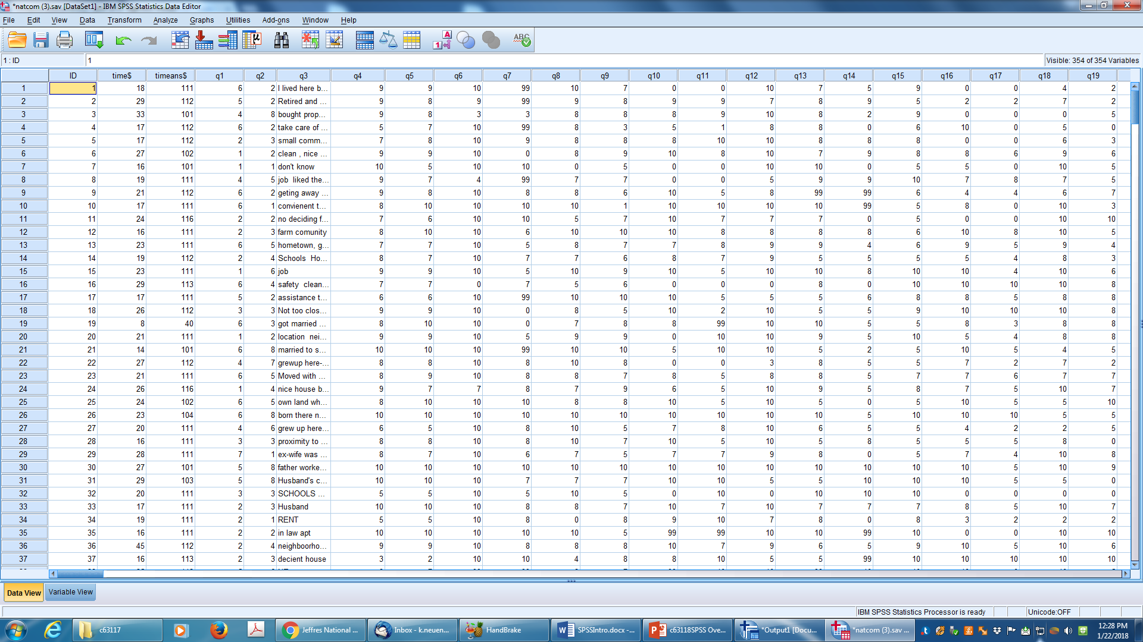
Data View

Slide 6
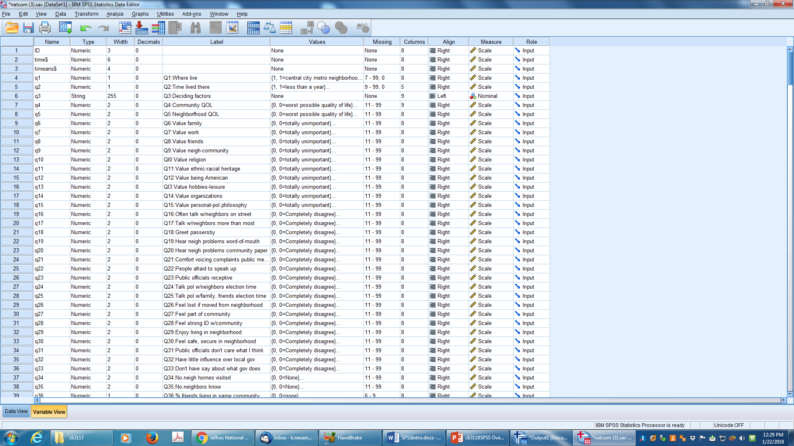
Variable View

Slide 7
Creating new variables…common examples:
1. Recoding variables (ALWAYS “into different variables”!)
e.g., reverse code an item
2. Computed scales

Slide 8
Recoded variables

Slide 9
Computed scales

Slide 10
Keeping a record of your SYNTAX
Again, it’s nice to use SYNTAX so that you can rerun your SPSS jobs across machines and across SPSS versions. You also can share your saved SPSS SYNTAX with others who have SPSS.
1. “Display commands in the log”—make sure your installation of SPSS, or the one you are using in a lab, has this set. This can be set by doing the following: Edit → Options → [Draft] Viewer → Display commands in the log.
2. When running SPSS procedures with the pull-down commands, use the “Paste” option to write to a syntax file. Then, you can run from the syntax file if you wish, either immediately or later.

Slide 11
SYNTAX file

Slide 12
end

