Slide 1
The Variate
COM 631/731

Slide 2
The Variate
As defined by Hair et al.: “Linear combination of variables formed in a multivariate technique by deriving empirical weights applied to a set of variables specified by the researcher”
It is essentially a scale…a combination of two or more individual measures…that is often derived from a multivariate procedure

Slide 3
The Variate
The variables are specified by the researcher, whereas the weights are determined by the multivariate technique in some multiple regression formula.
A sample formula:
Variate value = w₁X1 + w₂X2 + w₃X3 + . . . + w_{k}Xk
Think of this as analogous to a recipe, where the variables (X’s) are different ingredients, and the weights (w’s) are the amounts of each ingredient to be used in the recipe.
However, in multivariate techniques, the “recipes” are created by the procedures, to maximize something!

Slide 4
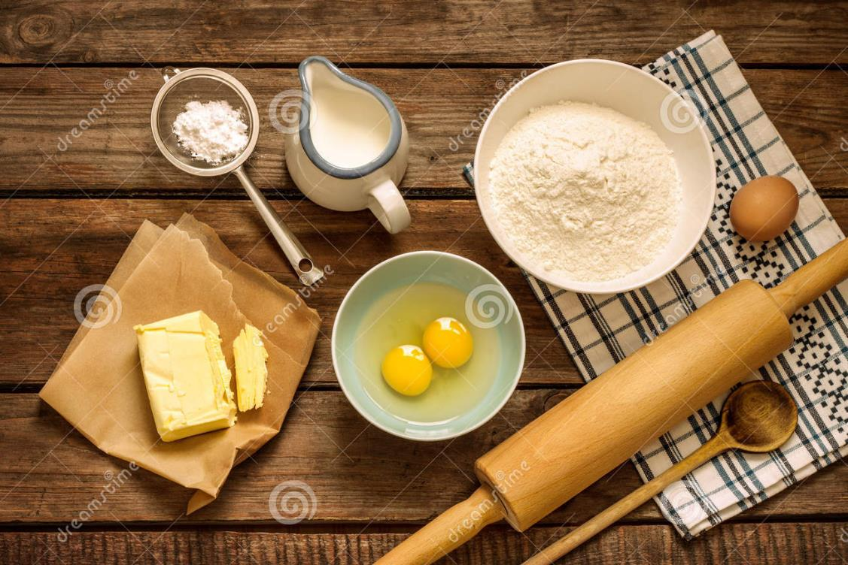
The Variate as Recipe

Slide 5
The Variate as Recipe
Just as you can make different food items from different recipes using the same ingredients, there can be multiple variates created from the same set of variables.
e.g., In factor analysis, we usually see more than one factor emerge from a set of variables.

Slide 6
Examples of Variates
Multivariate Procedure | Variate
Multiple Regression | Regression equation
Factor Analysis | Factor (F)
Discriminant Analysis | Discriminant function (DF)
Logistic Regression | Logistic regression equation
MANOVA | Discriminant function (DF)
Canonical Correlation | Canonical variate (CV)

Slide 7
The generic variate formula:
Variate value = w₁X1 + w₂X2 + w₃X3 + . . .
Multiple regression:
Unstandardized:
Y' = a + b₁X1 + b₂X2 + b₃X3 + b₄X4 + ...
Standardized:
Y’_{z} = β₁X1_{z} + β₂X2_{z} + β₃X3_{z} + β₄X4_{z} + ...
Factor analysis:
F1 = β_{1a}X1_{z} + β_{2a}X2_{z} + β_{3a}X3_{z} + ...
F2 = β_{1b}X1_{z} + β_{2b}X2_{z} + β_{3b}X3_{z} + ...
Discriminant analysis:
DF1 = ß_{1a}X1_{z} + ß_{2a}X2_{z} + ß_{3a}X3_{z} + . . .
DF2 = ß_{1b}X1_{z} + ß_{2b}X2_{z} + ß_{3b}X3_{z} + . . .
Logistic regression:
Logit = ln(Odds) = B₀ + B₁X1 + B₂X2 + B₃X3 + ...
MANOVA: TBA
Canonical correlation: TBA

Slide 8
end

