Slide 1
Homoscedasticity/ Heteroscedasticity In Brief
COM 631

Slide 2
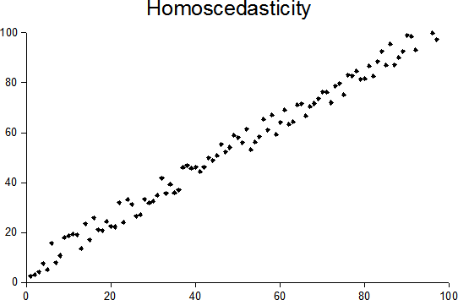
Homoscedasticity
Homoscedasticity describes a situation in which the error term (e; or, the residual) is the same across all values of the independent variable.
Homoscedasticity is assumed for many statistical tests, and we tend to test for it in many procedures. (Actually the assumption is typically for the population, but of course we test the sample.) We may need to transform one or more variables if we encounter strong heteroscedasticity.

Slide 3
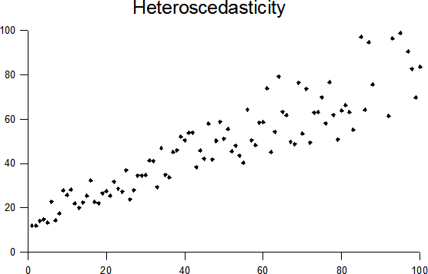
Heteroscedasticity
Heteroscedasticity is shown when the error terms (residuals) are different across the different values of the independent variable (IV).
Heteroscedasticity may also be assessed by looking at residuals across different values of the predicted variable, when there are multiple IVs (see slides 5 – 7).

Slide 4
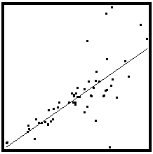

Slide 5
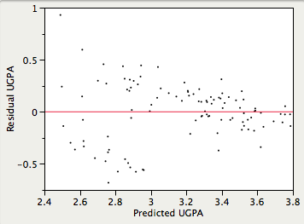

Slide 6
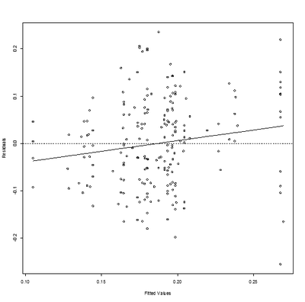

Slide 7
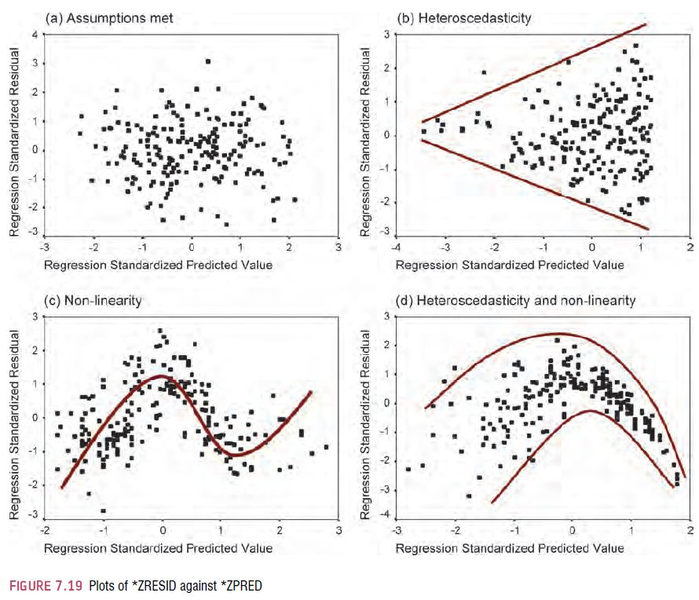

Slide 8
end

