Slide 1
FOUR MOMENTS: Ways to Describe a (Univariate I/R) Distribution
COM 631

Slide 2
Ways to summarize a distribution
First most important way?

Slide 3
Ways to summarize a distribution
First most important way?
CENTRAL TENDENCY
Mean
Median
Mode

Slide 4
Ways to summarize a distribution
How about the second most important way?

Slide 5
Ways to summarize a distribution
How about the second most important way?
DISPERSION
Standard deviation and Variance (s and s²)
Range

Slide 6
Ways to summarize a distribution
Any other ways?

Slide 7
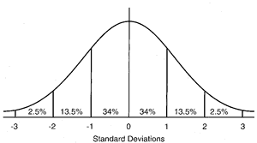
Ways to summarize a distribution
Any other ways?
Think about a normal distribution
And ways a distribution can deviate from normality

Slide 8
Skewness and Kurtosis
Skewness = Asymmetry of a distribution
Kurtosis = Deviation from normality due to tails that are heavy or light (and the distribution looks too flat or too peaked/pointy)

Slide 9
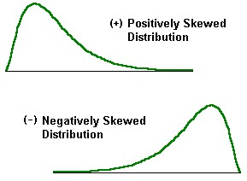
Skew

Slide 10
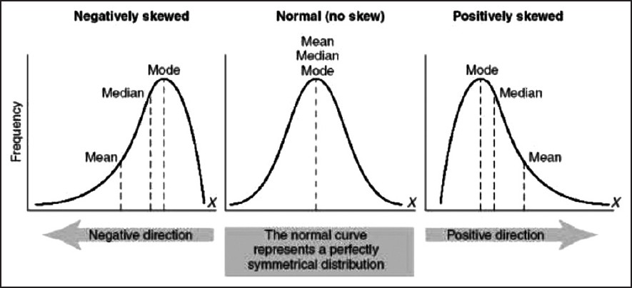
In a perfectly normal distribution, the mean, median, and mode are all the same. In a skewed distribution, they are not. (The mean is the most “sensitive” to extreme scores…remember, that’s why we often report median household income rather than mean household income.)

Slide 11
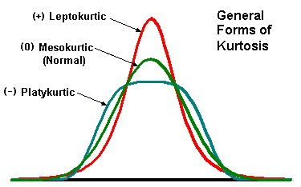
Kurtosis

Slide 12
Rules of Thumb for Skew & Kurtosis
There are many rules of thumb! A couple examples:
If skew or kurtosis is greater than 1.0 or less than -1.0, transform the variable to correct
If skew or kurtosis is greater than 3.0 or less than -3.0, transform the variable to correct
Actually, there are statistical “corrections” for skew and negative kurtosis, but not positive kurtosis (pointiness) … (see handout on Transforming Data)

Slide 13
The Four Moments
So the four ways to summarize a distribution are:
1 - Central Tendency
2 - Dispersion
3 - Skew
4 - Kurtosis
These correspond to something called the “four moments,” which comes from mechanics. A separate handout explains the connection, if you are interested.

Slide 14
end

