Slide 1
CIS454/554
Data Comm. Networks
Lecture 10
Wenbing Zhao
(Part of the slides are based on Drs. Kurose & Ross’s slides for their Computer Networking book)

Slide 2
Outline
Reminder
  Time to start working on the project#1!
Routing algorithms
  Link state routing
  Distance vector routing
Internet protocol v4
  Header
  Fragmentation (omitted)
Internet Protocol v6 (omitted)

Slide 3
Routing Algorithms
Routing algorithm: algorithm that finds least-cost path
Least-cost in what sense?
  Number of hops, geographical distance, least queueing and transmission delay
Desirable properties
  Correctness, simplicity
  Robustness to faults
  Stability – converge to equilibrium

Slide 4
Routing Algorithm Classification
Static or dynamic?
Non-adaptive (static) - Route computed in advance, off-line, downloaded to routers
Adaptive (dynamic) - Route based on measurements or estimates of current traffic and topology

Slide 5
Routing Algorithm Classification
Global or decentralized information?
Global:
  all routers have complete topology & link cost info
  “link state” algorithms
Decentralized:
  router knows physically-connected neighbors, link costs to neighbors
  iterative process of computation, exchange of info with neighbors
  “distance vector” algorithms

Slide 6
Link State Routing
Basic idea
Assumes net topology & link costs known to all nodes
  Accomplished via “link state broadcast”
  All nodes have same info
Computes least cost paths from one node (‘source”) to all other nodes, using Dijkstra’s Algorithm
  Gives forwarding table for that node

Slide 7
Dijkstra’s Algorithm
Each node labeled with distance from source node along best known path
Initially, no paths known so all nodes labeled with infinity
As algorithm proceeds, labels may change reflecting shortest path
Label may be tentative or permanent, initially, all tentative
When label represents shortest path from source to node, label becomes permanent

Slide 8
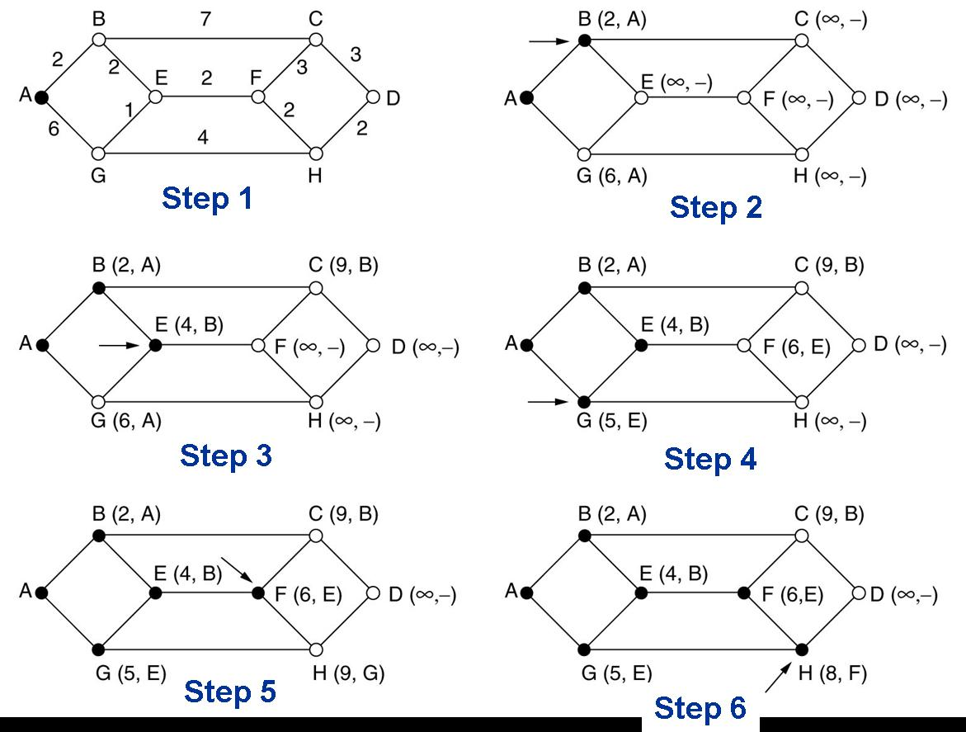
Compute Shortest Path from A to D
Start with node A as the initial working node
Examine each of the nodes adjacent to A, i.e., B and G, relabeling them with the distance to A
Examine all the tentatively labeled nodes in the whole graph and make the one with the smallest label permanent, i.e., B. B is the new working node
Notes:
Steps computing the shortest path from A to D, using Dijkstra’s algorithm. The arrows indicate the working node.
We start out by marking node A as permanent, indicated by a filled-in circle. Then we examine, in turn, each of the nodes adjacent to A (the working node), relabeling each one with the distance to A. Whenever a node is relabeled, we also label it with the node from which the probe was made so that we can reconstruct the final path later. Having examined each of the nodes adjacent to A, we examine all the tentatively labeled nodes in the whole graph and make the one with the smallest label permanent. This one becomes the new working node.
Last two steps: C(9,B) permanent; D(10,H) permanent;

Slide 9
Compute Shortest Path from A to D
Notes:
Stopped here step3

Slide 10
Step | Permanently labeled | B | G | E | C | F | H | D
1 | A | 2,A | 6,A | ∞ | ∞ | ∞ | ∞ | ∞
2 | AB |  | 6,A | 4,B | 9,B | ∞ | ∞ | ∞
3 | ABE |  | 5,E |  | 9,B | 6,E | ∞ | ∞
4 | ABEG |  |  |  | 9,B | 6,E | 9,G | ∞
5 | ABEGF |  |  |  | 9,B |  | 8,F | ∞
6 | ABEGFH |  |  |  | 9,B |  |  | 10,H
7 | ABEGFHC |  |  |  |  |  |  | 10,H
8 | ABEGFHCD

Slide 11
Computation Results
C
B
A
E
F
D
G
H
Routing Table in A
Destination
link
B
C
D
E
F
G
H
(A,B)
(A,B)
(A,B)
(A,B)
(A,B)
(A,B)
(A,B)

Slide 12
Distance Vector Routing
Also called Bellman-Ford or Ford-Fulkerson
Each router maintains a table, giving best known distance to each destination and which line to use to get there
  Table is updated by exchanging info with neighbors
  Table contains one entry for each router in network with
    Preferred outgoing line to that destination
    Estimate of time or distance to that destination
  Once every T msec, router sends to each neighbor a list of estimated delays to each destination and receives same from those neighbors
Notes:
Used in ARPANET

Slide 13
Distance Vector Routing:
How each entry is updated
A
d(A,Y)
Y
At router A, for Z
Compute d(A,X) + d(X,Z) and
d(A,Y) + d(Y,Z), take minimum
d(Y,Z)
d(A,X)
X
Z
d(X,Z)
d(A,Z) = min {d(A,v) + d(v,Z) }
where min is taken over all neighbors v of A

Slide 14
d(x,y) = min{d(x,y) + d(y,y), d(x,z) + d(z,y)}
= min{2+0 , 7+1} = 2
d(x,z) = min{d(x,y) +
d(y,z), d(x,z) + d(z,z)}
= min{2+1 , 7+0} = 3
node x table
cost to
cost to
x y z
x y z
x
0 2 7
x
0
2
3
y
y
from
∞
∞
∞
from
2 0 1
z
∞
∞
∞
z
7 1 0
node y table
cost to
x y z
y
2
1
x
∞
∞
z
∞
2 0 1
x
y
7
from
z
∞
∞
∞
node z table
Each node keeps track of the following info:
Its own distance vector: least-cost to each of other routers
Each of its neighbor’s distance vector received most recently
If there is a change in distance vector, a node sends the update to all its neighbors
cost to
x y z
x
∞ ∞ ∞
y
from
∞
∞
∞
z
7
1
0
time

Slide 15
d(x,y) = min{d(x,y) + d(y,y), d(x,z) + d(z,y)}
= min{2+0 , 7+1} = 2
d(x,z) = min{d(x,y) +
d(y,z), d(x,z) + d(z,z)}
= min{2+1 , 7+0} = 3
node x table
cost to
cost to
cost to
x y z
x y z
x y z
x
0 2 7
x
0 2 3
x
0 2 3
y
y
from
∞
∞
∞
from
2 0 1
y
from
2 0 1
z
∞
∞
∞
z
7 1 0
z
3 1 0
node y table
cost to
cost to
cost to
x y z
x y z
x y z
y
2
1
x
∞
∞
x
0 2 7
z
∞
2 0 1
x
0 2 3
x
y
y
7
from
from
2 0 1
y
from
2 0 1
z
∞
∞
∞
z
7 1 0
z
3 1 0
node z table
cost to
cost to
cost to
x y z
x y z
x y z
x
∞ ∞ ∞
x
0 2 7
x
0 2 3
y
y
2 0 1
y
from
2 0 1
from
from
∞
∞
∞
z
z
3 1 0
z
3 1 0
7
1
0
time

Slide 16
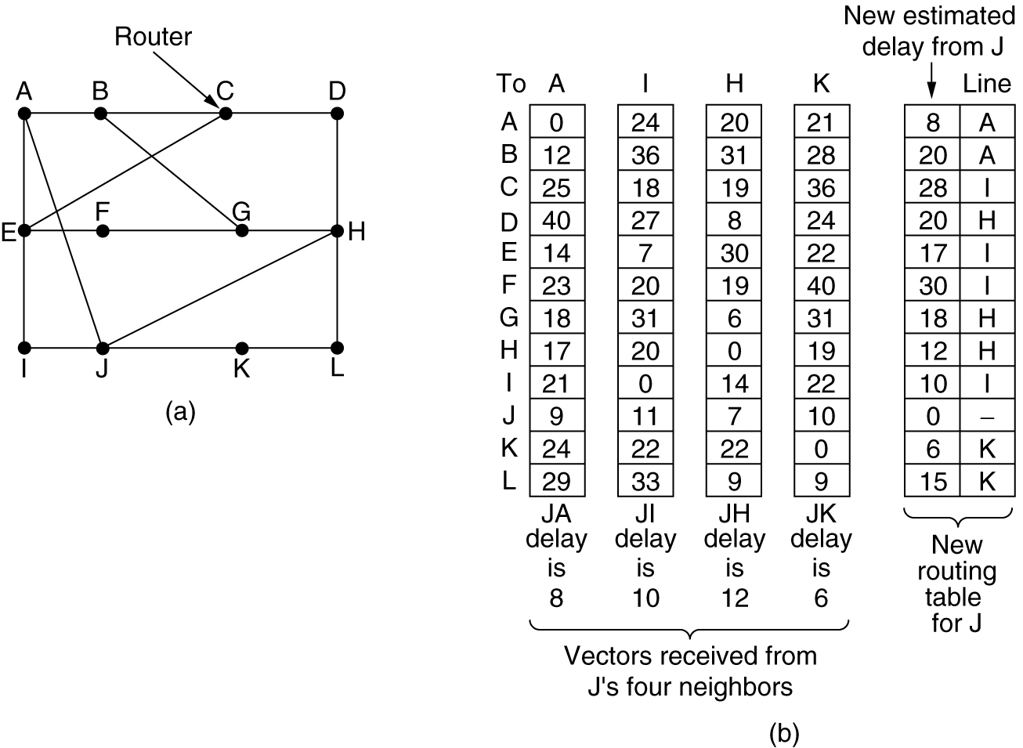
Distance Vector Routing
Distance from A to B 12ms, to C 25ms, to D 40ms, to G 18ms
Distance from J to A 8ms, to I 10ms, to H 12ms, to K 6ms
Distance from J to A to G 8+18 = 26ms
to I to G 10+31 = 41ms
to H to G 12+6=18ms
to K to G 6+31=37ms

Slide 17
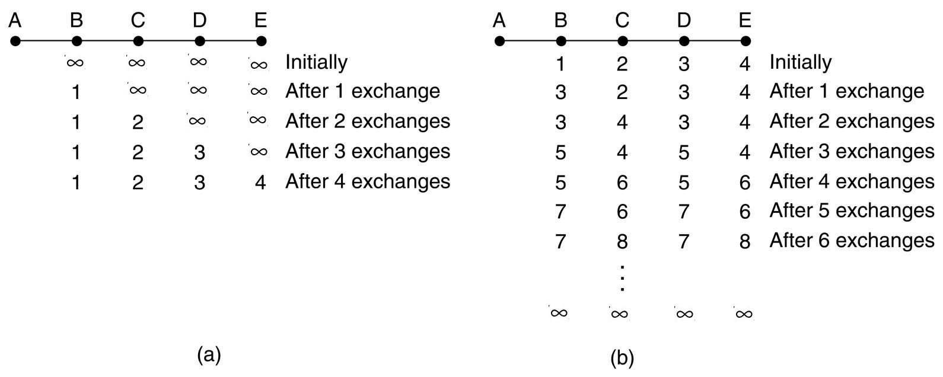
Distance Vector Routing
Good news travels fast
Bad news travels slow
Count to infinity problem: Takes too long to converge upon router failure
×
Routers’ knowledge about the cost to A
Cost from current router to A

Slide 18
The Network Layer in Internet
Host, router network layer functions:
Transport layer: TCP, UDP
Routing protocols
path selection
RIP, OSPF, BGP
IP protocol
addressing conventions
datagram format
packet handling conventions
Network
layer
forwarding
table
ICMP protocol
error reporting
router “signaling”
Link layer
physical layer
Notes:
Routing Information Protocol (RIP)
Open Shortest Path First (OSPF)
Border Gateway Protocol (BGP)

Slide 19
IPv4 Datagram Format
IP protocol version
number
32 bits
total datagram
length (bytes)
header length
(bytes)
IHL
type of
service
Total
length
ver
for
fragmentation/
reassembly
“type” of data
flgs
fragment
offset
16-bit identifier
max number
remaining hops
(decremented at
each router)
time to
live
protocol
header
checksum
32 bit source IP address
upper layer protocol
to deliver payload to
32 bit destination IP address
Options (if any)
E.g. timestamp,
record route
taken, specify
list of routers
to visit.
How much overhead with TCP?
20 bytes of TCP
20 bytes of IP
= 40 bytes + app layer overhead
data
(variable length,
typically a TCP
or UDP segment)
Notes:
Type of service field: 6 bits, after which, there are 2 reserved bits
Flags field has 3 bits: first bit is reserved, second bit: DF, third bit: MF
Fragmentation offset is 13 bits long

Slide 20
The IPv4 Header
Version – 4
IHL – length of header in 32-bit words
  Min 5, max 15 – i.e., 60 bytes
Type of service - to distinguish different classes of service
  To accommodate differentiated services (which class this packet belongs to)
Total length – header and data ≤ 65,535 (2¹⁶-1) bytes
Identification – allows destination to determine which datagram a fragment belongs to

Slide 21
The IPv4 Header
Time to live – counter to limit packet lifetimes
  Max lifetime 255sec
  Packet is destroyed when counter becomes 0
Protocol – which transport layer protocols being used
Header checksum – verifies header

Slide 22
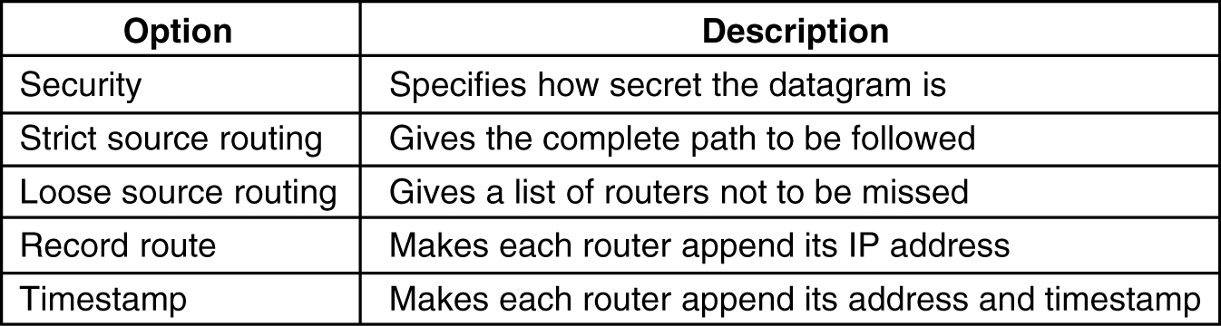
The IPv4 Header
Options – security, error reporting, etc.
  Some of the IP options

Slide 23
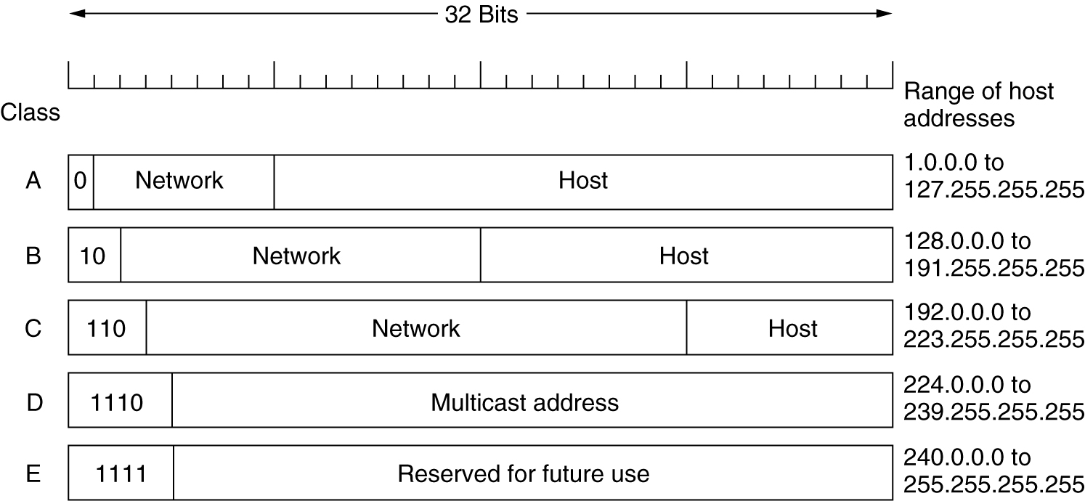
IPv4 Addresses

Slide 24
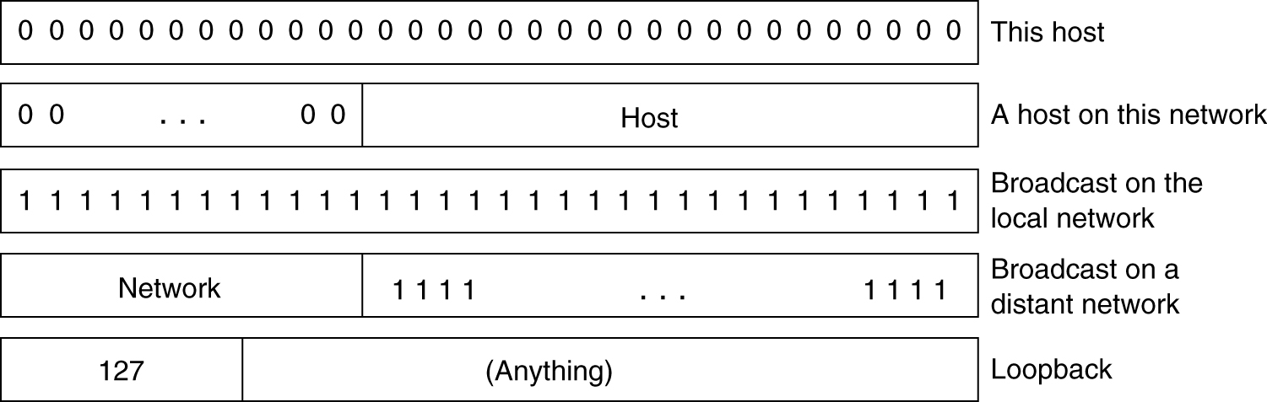
IPv4 Addresses
IP address are usually written in dotted decimal notation
  Each of the 4 bytes is written in decimal, from 0 to 255
  Lowest IP 0.0.0.0, highest 255.255.255.255
Special IP addresses

Slide 25
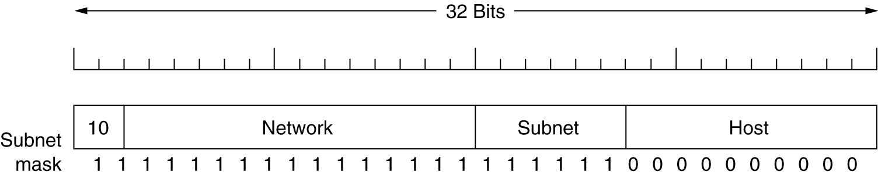
Subnets
Allow a network to be split into several parts for internal use, but to act as a single network to outside world
Take some bits away from host numbers
Subnet mask – needed by the main router. Indicates split between network + subnet number and host
  Write the address and the mask as a binary number
  If mask bit is 1, then corresponding bit of address matters

Slide 26
Subnets
E.g., A class B network can be subnetted into 64 subnets
  Originally 16 bits for host info. Now, 6 bits used for subnet and 10 bits for host numbers
  Subnet mask can be written as 255.255.252.0 or /22
Subnet 1: 10000010 00110010 000001 00 00000001 130.50.4.1
Subnet 2: 10000010 00110010 000010 00 00000001 130.50.8.1
Subnet 3: 10000010 00110010 000011 00 00000001 130.50.12.1
A subnet is often represented in the form of base addr/mask: 130.50.4.0/22
Notes:
Note: subnet mask in dotted decimal form, e.g., 255.255.252.0 (for /22) is DIFFERENT from the base address of a network, e.g., 130.50.4.0!

Slide 27
Homework#3.1
Objective 1: Able to compute the forwarding table using the link state routing method
Important concepts/knowledge
  Computation objective, and Information needed for the computation
  Dijkstra’s Algorithm
  Shortest-path tree
Key points
  The Dijkstra’s algorithm works in rounds
  In each round, a new path is found, as the result, the distance previously labeled may have to be updated, that is, a previous longer path might now become shorter via this new path
  The algorithm terms once all nodes in the network have been considered
  Never replace a temporarily labeled route by another route of longer or the same distance!
Problem: Given the subnet shown below, using the Dijkstra’s Algorithm, determine the shortest path tree from node u and its routing table. Please show all intermediate steps!

Slide 28
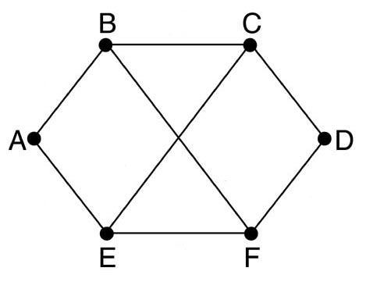
Homework#3.2
Objective 2: Able to compute the forwarding table using the distance vector routing method
Important concepts/knowledge (please elaborate each)
  Computation objective
  Information exchanged between neighboring nodes
  Algorithm used to compute/update forwarding table
Key points
  Never compute/update the cost/outgoing link for the entry corresponding to the router itself!
Problem: Consider the subnet shown below. Distance vector routing is used, and the following vectors have just come in to router C: from B: (5, 0, 8, 12, 6, 2); from D: (16, 12, 6, 0, 9, 10); and from E: (7, 6, 3, 9, 0, 4). The measured delays to B, D, and E, are 6, 3, and 5, respectively. What is C's new routing table? Give both the outgoing line to use and the expected delay. Please show all intermediate steps!

Slide 29
Homework#3.3
Objective 3: Understand the issues with the distance vector routing method
Important concepts/knowledge (please elaborate each)
  The count-to-infinity issue
  The fundamental reason for the count-to-infinity issue

Slide 30
Homework#3.4
Objective 3: Understand how the time-to-live field in the IPv4 header is used
Important concepts/knowledge (please elaborate each)
  Size of the TTL field (hence, max and min value of the TTL value)
  How the TTL field is updated
  What happens when TTL drops to 0
  Objective of the TTL field
Key points
  TTL is never increased in an IPv4 packet
Problem: (a) If TTL=9 when an IPv4 packet leaves a router, what is the TTL value when that packet entered the router? (b) If TTL=1 when an IPv4 packet arrives at a router, and this router is not the final destination of the packet, what would happen to this packet? (c) When an IPv4 packet leaves a router, what fields in the IPv4 header would be different from those when the packet entered the router and why?

Slide 31
Homework#3.5
Objective 4: Understand the classful IPv4 addressing
Important concepts/knowledge (please elaborate each)
  Definition of class A, class B, and class C
  IPv4 dotted decimal notation
  Special IPv4 addresses
  IPv4 subnetting: why and how it is accomplished
  Issues with classful addressing
Problem: Given a class B network, if the administrator wanted to subnet it to 32 subnets, answer the following questions: (a) How many bits will be taken from the host bits to designate each subnet? (b) Please denote the subnet mask in both the dotted decimal format and /xx formats. (c) How many hosts are there in each subnet (including special IPv4 addresses). (d) How many subnets can be created in the class B network?

Slide 32
Homework#3.6
Objective 5: Understand Classless InterDomain Routing (CIDR)
Important concepts/knowledge (please elaborate each)
  Rules for CIDR address allocation regarding the size of the block and the beginning of the address
  What it means by “an address falls on the boundary of the block size”, and how to determine it?
  Notation for a CIDR network in w.x.y.z/s format
  How to calculate quickly the CIDR subnet mask
Problem: According to Classless InterDomain Routing, the remaining IP addresses are allocated in variable-sized blocks, without regard to the classes. However, the starting address must fall on the boundary of the block size allocated. Assuming that a large number of consecutive IP address are available starting at 194.24.0.0. Suppose that three organizations, A, B, and C, request 4000, 1000, and 2000 addresses, respectively, and in that order. For each of these, give the first IP address assigned, the last IP address assigned, both must be in dotted decimal form, and the mask in the w.x.y.z/s notation.

Slide 33
Homework#3.7
Objective 6: Understand IPv4 Network Address Translation (NAT)
Important concepts/knowledge (please elaborate each)
  Ranges of private IPv4 addresses
  Key ideas behind NAT (what the NAT box would have to do)
  Limitations of NAT
Problem: Answer the following questions regarding NAT. (a) What is the maximum number of hosts can be accommodated by a single NAT box? (b) If an application-level protocol embed the sender’s local IP in its playload, what would have to be done by the NAT box?

