Slide 1
CIS454/554
Data Comm. Networks
Lecture 11
Wenbing Zhao
(Part of the slides are based on Drs. Kurose & Ross’s slides for their Computer Networking book)

Slide 2
Outline
Internet protocol v4
IPv4 Addressing
  Classful IP address allocation
  CIDR
Network address translation
Internet Control Message Protocol

Slide 3
The Network Layer in Internet
Host, router network layer functions:
Transport layer: TCP, UDP
Routing protocols
path selection
RIP, OSPF, BGP
IP protocol
addressing conventions
datagram format
packet handling conventions
Network
layer
forwarding
table
ICMP protocol
error reporting
router “signaling”
Link layer
physical layer
Notes:
Routing Information Protocol (RIP)
Open Shortest Path First (OSPF)
Border Gateway Protocol (BGP)

Slide 4
IPv4 Datagram Format
IP protocol version
number
32 bits
total datagram
length (bytes)
header length
(bytes)
IHL
type of
service
Total
length
ver
for
fragmentation/
reassembly
“type” of data
flgs
fragment
offset
16-bit identifier
max number
remaining hops
(decremented at
each router)
time to
live
protocol
header
checksum
32 bit source IP address
upper layer protocol
to deliver payload to
32 bit destination IP address
Options (if any)
E.g. timestamp,
record route
taken, specify
list of routers
to visit.
How much overhead with TCP?
20 bytes of TCP
20 bytes of IP
= 40 bytes + app layer overhead
data
(variable length,
typically a TCP
or UDP segment)
Notes:
Type of service field: 6 bits, after which, there are 2 reserved bits
Flags field has 3 bits: first bit is reserved, second bit: DF, third bit: MF
Fragmentation offset is 13 bits long

Slide 5
The IPv4 Header
Version – 4
IHL – length of header in 32-bit words
  Min 5, max 15 – i.e., 60 bytes
Type of service - to distinguish different classes of service
  To accommodate differentiated services (which class this packet belongs to)
Total length – header and data ≤ 65,535 (2¹⁶-1) bytes
Identification – allows destination to determine which datagram a fragment belongs to

Slide 6
The IPv4 Header
Time to live – counter to limit packet lifetimes
  Max lifetime 255sec
  Packet is destroyed when counter becomes 0
Protocol – which transport layer protocols being used
Header checksum – verifies header

Slide 7
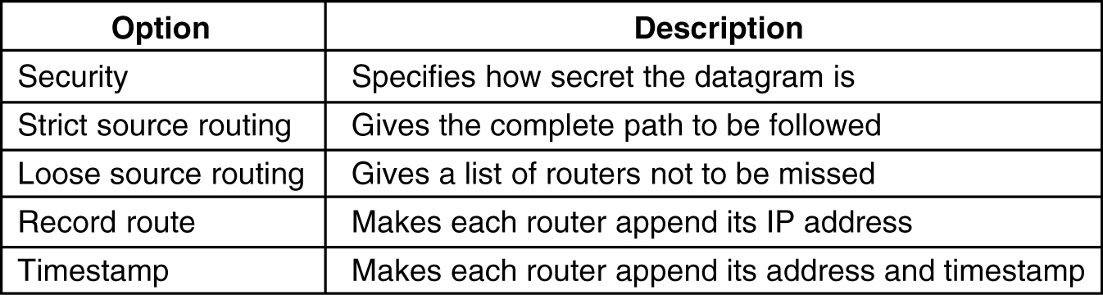
The IPv4 Header
Options – security, error reporting, etc.
  Some of the IP options

Slide 8
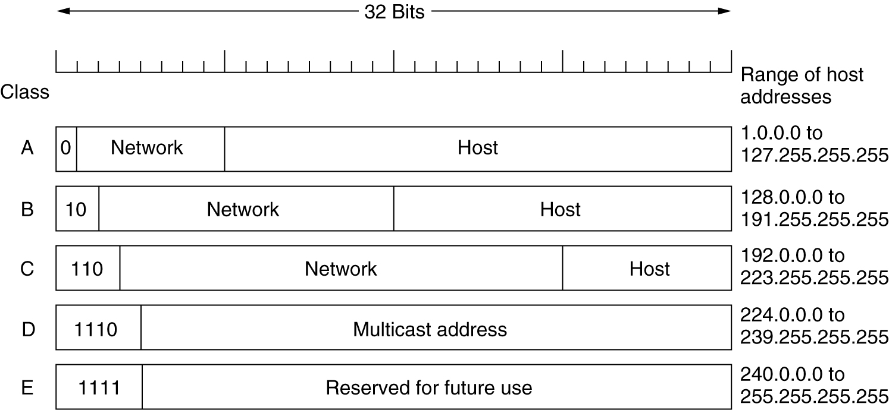
IPv4 Addresses

Slide 9
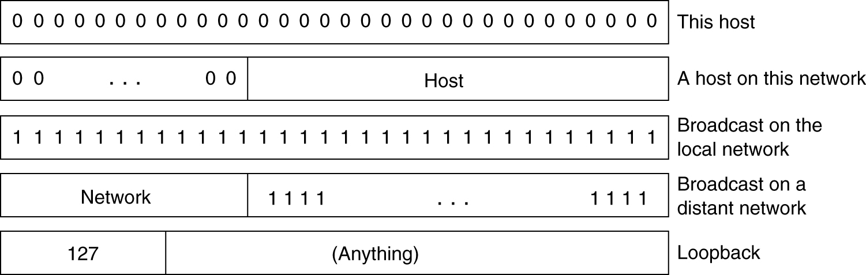
IPv4 Addresses
IP address are usually written in dotted decimal notation
  Each of the 4 bytes is written in decimal, from 0 to 255
  Lowest IP 0.0.0.0, highest 255.255.255.255
Special IP addresses

Slide 10
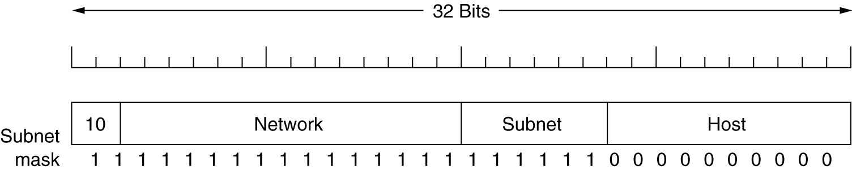
Subnets
Allow a network to be split into several parts for internal use, but to act as a single network to outside world
Take some bits away from host numbers
Subnet mask – needed by the main router. Indicates split between network + subnet number and host
  Write the address and the mask as a binary number
  If mask bit is 1, then corresponding bit of address matters

Slide 11
Subnets
E.g., A class B network can be subnetted into 64 subnets
  Originally 16 bits for host info. Now, 6 bits used for subnet and 10 bits for host numbers
  Subnet mask can be written as 255.255.252.0 or /22
Subnet 1: 10000010 00110010 000001 00 00000001 130.50.4.1
Subnet 2: 10000010 00110010 000010 00 00000001 130.50.8.1
Subnet 3: 10000010 00110010 000011 00 00000001 130.50.12.1
A subnet is often represented in the form of base addr/mask: 130.50.4.0/22
Notes:
Note: subnet mask in dotted decimal form, e.g., 255.255.252.0 (for /22) is DIFFERENT from the base address of a network, e.g., 130.50.4.0!

Slide 12
Problems with Classful Addressing
A class is obviously too large for any organization
C class is too small (only 256 addresses available)
B class is requested and allocated, but it is still too large for most organizations
⇒ Many IP addresses are wasted
⇒ Shortage of IP addresses

Slide 13
CIDR – Classless InterDomain Routing
For the remaining IP addresses, classless allocation is used
  Allocate remaining IP addresses in variable-sized blocks (must be power of 2), without regard to the classes
  The starting address must fall on the boundary of the block size
  E.g., if a site needs, say, 2000 addresses, it is given a block of 2048 addresses on a 2048-byte boundary

Slide 14
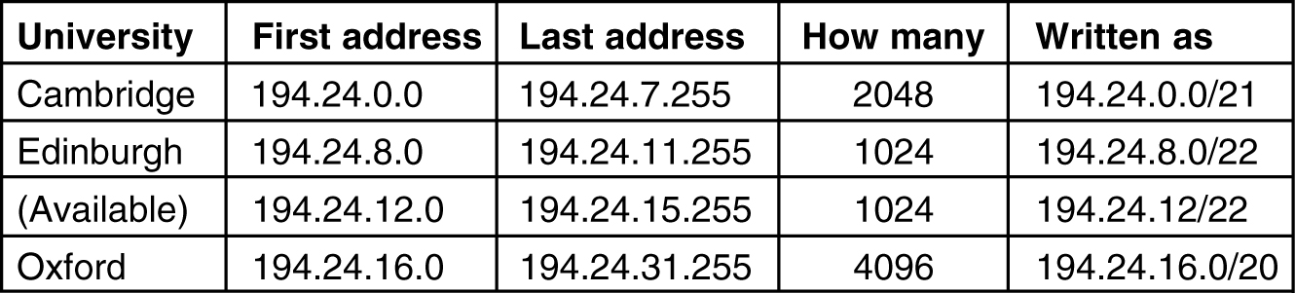
Classless Allocation – Example
Routing tables are updated with the three assigned entries. Each entry contains a base address and a subnet mask (in short: base address/subnet mask)
C: 11000010 00011000 00000000 00000000 11111111 11111111 11111000 00000000
E: 11000010 00011000 00001000 00000000 11111111 11111111 11111100 00000000
O: 11000010 00011000 00010000 00000000 11111111 11111111 11110000 00000000
Base address
Subnet mask
Notes:
Classful IP allocation is basically a special case of cidr with /8 /16 /24 masks

Slide 15
Classless Allocation – Example
For Cambridge:
  Ask 2000, allocate 2¹¹ = 2048 IP addresses block
  Start IP: 194.24.0.0 because it is multiple of 2¹¹
  (-------- -------- 00000000 00000000)
  Last IP: 194.24.7.255
  (i.e., 194.24.0.0 + 2¹¹ - 1: -------- -------- 00000111 11111111)
  Mask: 194.24.0.0/21 (8+8+5=21, or 32-11=21)
For Edinburgh:
  Ask 1000, allocate 2¹⁰ = 1024 IP addresses
  Start IP: 194.24.8.0 because it is multiple of 2¹⁰
  (-------- -------- 00001000 00000000)
  Last IP: 194.24.11.255
  (i.e., 194.24.8.0 + 2¹⁰ - 1: -------- -------- 00001011 11111111)
  Mask: 194.24.8.0/22
Notes:
Students prefer to work this out using the board because it is easier to follow!

Slide 16
Classless Allocation – Example
For Oxford:
  Ask 4000, allocate 2¹² = 4096 IP addresses
  Start IP: is 194.24.12.0 multiple of 4096?
    194.24.12.0: -------- -------- 00001100 00000000
    4096: -------- -------- 00010000 00000000
    No. => We can’t use 194.24.12.0 as the start IP for Oxford
  What is the next higher IP address that is multiple of 4096?
    194.24.16.0: -------- -------- 00010000 00000000
    => this is our start IP for O
  Last IP: 194.24.31.255: -------- -------- 00011111 11111111
  Mask: 194.24.16.0/20

Slide 17
Classless InterDomain Routing
Each routing table is extended by giving it a 32-bit mask
The routing table contains entries of
(IP address, subnet mask, outgoing line) triples
When a packet comes in, its destination IP address is first extracted
Then, the routing table is scanned entry by entry, masking the destination address and comparing it to the table entry looking for a match
If multiple entries (with different subnet mask lengths) match, the longest mask is used
  E.g., if there is a match for a /20 mask and a /24 mask, the /24 mask is used

Slide 18
CIDR Routing: Example
If a packet is addressed to 194.24.17.4, in binary
11000010 00011000 00010001 00000100
First it is Boolean ANDed with the Cambridge mask to get
11000010 00011000 00010000 00000000
This value does not match the Cambridge base address, so next try Edinburgh mask, to get
11000010 00011000 00010000 00000000
This value still does not match, so Oxford is tried, yielding
11000010 00011000 00010000 00000000
This value matches the Oxford base. If no longer matches are found, the Oxford entry is used and the packet is sent along the line named in it
C: 11000010 00011000 00000000 00000000 11111111 11111111 11111000 00000000
E: 11000010 00011000 00001000 00000000 11111111 11111111 11111100 00000000
O: 11000010 00011000 00010000 00000000 11111111 11111111 11110000 00000000
Base address
Subnet mask

Slide 19
NAT – Network Address Translation
Another workaround for the IP addresses shortage problem: network address translation
  One public IP address, many private IP addresses
  When a packet exits the private network and goes to the ISP, an address translation takes place
Three ranges of IP addresses have been declared as private:
  10.0.0.0 – 10.255.255.255 (16,777,216 hosts)
  172.16.0.0 – 172.31.255.255/12 (1,048,576 hosts)
  192.168.0.0 – 192.168.255.255/16 (65,536 hosts)

Slide 20
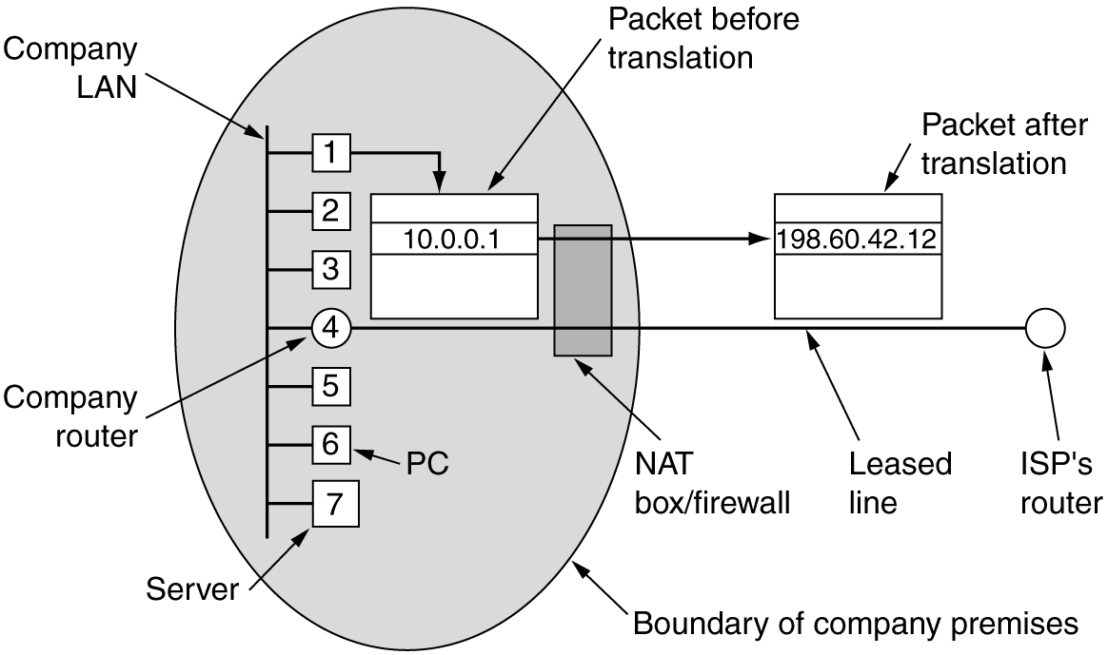
NAT – Network Address Translation
Placement and operation of a NAT box

Slide 21
NAT – What about the Incoming Traffic?
Solution is based on the assumption all traffic is TCP/UDP
TCP/UDP has two port fields, one for source port, the other for destination port, each 16 bits wide
The source port is used as an index to an internal table maintained by the NAT box
The internal sender’s private IP and original port info are stored in the table
When the reply comes back, it will carry the index as the destination port, the NAT box then translates the address back
For both outgoing and incoming address translations, the TCP/UDP and IP header checksums are recomputed

Slide 22
NAT in Action
137.142.142.71
Src: 192.168.8.4:1333
Src: 137.142.142.71:1
Dst: 137.142.140.2:80
Dst: 137.142.140.2:80
192.168.8.4:1333
Src: 137.142.140.2:80
1
192.168.8.4:1333
1
Dst: 137.142.142.71:1
Src: 137.142.140.2:80
Dst: 192.168.8.4:1333
Private Network
Public Network

Slide 23
Drawback of NAT
NAT violates the architectural model of IP, which states that every IP address uniquely identifies a single machine worldwide
NAT box must maintain mapping info for each connection passing through it. This changes the Internet from a connectionless network to a kind of connection-oriented network
NAT violates the most fundamental rule of protocol layering: layer k may not make any assumptions about what layer k+1 has put into the payload field
NAT only support UDP/TCP traffic
NAT has problem supporting apps that include local IPs in payload, such as FTP and H.323
Each NAT box can support at most 65,536 (2¹⁶) hosts

Slide 24
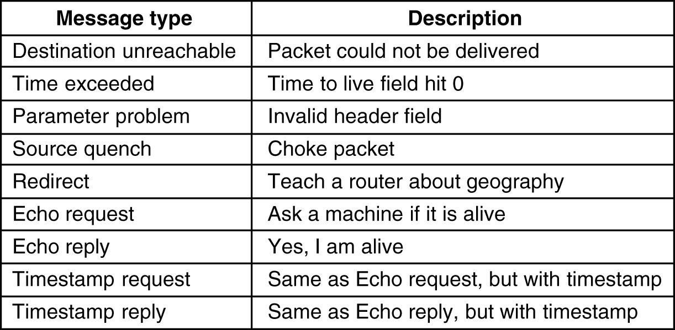
Internet Control Message Protocol
When something unexpected occurs in Internet, the event is reported by routers using ICMP
Principal ICMP message types

Slide 25
Internet Control Message Protocol
ICMP messages are sent using the basic IP header
The first byte of the data portion of the datagram is a ICMP type field
  The type field determines the format of the remaining data
Typical format: type, code plus first 8 bytes of IP datagram that has caused the error
Destination Unreliable Message Format
Notes:
The error is why the ICMP packet is sent
It is also used to test Internet.

Slide 26
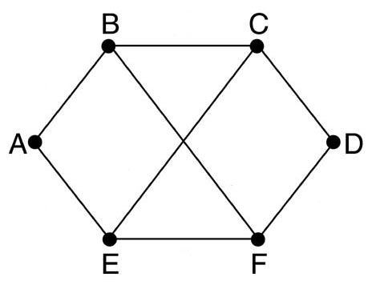
Homework#3.2
Objective 2: Able to compute the forwarding table using the distance vector routing method
Important concepts/knowledge (please elaborate each)
  Computation objective
  Information exchanged between neighboring nodes
  Algorithm used to compute/update forwarding table
Key points
  Never compute/update the cost/outgoing link for the entry corresponding to the router itself!
Problem: Consider the subnet shown below. Distance vector routing is used, and the following vectors have just come in to router C: from B: (5, 0, 8, 12, 6, 2); from D: (16, 12, 6, 0, 9, 10); and from E: (7, 6, 3, 9, 0, 4). The measured delays to B, D, and E, are 6, 3, and 5, respectively. What is C's new routing table? Give both the outgoing line to use and the expected delay. Please show all intermediate steps!

Slide 27
Homework#3.3
Objective 3: Understand the issues with the distance vector routing method
Important concepts/knowledge (please elaborate each)
  The count-to-infinity issue
  The fundamental reason for the count-to-infinity issue

Slide 28
Homework#3.4
Objective 4: Understand how the time-to-live field in the IPv4 header is used
Important concepts/knowledge (please elaborate each)
  Size of the TTL field (hence, max and min value of the TTL value)
  How the TTL field is updated
  What happens when TTL drops to 0
  Objective of the TTL field
Key points
  TTL is never increased in an IPv4 packet
Problem: (a) If TTL=9 when an IPv4 packet leaves a router, what is the TTL value when that packet entered the router? (b) If TTL=1 when an IPv4 packet arrives at a router, and this router is not the final destination of the packet, what would happen to this packet? (c) When an IPv4 packet leaves a router, what fields in the IPv4 header would be different from those when the packet entered the router and why?

Slide 29
Homework#3.5
Objective 5: Understand the classful IPv4 addressing
Important concepts/knowledge (please elaborate each)
  Definition of class A, class B, and class C
  IPv4 dotted decimal notation
  Special IPv4 addresses
  IPv4 subnetting: why and how it is accomplished
  Issues with classful addressing
Problem: Given a class B network, if the administrator wanted to subnet it to 32 subnets, answer the following questions: (a) How many bits will be taken from the host bits to designate each subnet? (b) Please denote the subnet mask in both the dotted decimal format and /xx formats. (c) How many hosts are there in each subnet (including special IPv4 addresses). (d) How many subnets can be created in the class B network?

Slide 30
Homework#3.6
Objective 6: Understand Classless InterDomain Routing (CIDR)
Important concepts/knowledge (please elaborate each)
  Rules for CIDR address allocation regarding the size of the block and the beginning of the address
  What it means by “an address falls on the boundary of the block size”, and how to determine it?
  Notation for a CIDR network in w.x.y.z/s format
  How to calculate quickly the CIDR subnet mask
Problem: According to Classless InterDomain Routing, the remaining IP addresses are allocated in variable-sized blocks, without regard to the classes. However, the starting address must fall on the boundary of the block size allocated. Assuming that a large number of consecutive IP address are available starting at 194.24.0.0. Suppose that three organizations, A, B, and C, request 4000, 1000, and 2000 addresses, respectively, and in that order. For each of these, give the first IP address assigned, the last IP address assigned, both must be in dotted decimal form, and the mask in the w.x.y.z/s notation.

Slide 31
Homework#3.7
Objective 7: Understand IPv4 Network Address Translation (NAT)
Important concepts/knowledge (please elaborate each)
  Ranges of private IPv4 addresses
  Key ideas behind NAT (what the NAT box would have to do)
  Limitations of NAT
Problem: Answer the following questions regarding NAT. (a) What is the maximum number of hosts can be accommodated by a single NAT box? (b) If an application-level protocol embed the sender’s local IP in its playload, what would have to be done by the NAT box?

