Slide 1
CIS454/554 Data Comm. Networks
Lecture 13
Wenbing Zhao

Slide 2
Outline
Ethernet
Manchester Encoding
The Ethernet MAC Sublayer Protocol
The Binary Exponential Backoff Algorithm
ARP and DHCP
Link layer devices

Slide 3
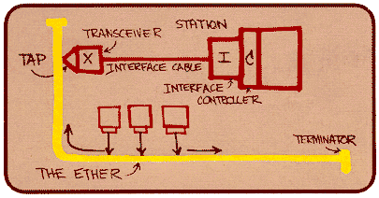
Ethernet
“dominant” wired LAN technology:
cheap $20 for NIC
first widely used LAN technology
simpler, cheaper than other schemes
kept up with speed race: 10 Mbps – 10 Gbps
Metcalfe’s Ethernet
sketch

Slide 4
802.3 Ethernet Standards: Link & Physical Layers
Many different Ethernet standards
common MAC protocol and frame format
different speeds: 2 Mbps, 10 Mbps, 100 Mbps, 1Gbps, 10G bps
different physical layer media: fiber, cable
application
transport
network
link
physical
MAC protocol
and frame format
100BASE-TX
100BASE-T2
100BASE-FX
100BASE-T4
100BASE-SX
100BASE-BX
copper (twister
pair) physical layer
fiber physical layer

Slide 5
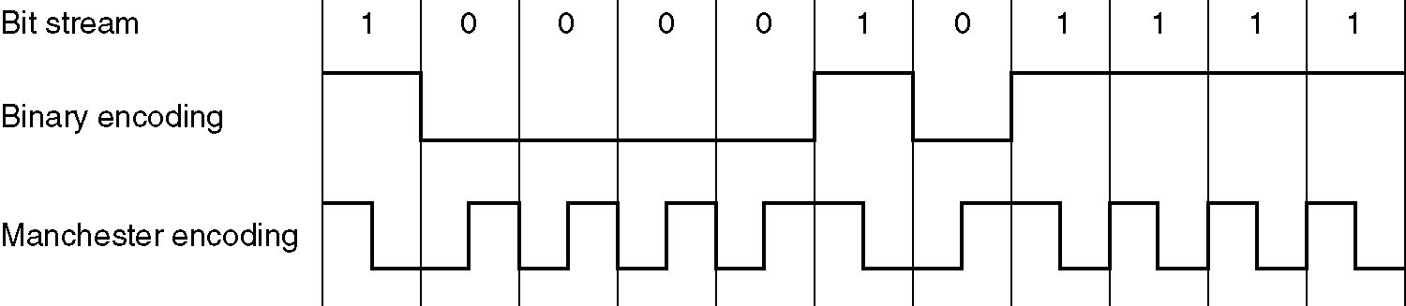
Manchester Encoding
Binary encoding
Hard to distinguish 0 bit (0-volt) from idle (0-volt)
Requires clocks of all stations synchronized
Manchester encoding
used in 10BaseT
each bit has a transition
allows clocks in sending and receiving nodes to synchronize to each other
no need for a centralized, global clock among nodes!
Notes:
Manchester enco
Differential Manchester is specified in the IEEE 802.5 standard for token ring LANs, and is used for many other applications, including magnetic and optical storage.ding used in 10BaseT

Slide 6
Ethernet Frame Structure
Preamble: for clock synchronization
First 7 bytes with pattern 10101010, last byte with pattern 10101011
The two consecutive 1’s indicate the start of a frame
How can the receiver tell the end of the frame?
No current on the wire (interesting discussion at http://www.tomshardware.com/forum/19951-42-detecting-length-ethernet-frame)
Not considered
as part of the header!
>= 64 bytes
Notes:
6

Slide 7
Ethernet Frame Structure
Destination address: 6 bytes (48 bits)
Highest order bit: 0 individual, 1 multicast; all 1’s broadcast
Frames received with non-matching destination address is discarded
Type/Length: type of network layer protocol (or length of payload)
Pad – used to produce valid frame >= 64 bytes
Checksum – 32-bit cyclic redundancy check
Notes:
From http://www.informit.com/articles/article.aspx?p=21320&seqNum=4
A Length/Type field two octets long. If the value in this field is 1500 (0x05dc hex) or less, it indicates the number of octets to follow in the data field. Network engineers know this as the original Ethernet 2.0 (Ethernet II) frame type. If the value is 1536 (0x0600 hex) or greater, it indicates the network-layer protocol. In most networks today, this value will be 2048 (0x0800 hex), which is the assigned protocol type for IP. The other most commonly found protocol type values are 33079 and 33080 (0x8137, 0x8138 hex), which is for Novell IPX.

Slide 8
CSMA with Collision Detection
If two stations start transmitting simultaneously, both detect collision and stop transmitting
Monitor collision while sending
Minimum time to detect collision => minimum frame length
Time divided into slots
Length of slot = 2τ = worst-case round-trip propagation time
To accommodate longest path, slot time = 512 bit times = 51.2 μsec (10Mbps Ethernet) => min frame length: 51.2 μsec X 10 Mbps = 512 b = 64 byte
Notes:
Ethernet requires that valid frames must be at least 64 bytes long, from destination address to checksum, including both. If the data portion of a frame is less than 46 bytes, the Pad field is used to fill out the frame to the minimum size.
For 10Mbps and 100Mbps Ethernet, the slot time is 512 bit times, which not coincidentally happens to be the minimum length of an Ethernet packet (64 octets is 512 bits). For gigabit Ethernet, the slot time is 4096 bit times.

Slide 9
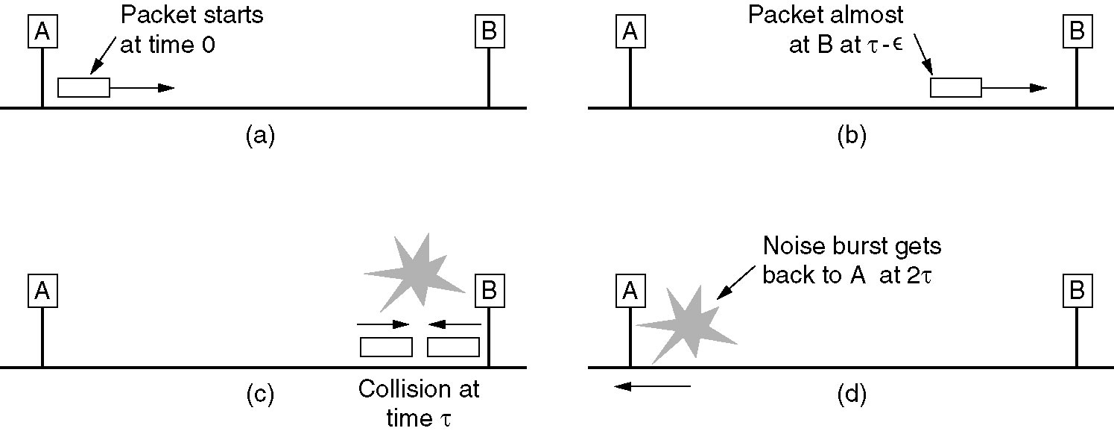
Minimum Time to Detect Collision (in worst-case scenario)
To ensure the sender can detect collision
All frames must take more than 2τ to send so that transmission is still taking place when the noise burst gets back to the sender
5/10/23
Notes:
9

Slide 10
Ethernet MAC Sublayer Protocol
Connectionless: No handshaking between sending and receiving NICs
Ethernet resides in the Network Interface Card (NIC)
Unreliable: receiving NIC doesn’t send acks or nacks to sending NIC
stream of datagrams passed to network layer can have gaps (missing datagrams)
gaps will be filled if app is using TCP
otherwise, app will see gaps
Ethernet’s MAC protocol: CSMA/CD

Slide 11
Ethernet CSMA/CD algorithm
1. NIC receives datagram from network layer, creates frame
2. If NIC senses channel idle, starts frame transmission If NIC senses channel busy, waits until channel idle, then transmits
3. If NIC transmits entire frame without detecting another transmission, NIC is done with frame !
4. If NIC detects another transmission while transmitting, aborts and sends jam signal
5. After aborting, NIC enters randomized exponential backoff: after mth collision, NIC chooses K at random from {0,1,2,…,2^{m}-1}. NIC waits K·512 bit times, returns to Step 2
Notes:
In telecommunications, a jam signal is a signal that carries a 32-bit binary pattern sent by a data station to inform the other stations that they must not transmit.
In CSMA/CD the maximum jam-time is calculated as follows: The maximum allowed diameter of an Ethernet installation is limited to 232 bits. This makes a round-trip-time of 464 bits. As the slot time in Ethernet is 512 bits, the difference between slot time and RTD is 48 bits (6 bytes), which is the maximum "jam-time".
This in turn means: A station noting a collision has occurred is sending a 4 to 6 byte long pattern composed of 16 1-0 bit combinations. Note: The size of this jam signal is clearly beyond the minimum allowed frame-size of 64 bytes.
The purpose of this is to ensure that any other node which may currently be receiving a frame will receive the jam signal in place of the correct 32-bit MAC CRC, this causes the other receivers to discard the frame due to a CRC error.

Slide 12
Randomization and Binary Exponential Backoff
After 1st collision, station picks 0 or 1 at random, waits that number of slots and tries again
After 2nd collision, station picks 0,1,2,3 at random, waits that number of slots and tries again
….
After i-th collision, station picks 0,1,…,2^{i}-1 at random, …
If 10 <= i < 16, station picks 0,1,…,2¹⁰-1 at random
If i=16, controller reports failure to computer
Why randomization is needed?

Slide 13
Ethernet/MAC Addresses
Ethernet (or MAC or LAN or physical) address:
Function: get frame from one interface to another physically-connected interface (same network)
48 bit MAC address
Burned in NIC ROM, also sometimes software settable

Slide 14
MAC Addresses
Each adapter on Ethernet has unique MAC address
1A-2F-BB-76-09-AD
Broadcast address =
FF-FF-FF-FF-FF-FF
LAN
(wired or
wireless)
= adapter
71-65-F7-2B-08-53
58-23-D7-FA-20-B0
0C-C4-11-6F-E3-98

Slide 15
MAC Addresses vs. IP Addresses
MAC address allocation administered by IEEE
Manufacturer buys portion of MAC address space (to assure uniqueness)
32-bit IP address:
network-layer address
used to get datagram to destination IP subnet
MAC flat address ➜ portability
Can move LAN card from one LAN to another
IP hierarchical address NOT portable
Address depends on IP subnet to which node is attached
Notes:
Analogy:
(a) MAC address: like Social Security Number
(b) IP address: like postal address

Slide 16
ARP: Address Resolution Protocol
Question: how to determine
MAC address of B
knowing B’s IP address?
Each IP node (host, router) on LAN has ARP table
ARP table: IP/MAC address mappings for some LAN nodes
< IP address; MAC address; TTL>
TTL (Time To Live): time after which address mapping will be forgotten (typically 20 min)
137.196.7.78
1A-2F-BB-76-09-AD
137.196.7.23
137.196.7.14
LAN
71-65-F7-2B-08-53
58-23-D7-FA-20-B0
0C-C4-11-6F-E3-98
137.196.7.88

Slide 17
ARP Protocol: Same LAN
A wants to send datagram to B, and B’s MAC address not in A’s ARP table.
A broadcasts ARP query packet, containing B's IP address
Dest MAC address = FF-FF-FF-FF-FF-FF
All machines on LAN receive ARP query
B receives ARP packet, replies to A with its (B's) MAC address
Frame sent to A’s MAC address (unicast)
A caches (saves) IP-to-MAC address pair in its ARP table until information becomes old (times out)
Soft state: information that times out (goes away) unless refreshed
ARP is “plug-and-play”:
Nodes create their ARP tables without intervention from net administrator

Slide 18
Addressing: Routing to Another LAN
Walkthrough: send datagram from A to B via R
Assume A knows B’s IP address
Two ARP tables in router R, one for each IP network
74-29-9C-E8-FF-55
88-B2-2F-54-1A-0F
A
E6-E9-00-17-BB-4B
222.222.222.221
111.111.111.111
1A-23-F9-CD-06-9B
222.222.222.220
222.222.222.222
111.111.111.110
B
111.111.111.112
R
49-BD-D2-C7-56-2A
CC-49-DE-D0-AB-7D

Slide 19
A creates IP datagram with source A, destination B
A uses ARP to get R’s MAC address for 111.111.111.110
A creates link-layer frame with R's MAC address as dest, frame contains A-to-B IP datagram
A’s NIC sends frame
R’s NIC receives frame
R removes IP datagram from Ethernet frame, sees its destined to B
R uses ARP to get B’s MAC address
R creates frame containing A-to-B IP datagram sends to B
This is a really important
example – make sure you
understand!
74-29-9C-E8-FF-55
88-B2-2F-54-1A-0F
A
E6-E9-00-17-BB-4B
222.222.222.221
111.111.111.111
1A-23-F9-CD-06-9B
222.222.222.220
222.222.222.222
111.111.111.110
B
111.111.111.112
R
49-BD-D2-C7-56-2A
CC-49-DE-D0-AB-7D

Slide 20
BOOTP – Bootstrap Protocol
BOOTP – uses UDP
A client broadcasts to 255.255.255.255
The source IP address is set to 0.0.0.0 if client does not know its own IP address yet
Port number: 67 for server, 68 for client
BOOTP drawbacks
Requires manual configuration of tables mapping IP address to Ethernet address at the BOOTP server
Replaced by DHCP
32-bit Internet address
ARP
BOOTP
(DHCP)
48-bit Ethernet address

Slide 21
Dynamic Host Configuration Protocol
Allow host to dynamically obtain its IP address from network server when it joins network
IP address assignment is lease-based (to cope with client failure, also enables reuse of addresses)
Can renew its lease on address in use
DHCP overview (UDP is used for communication)
Host broadcasts “DHCP discover” msg
DHCP server responds with “DHCP offer” msg
Host requests IP address: “DHCP request” msg
DHCP server sends address: “DHCP ack” msg
Why two phases?
To deal with multiple DHCP servers
Notes:
DHCP has largely replaced RARP and BOOTP

Slide 22
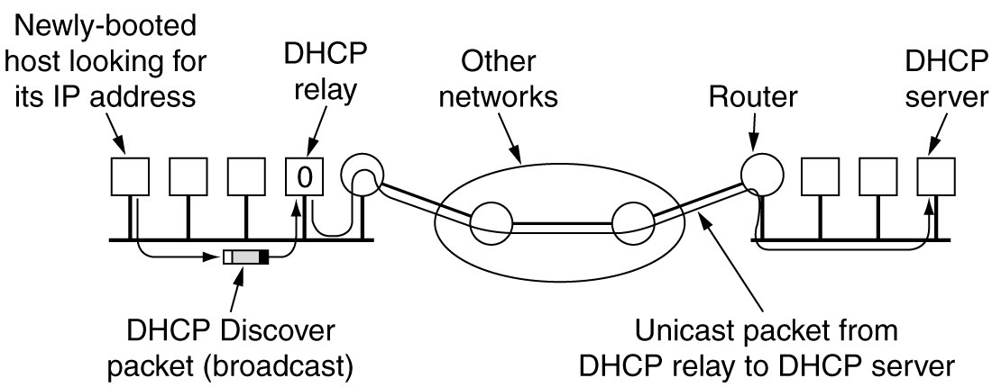
DHCP Relay
A DHCP relay agent can be configured on each LAN
The agent stores the IP address of the DHCP server and forward the request to the server

Slide 23
DHCP with Relay Agent
To find its IP address, a newly-booted machine broadcasts a DHCP Discover packet
The DHCP relay agent on its LAN receives all DHCP broadcasts
On receiving a DHCP Discover packet, the agent sends the packet as a unicast packet to the DHCP server, possibly on a distant network

Slide 24
Homework#4.4
Objective 4: Understand the Ethernet Frame Structure
Important concepts/knowledge (please elaborate each)
Preamble,
MAC addresses (including special addresses),
type/length field,
Padding, minimum frame length
Problem: An IP packet to be transmitted by Ethernet is 60 bytes long. Is padding needed in the Ethernet frame, and if so, how many bytes?

Slide 25
Homework#4.5
Objective 5: Understand Collision Detection in CSMA/CD
Important concepts/knowledge (please elaborate each)
Minimum time to detection collision
Minimum frame length
Time slot in Ethernet
Problem: Consider building a CSMA/CD network running at 1 Gbps over a 1-km cable. The signal speed in the cable is 200,000 km/sec. What is the minimum frame size?

Slide 26
Homework#4.6
Objective 6: Understand the Ethernet MAC sublayer protocol
Important concepts/knowledge (please elaborate each)
Connectionless or connection-oriented
Reliable or unreliable data communication
Ethernet CSMA/CD algorithm
Randomized exponential backoff mechanism in Ethernet protocol
Problem: Why randomization is necessary in the Ethernet MAC sublayer protocol when determining how much time a station must wait after the detection of a collision? What if a deterministic algorithm is used in this case?

Slide 27
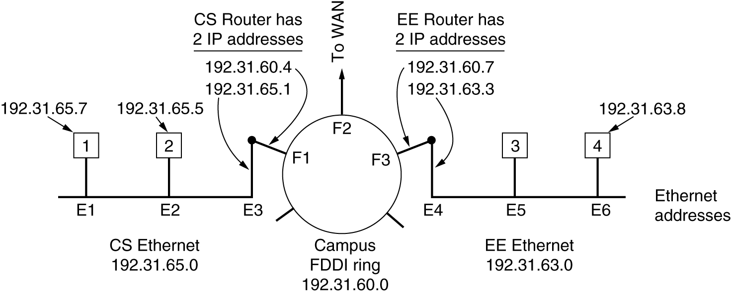
Homework#4.7
Objective 7: Understand the Address Resolution Protocol
Important concepts/knowledge (please elaborate each)
ARP table
ARP request
ARP reply
ARP caching
Proxy ARP
Problem: (a) Node 1 wants to send a packet to node 4, what will be returned by ARP? (b) Node 1 wants to send a packet to node 2, what will be returned by ARP?

Slide 28
Homework#4.8
Objective 8: Understand DHCP protocol
Important concepts/knowledge (please elaborate each)
Transport level protocol used in DHCP
DHCP message exchanges
DHCP relay
Problem: What is the main purpose of DHCP? Why a client broadcasts its DHCP request instead of unicasts it to the specific DHCP server? Why two phases are needed in DHCP?

