Slide 1
CIS454/554 Data Comm. Networks
Lecture 14
Wenbing Zhao

Slide 2
Outline
Link layer devices
802.11 wireless LAN

Slide 3
Link Layer Devices
Hubs
Switches

Slide 4
Hubs
… physical-layer (“dumb”) repeaters:
Bits coming in one link go out all other links at same rate
All nodes connected to hub can collide with one another
No frame buffering
No CSMA/CD at hub: host NICs detect collisions
twisted pair
hub

Slide 5
Switch
Link-layer device: smarter than hubs, take active role
Store, forward Ethernet frames
Examine incoming frame’s MAC address, selectively forward frame to one-or-more outgoing links when frame is to be forwarded on segment, uses CSMA/CD to access segment
Transparent
Hosts are unaware of presence of switches
Plug-and-play, self-learning
Switches do not need to be configured

Slide 6
Switch: Allows Multiple Simultaneous Transmissions
A
Hosts have dedicated, direct connection to switch
Switches buffer packets
Ethernet protocol used on each incoming link, but no collisions; full duplex
Each link is its own collision domain
Switching: a-to-a’ and b-to-b’ simultaneously, without collisions
Not possible with dumb hub
C’
B
1
2
6
3
5
4
C
B’
A’
switch with six interfaces
(1,2,3,4,5,6)

Slide 7
Switch Table
A
Q: how does switch know that A’ reachable via interface 4, B’ reachable via interface 5?
A: each switch has a switch table, each entry:
(MAC address of host, interface to reach host, time stamp)
Looks like a routing table!
Q: how are entries created, maintained in switch table?
Something like a routing protocol?
C’
B
1
2
6
3
5
4
C
B’
A’
switch with six interfaces
(1,2,3,4,5,6)

Slide 8
Switch: Self-Learning
Source: A
Dest: A’
A
A A’
Switch learns which hosts can be reached through which interfaces
When frame received, switch “learns” location of sender: incoming LAN segment
Records sender/location pair in switch table
C’
B
1
2
6
3
5
4
C
B’
A’
MAC addr interface TTL
A
1
60
Switch table
(initially empty)

Slide 9
Switch: Frame Filtering/Forwarding
When frame received:
1. record link associated with sending host
2. index switch table using MAC dest address
3. if entry found for destination then {
if dest on segment from which frame arrived then drop the frame
else forward the frame on interface indicated
}
else flood
forward on all but the interface
on which the frame arrived

Slide 10
Self-Learning, Forwarding: Example
Source: A
Dest: A’
A
A A’
C’
B
Frame destination unknown: flood
Destination A location known: selective send
1
2
6
3
A A’
A A’
A A’
A A’
A A’
5
4
C
A’ A
B’
A’
MAC addr interface TTL
A
1
60
Switch table
(initially empty)
A’
4
60

Slide 11
Interconnecting Switches
Switches can be connected together
S₄
S₁
S₃
A
S₂
F
I
B
C
D
E
G
H
Q: sending from A to G - how does S₁ know to forward frame destined to G via S₄ and S₃?
A: self learning! (works exactly the same as in single-switch case!)

Slide 12
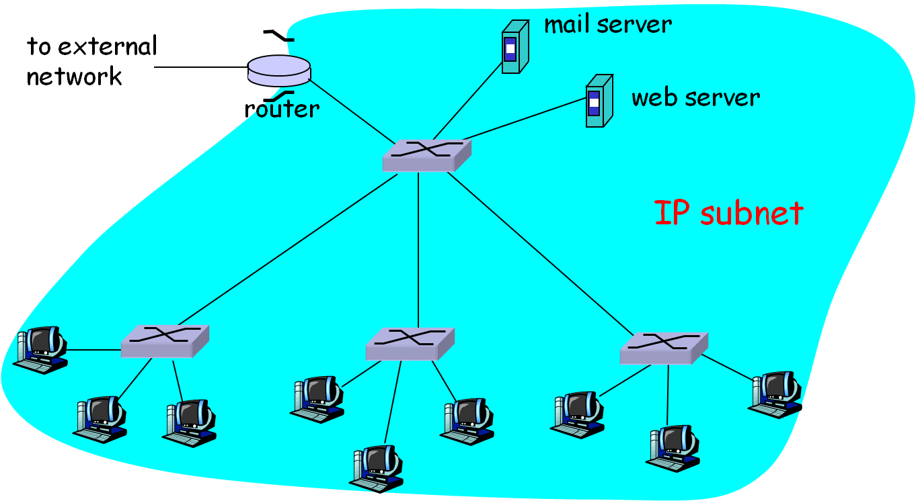
Institutional Network

Slide 13
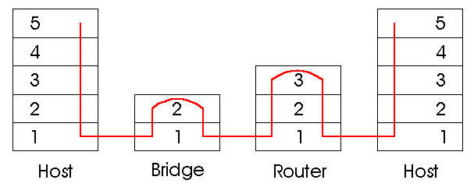
Switches vs. Routers
Both store-and-forward devices
Routers: network layer devices (examine network layer headers)
Switches are link layer devices
Routers maintain routing tables, implement routing algorithms
Switches maintain switch tables, implement filtering, learning algorithms

Slide 14
IEEE 802.11 Wireless LAN
802.11b
2.4-5 GHz unlicensed spectrum
up to 11 Mbps
direct sequence spread spectrum (DSSS) in physical layer
all hosts use same chipping code
802.11a
5-6 GHz range
up to 54 Mbps
802.11g
2.4-5 GHz range
up to 54 Mbps
802.11n: multiple antennae
2.4-5 GHz range
up to 200 Mbps
all use CSMA/CA for multiple access
all have base-station and ad-hoc network versions

Slide 15
802.11 LAN architecture
wireless host communicates with base station
base station = access point (AP)
Basic Service Set (BSS) (aka “cell”) in infrastructure mode contains:
wireless hosts
access point (AP): base station
ad hoc mode: hosts only
Internet
hub, switch
or router
AP
BSS 1
AP
BSS 2

Slide 16
802.11: Channels, association
802.11b: 2.4GHz-2.485GHz spectrum divided into 11 channels at different frequencies
AP admin chooses frequency for AP
interference possible: channel can be same as that chosen by neighboring AP!
host: must associate with an AP
scans channels, listening for beacon frames containing AP’s name (SSID) and MAC address
selects AP to associate with
may perform authentication
will typically run DHCP to get IP address in AP’s subnet

Slide 17
802.11: passive/active scanning
BBS 1
BBS 2
BBS 1
BBS 2
AP 1
AP 2
AP 1
1
AP 2
1
1
2
2
2
3
3
4
H1
H1
Passive Scanning:
beacon frames sent from APs
association Request frame sent: H1 to selected AP
association Response frame sent: selected AP to H1
Active Scanning:
Probe Request frame broadcast from H1
Probes response frame sent from APs
Association Request frame sent: H1 to selected AP
Association Response frame sent: selected AP to H1

Slide 18
IEEE 802.11: multiple access
avoid collisions: 2⁺ nodes transmitting at same time
802.11: CSMA - sense before transmitting
don’t collide with ongoing transmission by other node
802.11: no collision detection!
difficult to receive (sense collisions) when transmitting due to weak received signals (fading)
can’t sense all collisions in any case: hidden terminal, fading
Solution:
Link layer acknowledgement
Collision avoidance: CSMA/C(ollision)A(voidance)
A
B
C
C
A’s signal
strength
C’s signal
strength
B
A
space

Slide 19
IEEE 802.11 MAC Protocol: CSMA/CA: Link layer acknowledgement
802.11 sender
1 if sense channel idle for DIFS then
transmit entire frame (no CD)
2 if sense channel busy then
start random backoff time
timer counts down while channel idle
transmit when timer expires
if no ACK, increase random backoff interval, repeat 2
802.11 receiver
- if frame received OK
return ACK after SIFS (ACK needed due to hidden terminal problem)
sender
receiver
DIFS
data
SIFS
ACK
Notes:
Difs: distributed inter-frame space
Sifs: short inter-frame spacing

Slide 20
Avoiding Collisions: when ack is not received in time
idea: allow sender to “reserve” channel rather than random access of data frames: avoid collisions of long data frames
sender first transmits small request-to-send (RTS) packets to BS using CSMA
RTSs may still collide with each other (but they’re short)
BS broadcasts clear-to-send CTS in response to RTS
CTS heard by all nodes
sender transmits data frame
other stations defer transmissions
avoid data frame collisions completely
using small reservation packets!

Slide 21
Collision Avoidance: RTS-CTS exchange
A
B
AP
RTS(B)
RTS(A)
reservation collision
RTS(A)
CTS(A)
CTS(A)
DATA (A)
defer
time
ACK(A)
ACK(A)

Slide 22
Homework#4.9
Objective 9: Understand the switch self-learning protocol
Important concepts/knowledge (please elaborate each)
Difference between Hubs and Switches
How CSMA/CD is used in switches?
How a switch is made transparent to hosts?
Switch self-learning protocol
When switches are interconnected together, how do they work together?
Problem: Suppose C sends frame to I, I responds to C, as shown in the figure below. Show switch tables and frame forwarding in S₁, S₂, S₃, S₄
1
S₄
S₁
2
S₃
A
S₂
F
I
B
C
D
E
G
H

