Slide 1
CIS454/554
Data Comm. Networks
Lecture 4
Wenbing Zhao
(Part of the slides are based on Drs. Kurose & Ross’s slides for their Computer Networking book)

Slide 2
Administrative:
  Lab report requirement:
    Submit in blackboard
    Typed, must include questions/tasks, your answers, and screenshots to backup your answers
Today’s topics
  Web and HTTP

Slide 3
The World Wide Web
Creation of Tim Berners-Lee, in 1989 CERN nuclear physics research
  Mosaic – first graphical interface, creation of Marc Andersson (and others), precursor to Netscape
Uses a client-server architecture
  Web server
  Web browser
Runs on HTTP over TCP

Slide 4
Web and HTTP
Web page consists of objects
Object can be HTML file, JPEG image, Java applet, audio file,…
A Web page consists of a base HTML-file which includes several referenced objects
Each object is addressable by a URL
The idea of having one page point to another is called hypertext
  Invented by Vannevar Bush, a MIT EE professor, in 1945

Slide 5
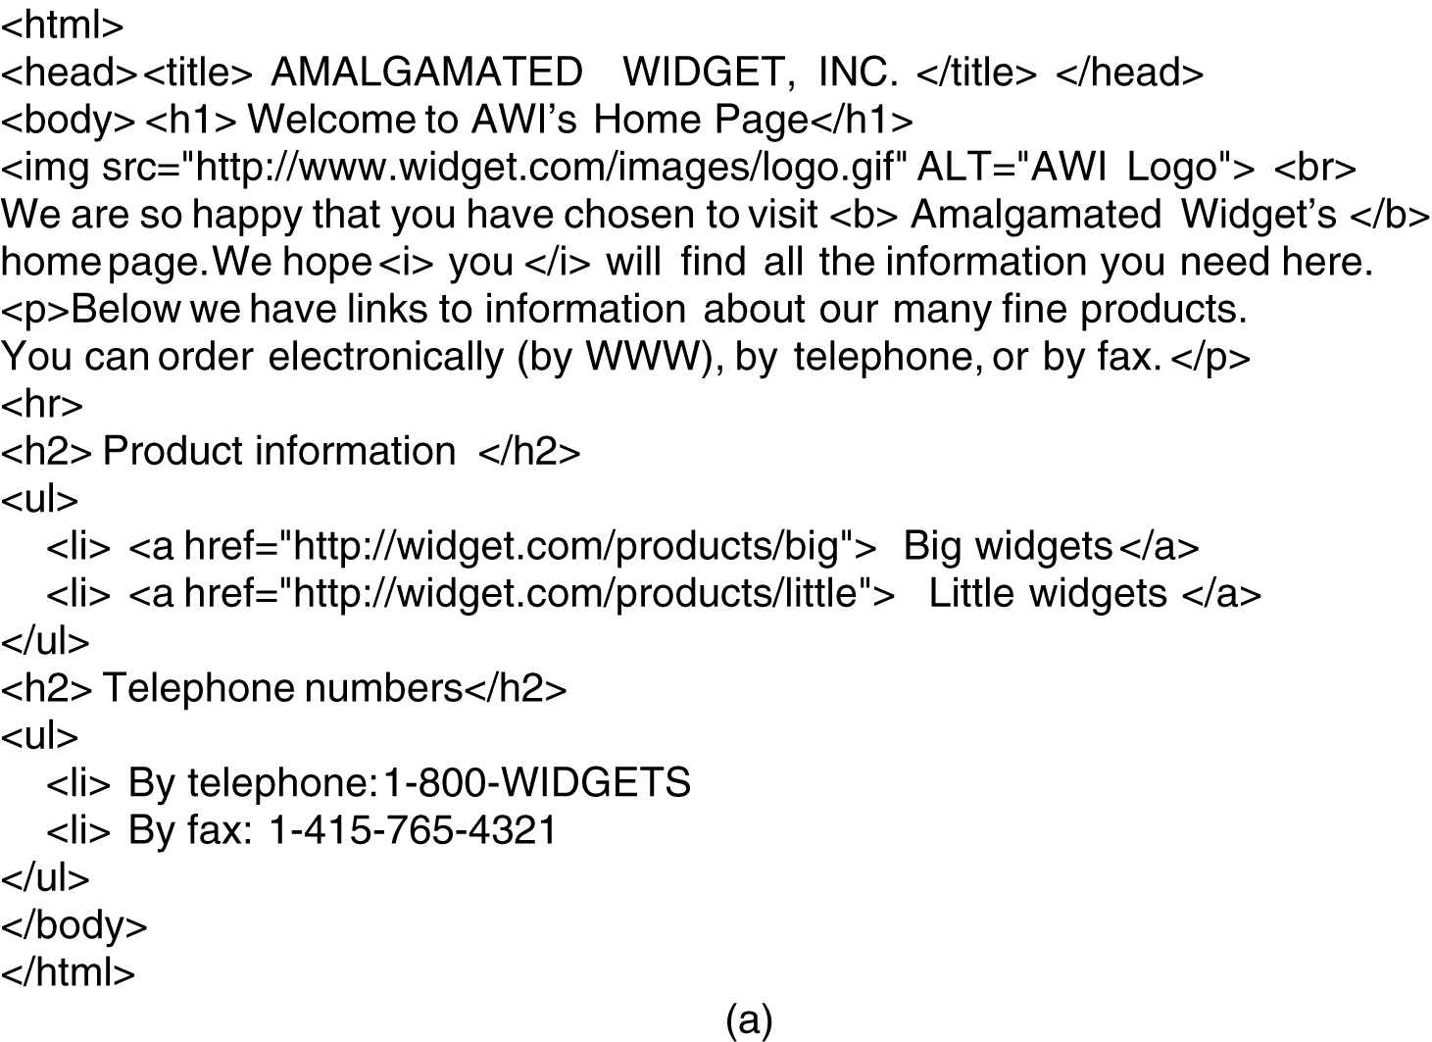
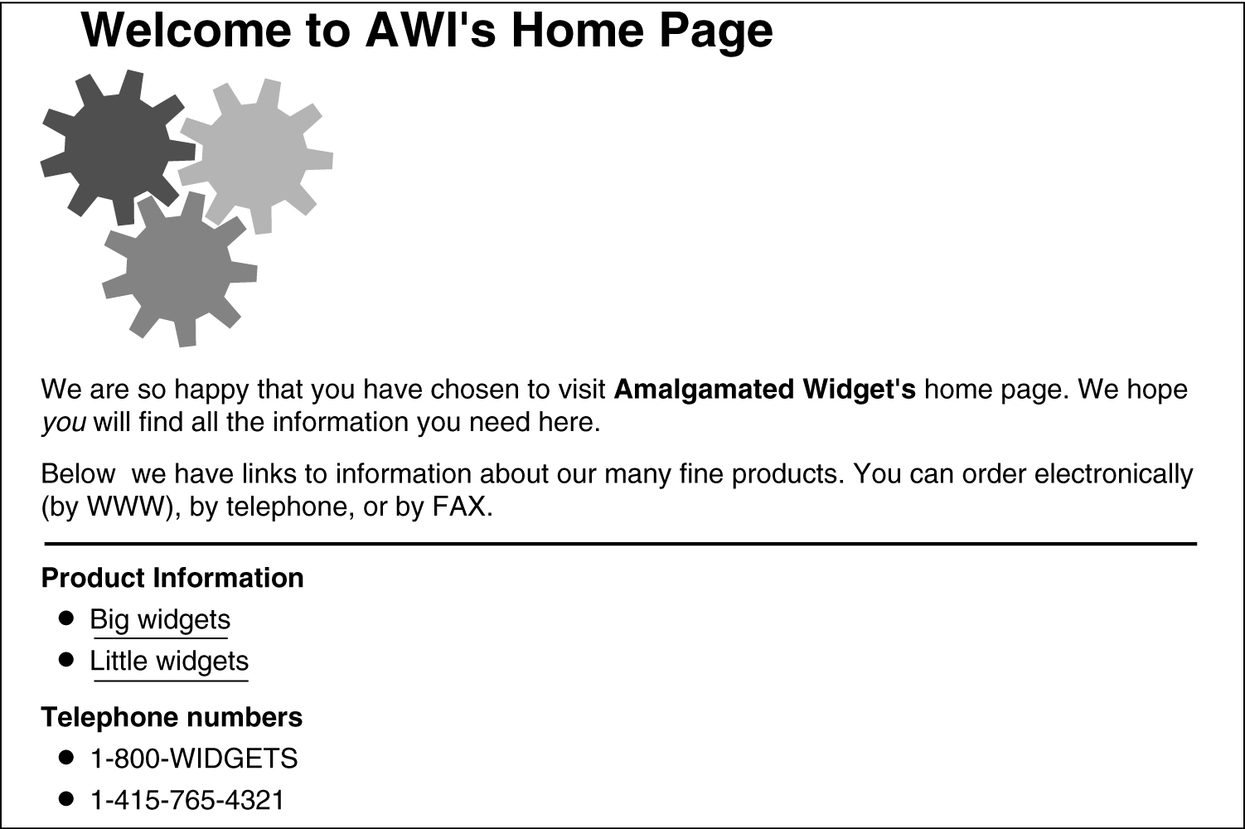
HTML – HyperText Markup Language
The HTML for a sample Web page
The formatted page

Slide 6
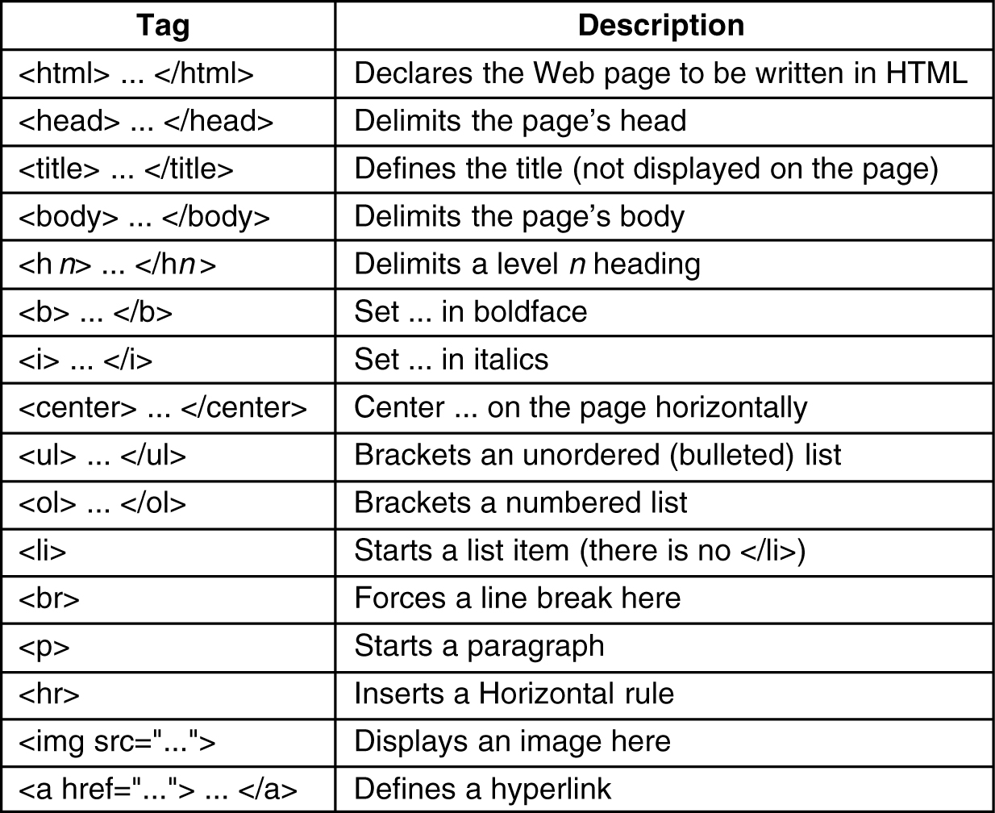
Common HTML Tags

Slide 7
URL – Uniform Resource Locater
http://www.someschool.edu/someDept/pic.gif
protocol name
host name
path name
Example URL:
URL encodes three types of information
  What is the page called – local path name uniquely indicating the specific page
  Where is the page located – Host name of the server on which the page is located
  How can the page be accessed – protocol, e.g., http, ftp

Slide 8
HTTP Overview
HTTP: HyperText Transfer Protocol
Web’s application layer protocol
client/server model
HTTP 1.0: RFC 1945
HTTP 1.1: RFC 2068
HTTP request
PC running
Explorer
HTTP response
HTTP request
Server
running
Apache Web
server
HTTP response
Mac running
Navigator
Notes:
client: browser that requests, receives, “displays” Web objects
server: Web server sends objects in response to requests

Slide 9
HTTP Overview
Client initiates TCP connection (creates socket) to server, port 80
Server accepts TCP connection from client
HTTP messages (application-layer protocol messages) exchanged between browser (HTTP client) and Web server (HTTP server)
TCP connection closed

Slide 10
HTTP Overview
HTTP is “stateless”
  Server maintains no information about past client requests
Protocols that maintain “state” are complex!
  Past history (state) must be maintained
  If server/client crashes, their views of “state” may be inconsistent, must be reconciled

Slide 11
HTTP Connections
Nonpersistent HTTP
At most one object is sent over a TCP connection
HTTP/1.0 uses nonpersistent HTTP
Persistent HTTP
Multiple objects can be sent over single TCP connection between client and server
HTTP/1.1 uses persistent connections in default mode

Slide 12
Nonpersistent HTTP
Suppose user enters URL http://www.someSchool.edu/someDept/home.index
1a. HTTP client initiates TCP connection to HTTP server at www.someSchool.edu on port 80
(contains text, references to 10 jpeg images)
1b. HTTP server at host www.someSchool.edu waiting for TCP connection at port 80. “accepts” connection, notifying client
2. HTTP client sends HTTP request message (containing URL) into TCP connection socket. Message indicates that client wants object someDept/home.index
3. HTTP server receives request message, forms response message containing requested object, and sends message into its socket
time

Slide 13
Nonpersistent HTTP
4. HTTP server closes TCP connection.
5. HTTP client receives response message containing html file, displays html. Parsing html file, finds 10 referenced jpeg objects
time
6. Steps 1-5 repeated for each of 10 jpeg objects

Slide 14
Non-Persistent HTTP:
Response Time
Definition of RTT: time to send a small packet to travel from client to server and back (Round Trip Time)
initiate TCP
connection
RTT
request
file
time to
transmit
file
RTT
file
received
time
time

Slide 15
Non-Persistent HTTP: Response Time
Response time:
one RTT to initiate TCP connection
one RTT for HTTP request and first few bytes of HTTP response to return
file transmission time
Total = 2RTT+transmission time

Slide 16
Non-Persistent HTTP Issues
To reduce response time, browsers often open parallel TCP connections to fetch referenced objects
Requires 2 RTTs per object
OS overhead for each TCP connection

Slide 17
Persistent HTTP
Server leaves connection open after sending response
Subsequent HTTP messages between same client/server sent over open connection

Slide 18
Persistent HTTP
Persistent without pipelining:
Client issues new request only when previous response has been received
One RTT for each referenced object
Persistent with pipelining:
Default in HTTP/1.1
Multiple requests are sent over the same connection concurrently. That is, after the first request, the second request is sent before the reply for the first request is received
As little as one RTT for all the referenced objects
Notes:
Question: one-RTT for all referenced objects in persistent with pipelining, what about nonpersistent HTTP?

Slide 19
HTTP Request Message
Two types of HTTP messages: request, response
HTTP request message:
  ASCII (human-readable format)
request line
(GET, POST,
HEAD commands)
GET /somedir/page.html HTTP/1.1
Host: www.someschool.edu
User-agent: Mozilla/4.0
Connection: close
Accept-language:fr
(extra carriage return, line feed)
header
lines
Carriage return,
line feed
indicates end
of message
Notes:
From http://www.w3.org/Protocols/rfc2616/rfc2616-sec14.html
HTTP/1.1 defines the "close" connection option for the sender to signal that the connection will be closed after completion of the response. For example,
Connection: close in either the request or the response header fields indicates that the connection SHOULD NOT be considered `persistent' (section 8.1) after the current request/response is complete.
“keep alive” => persistent connection

Slide 20
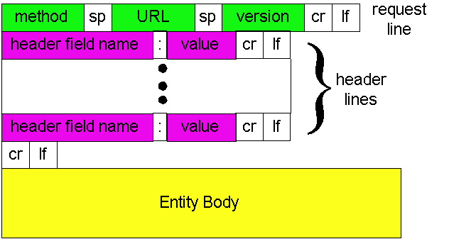
HTTP Request Message:
General Format
HTTP header is pure ASCII based. It is very different from lower layer protocols such as TCP, which is binary based
Notes:
Sp: space
Cr: carriage return
Lf: line feed

Slide 21
Method Types
HTTP/1.0
GET
POST
HEAD
  Asks server to include only the header part in response
HTTP/1.1
GET, POST, HEAD
PUT
  Uploads file in entity body to path specified in URL field
DELETE
  Deletes file specified in the URL field

Slide 22
HTTP Response Message
status line
(protocol
status code
status phrase)
HTTP/1.1 200 OK
Connection close
Date: Thu, 06 Aug 1998 12:00:15 GMT
Server: Apache/1.3.0 (Unix)
Last-Modified: Mon, 22 Jun 1998 …...
Content-Length: 6821
Content-Type: text/html
data data data data data ...
header
lines
data, e.g.,
requested
HTML file
Notes:
The Date general-header field represents the date and time at which the message was originated
The Last-Modified entity-header field indicates the date and time at which the origin server believes the variant was last modified.
Last-Modified = "Last-Modified" ":" HTTP-date An example of its use is
Last-Modified: Tue, 15 Nov 1994 12:45:26 GMT The exact meaning of this header field depends on the implementation of the origin server and the nature of the original resource. For files, it may be just the file system last-modified time. For entities with dynamically included parts, it may be the most recent of the set of last-modify times for its component parts. For database gateways, it may be the last-update time stamp of the record. For virtual objects, it may be the last time the internal state changed.
An origin server MUST NOT send a Last-Modified date which is later than the server's time of message origination. In such cases, where the resource's last modification would indicate some time in the future, the server MUST replace that date with the message origination date.
An origin server SHOULD obtain the Last-Modified value of the entity as close as possible to the time that it generates the Date value of its response. This allows a recipient to make an accurate assessment of the entity's modification time, especially if the entity changes near the time that the response is generated.
HTTP/1.1 servers SHOULD send Last-Modified whenever feasible.

Slide 23
HTTP Response Status Codes
Status code is in first line of the response message:
200 OK
  request succeeded, requested object later in this message
301 Moved Permanently
  requested object moved, new location specified later in this message (Location:)
400 Bad Request
  request message not understood by server
404 Not Found
  requested document not found on this server
505 HTTP Version Not Supported
Notes:
A few sample codes:

Slide 24
Web Caching
Goal: satisfy client request without involving origin server
user sets browser: Web accesses via proxy server
browser sends all HTTP requests to proxy server
  object in cache: returns cached object
  else cache requests object from origin server, then returns object to client
origin
server
Proxy
server
HTTP request
HTTP request
client
HTTP response
HTTP response
HTTP request
HTTP response
client
origin
server
Notes:
Proxy server: caching

Slide 25
More about Web Caching
Proxy server acts as both client and server
Typically proxy server is installed by ISP (university, company, residential ISP)
Why Web caching?
Reduce response time for client request
Reduce traffic on an institution’s access link
Internet dense with caches: enables “poor” content providers to effectively deliver content

Slide 26
Conditional GET: HTTP Build-in Support for Caching
Proxy
server
Origin
Server
HTTP request msg
If-modified-since: <date>
Goal: don’t send object if cache is up-to-date
Proxy server: specify date of cached copy in HTTP request
  If-modified-since: <date>
Origin server: response contains no object if cached copy is up-to-date:
  HTTP/1.0 304 Not Modified
object
not
modified
HTTP response
HTTP/1.0
304 Not Modified
HTTP request msg
If-modified-since: <date>
object
modified
HTTP response
HTTP/1.0 200 OK
<data>

Slide 27
Non-Caching Example
origin
servers
Assumptions
Average object size = 100,000 bits
Avg. request rate from institution’s browsers to origin servers = 15/sec
Delay from institutional router to any origin server and back to router = 2 sec
public
Internet
1.5 Mbps
access link
institutional
network
10 Mbps LAN
Notes:
Traffic per second: 15 * 100Kb = 1.5 Mbps = access link bandwidth
1.5/10 => 15% utilization on LAN

Slide 28
Non-Caching Example
origin
servers
Consequences
Utilization on LAN = 15%
Utilization on access link = 100%
Total delay = Internet delay + access delay + LAN delay
= 2 sec + minutes + milliseconds
public
Internet
1.5 Mbps
access link
institutional
network
10 Mbps LAN
Notes:
Access delay: waiting in a queue at the edge router. When the load is reaching 100% of the capacity, a very large is going to be built up. The waiting time can be very long. Can be calculated based on queueing model
Advertise for EEC685

Slide 29
Non-Caching Example
origin
servers
Possible solution
Increase bandwidth of access link to, say, 10 Mbps
Consequences
Utilization on LAN = 15%
Utilization on access link = 15%
Total delay = Internet delay + access delay + LAN delay
= 2 sec + msecs + msecs
Often a costly upgrade
public
Internet
10 Mbps
access link
institutional
network
10 Mbps LAN

Slide 30
Caching Example
Install proxy server
Suppose hit rate is 0.4
Consequence
40% requests will be satisfied almost immediately
60% requests satisfied by origin server
Utilization of access link reduced to 60%, resulting in negligible delays (say 10 msec)
Total avg delay = Internet delay + access delay + LAN delay = .6*(2.01) secs + .4*milliseconds < 1.4 secs
origin
servers
public
Internet
1.5 Mbps
access link
institutional
network
10 Mbps LAN
Institutional
Proxy server

Slide 31
Homework#1.3
Objective 3: Able to understand how a Uniform Resource Locater is constructed and its internal components
Problem. Imagine that someone in the CS Department at Stanford has just written a new program that he wants to distribute by FTP. He puts the program in the FTP directory ftp/pub/freebies/newprog.c. What is the URL for this program likely to be?
Notes:
Solution:
The URL is probably ftp://www.cs.stanford.edu/ftp/pub/freebies/newprog.c

Slide 32
Homework#1.4
Objective 4: Able to understand the built-in support for caching in HTTP and the HTTP protocol itself
Key point:
  HTTP has support for a conditional get request to work with the caching so that the network traffic can be reduced and the end-to-end latency is shortened
Problem. The If-Modified-Since header can be used to check whether a cached page is still valid. Requests can be made for pages containing images, sound, video, and so on, as well as HTML. Do you think the effectiveness of this technique is better or worse for JPEG images as compared to HTML?
Notes:
Solution: It is more effective for JPEG images
Better hit rate: Most likely HTML pages change more often than JPEG files. So, caching images are more effective
Pay off: Can we reduce response time by caching?
There is not much difference in response time between getting a 304 message and getting 500 lines of HTML.
Image files are large, so not having to send one is a big win.

Slide 33
Homework#1.5
Objective 5: Able to compute the response time as seen by a client that issued a HTTP request.
Key point:
Queueing delay at the router can be a significant factor in response time
The heavier the traffic, the longer the queue at the router, which causes the longer delay
Using caching, a portion of the HTTP requests will be served at the local proxy server instead of computing for resources at the router, which reduces the queue at the router and shorten the response time
Problem. Consider an institutional network connected to the internet. Suppose that the average object size is 900,000 bits and that the average request rate from the institution’s browsers to the origin servers is 1.5 requests per second. The bandwidth of the access link is 1.5 Mbps. Also suppose that the amount of time it takes from when the router on the Internet side of the access link forwards an HTTP request until it receives the response in two seconds on average. Model the total average response time as the sum of the average access delay (that is, the delay from Internet router to institution router) and the average Internet delay. For the average access delay, use Δ/(1-Δβ), where Δ is the average time required to send an object over the access link and β is the arrival rate of objects to the access link.
(1) Find the total average response time.
(2) Now suppose a cache is installed in the institutional LAN. Suppose the hit rate is 0.4. Find the total average response time

Slide 34
Homework#1.6
Objective 6: Able to fully understand HTTP
Key points
  HTTP has two versions so far: 1.0 and 1.1
  HTTP 1.0: TCP connection is not persistent, that is, to retrieve any object, a new TCP connection is made and then is terminated
  HTTP 1.1: Support persistent TCP connection in that the same connection is used to retrieve multiple objects if necessary
  TCP uses a three-way handshake to establish a new connection, which adds a round trip delay by itself
Problem: Suppose within your Web browser you click on a link to obtain a Web page. The IP address for the associated URL has already been cached in your local host so a DNS look-up is unnecessary. Suppose that the Web page associated with the link contains some HTML text and 20 jpeg images that are hosted on the same Web server. Let RTT0 denote the RTT between the local host and the Web server. Assuming 0 transmission time of the HTML text and the embedded images, calculate how much time elapses from when the client clicks on the link until the client receives the Web page (HTML text and the embedded images) under the following scenarios:
  HTTP 1.1 with pipelining (and with persistent connection)
  HTTP 1.1 without pipelining (and with persistent connection)

