Slide 1
CIS454/554 Data Comm. Networks
Lecture 5
Wenbing Zhao
(Part of the slides are based on Drs. Kurose & Ross’s slides for their Computer Networking book)

Slide 2
Outline
Reminder:
HTTP & DNS Labs
Discussion session for quiz#1, 6/6
Quiz#1 (lectures 1-5, labs 1-2), 6/8 Wednesday
Host name and IP addresses
DNS: Domain name systems
Services provided
Name spaces
Name servers
DNS records and protocol

Slide 3
Host Names vs. IP addresses
Host names
Mnemonic name appreciated by humans
Variable length, alpha-numeric characters
Provide little (if any) information about location
Examples: www.google.com
IP addresses
Numerical address appreciated by routers
Fixed length, binary number
Hierarchical, related to host location
Examples: 64.233.167.147

Slide 4
Separating Naming and Addressing
Names are easier to remember
www.google.com vs. 64.233.167.147
Addresses can change underneath
Move www.google.com to 64.233.167.88
E.g., renumbering when changing providers
Name could map to multiple IP addresses
www.google.com to multiple replicas of the Web site: 64.233.167.147, 64.233.167.99, 64.233.167.104

Slide 5
Separating Naming and Addressing
Map to different addresses in different places
Address of a nearby copy of the Web site
E.g., to reduce latency, or return different content
Multiple names for the same address
E.g., aliases like ee.mit.edu and cs.mit.edu

Slide 6
DNS Services
Hostname to IP address translation
Host aliasing
Canonical and alias names
Mail server aliasing
Load distribution
Replicated Web servers: set of IP addresses for one canonical name
Notes:
What services the DNS provides?
Why not centralize DNS?
single point of failure
traffic volume
distant centralized database
maintenance
doesn’t scale!

Slide 7
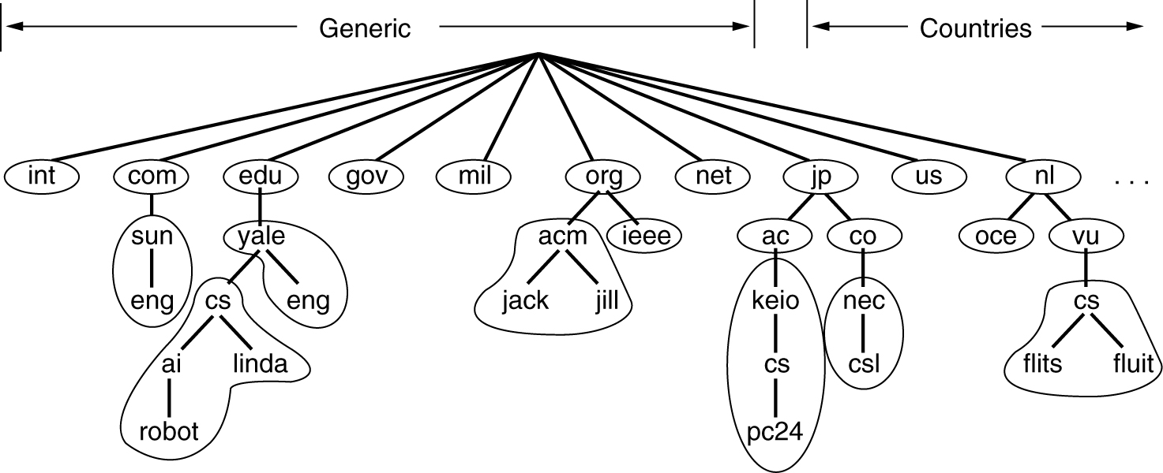
The DNS Name Space
Each domain is named by the path upward from it to the unnamed root. The components are separated by period
E.g., eng.sun.com.
Domain names can be absolute (end with period), or relative
Domain names are case insentive
Component names <= 63 chars
Full path names <= 255 chars
Domain names cannot be all numerical
Top level
domain names
Notes:
Domain names cannot be all numerical, why?
Top level domain names are not numerical
Domain name space is abstract, it is about the partitioning of data (domain names)
Name servers are the actual servers that manage the data and provide access services to the data

Slide 8
DNS: Domain Name System
Properties of DNS
Hierarchical name space divided into zones
Distributed over a collection of DNS servers
Hierarchy of DNS servers
Root servers
Top-level domain (TLD) servers
Authoritative DNS servers
Performing the translations
Local DNS servers
Resolver software
Notes:
note: core Internet function, implemented as application-layer protocol
complexity at network’s “edge”: why? Because notes in the subnet does not need to use domain name, there is no translation needed

Slide 9
Hierarchy of DNS Servers
Root servers
Root DNS Servers
Top-level domain
(TLD) servers
com DNS servers
org DNS servers
edu DNS servers
yahoo.com
DNS servers
pbs.org
DNS servers
poly.edu
DNS servers
umass.edu
DNS servers
amazon.com
DNS servers
Authoritative DNS servers
Notes:
DNS name space divided into non-overlapping zones
Each zone contains part of tree and name servers holding info about zone
One primary name server gets its info off disk
One or more non-primary name servers get info from primary name server

Slide 10
DNS: Root Name Servers
Contacted by local name server that cannot resolve name
Root name server:
Contacts authoritative name server if name mapping not known
Gets mapping
Returns mapping to local name server

Slide 11
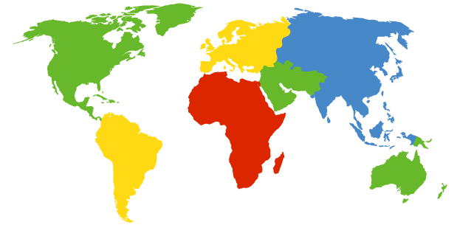
DNS: Root Name Servers
13 root name servers worldwide
a Verisign, Dulles, VA
c Cogent, Herndon, VA (also Los Angeles)
d U Maryland College Park, MD
g US DoD Vienna, VA
h ARL Aberdeen, MD
j Verisign, ( 11 locations)
k RIPE London (also Amsterdam, Frankfurt)
i Autonomica, Stockholm (plus 3 other locations)
e NASA Mt View, CA
f Internet Software C. Palo Alto, CA (and 17 other locations)
m WIDE Tokyo
b USC-ISI Marina del Rey, CA
l ICANN Los Angeles, CA

Slide 12
Top-Level Domain Servers
Generic domains (e.g., com, org, edu)
Country domains (e.g., uk, fr, ca, jp)
Typically managed professionally
Network Solutions maintains servers for “com”
Educause maintains servers for “edu”

Slide 13
Authoritative DNS Servers
Provide public records for hosts at an organization
For the organization’s servers (e.g., Web and mail)
Can be maintained locally or by a service provider

Slide 14
Local Name Server
Does not strictly belong to hierarchy
Each ISP (residential ISP, company, university) has one
Also called “default name server”
When a host makes a DNS query, query is sent to its local DNS server
Acts as a proxy, forwards query into hierarchy
Query is often triggered by gethostbyname()
Notes:
Does not strictly belong to hierarchy, why? It is basically a cache server, it caches mappings but it is not authoritative server of any domain name

Slide 15
DNS name resolution example
root DNS server
2
host at cis.poly.edu wants IP address for gaia.cs.umass.edu
3
TLD DNS server
4
5
iterated query:
contacted server replies with name of server to contact
“I don’t know this name, but ask this server”
local DNS server
dns.poly.edu
7
6
1
8
authoritative DNS server
dns.cs.umass.edu
requesting host
cis.poly.edu
gaia.cs.umass.edu
Application 2-15

Slide 16
DNS name resolution example
root DNS server
recursive query:
puts burden of name resolution on contacted name server
heavy load?
2
3
7
6
TLD DNS server
local DNS server
dns.poly.edu
5
4
1
8
authoritative DNS server
dns.cs.umass.edu
requesting host
cis.poly.edu
gaia.cs.umass.edu
Application 2-16

Slide 17
Recursive Queries
Recursive query:
puts burden of name resolution on contacted name server (i.e., please give me the info I need – you do all the work)
heavy load?
Iterated query:
contacted server replies with name of server to contact
“I don’t know this name, but ask this server”

Slide 18
DNS Caching
Performing all these queries take time
All this before the actual communication takes place
E.g., 1-second latency before starting Web download
Caching can substantially reduce overhead
The top-level servers very rarely change
Popular sites (e.g., www.google.com) visited often
Local DNS server often has the information cached

Slide 19
DNS Caching
How DNS caching works
DNS servers cache responses to queries
Responses include a “time to live” (TTL) field
Server deletes the cached entry after TTL expires

Slide 20
DNS Records
DNS: distributed db storing resource records (RR)
RR format: (name, value, type, ttl)
Type=A/AAAA
name is hostname
value is IP address
Type=NS
name is domain (e.g. foo.com)
value is hostname of authoritative name server for this domain
Type=CNAME
name is alias name for some “canonical” (the real) name
www.ibm.com is really
www.ibm.com.cs186.net
value is canonical name
Type=MX
value is name of mailserver associated with name
Notes:
Db = database

Slide 21
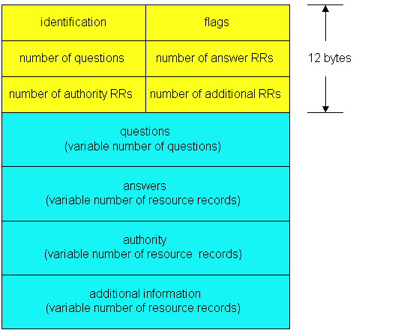
DNS Protocol, Messages
DNS protocol : query and reply messages, both with same message format
msg header
Identification: 16 bit # for query, reply to query uses same #
Flags:
query or reply
recursion desired
recursion available
reply is authoritative
Notes:
It is best to show a demo using wireshark tool

Slide 22
DNS Protocol, Messages
Name, type fields
for a query
RRs in response
to query
records for
authoritative servers
additional “helpful”
info that may be used
Notes:
Note that the “authority” section contains records for authoritative DNS servers for the domain requested
“Additional information” section often contains A records for those authoritative DNS servers

Slide 23
Reliability
DNS servers are replicated
Name service available if at least one replica is up
Queries can be load balanced between replicas
UDP used for queries
Need reliability: must implement this on top of UDP
Try alternate servers on timeout
Exponential backoff when retrying same server
Same identifier for all queries
Don’t care which server responds
Notes:
Both tcp and udp are allowed transport method for dns. But udp is preferred

Slide 24
Inserting Records into DNS
Example: just created startup “FooBar”
Register foobar.com at Network Solutions
Provide registrar with names and IP addresses of your authoritative name server (primary and secondary)
Registrar inserts two RRs into the com TLD server:
(foobar.com, dns1.foobar.com, NS)
(dns1.foobar.com, 212.212.212.1, A)
Put in authoritative server dns1.foobar.com
Type A record for www.foobar.com
Type MX record for foobar.com

Slide 25
DNS Query in Web Download
User types or clicks on a URL
E.g., http://www.cnn.com/2006/leadstory.html
Browser extracts the site name
E.g., www.cnn.com
Browser calls gethostbyname() to learn IP address
Triggers resolver code to query the local DNS server
Eventually, the resolver gets a reply
Resolver returns the IP address to the browser
Then, the browser contacts the Web server
Creates and connects socket, and sends HTTP request

Slide 26
Multiple DNS Queries
Often a Web page has embedded objects
E.g., HTML file with embedded images
Each embedded object has its own URL
… and potentially lives on a different Web server
E.g., http://www.myimages.com/image1.jpg
Browser downloads embedded objects
Usually done automatically, unless configured otherwise
E.g., need to query the address of www.myimages.com

Slide 27
Web Server Replicas
Popular Web sites can be easily overloaded
Web site often runs on multiple server machines
Internet

Slide 28
Directing Web Clients to Replicas
Simple approach: different names
www1.cnn.com, www2.cnn.com, www3.cnn.com
But, this requires users to select specific replicas
More elegant approach: different IP addresses
Single name (e.g., www.cnn.com), multiple addresses
E.g., 64.236.16.20, 64.236.16.52, 64.236.16.84, …
Authoritative DNS server returns many addresses
And the local DNS server selects one address
Authoritative server may vary the order of addresses

Slide 29
Clever Load Balancing Schemes
Selecting the “best” IP address to return
Based on server performance
Based on geographic proximity
Based on network load
…
Example policies
Round-robin scheduling to balance server load
U.S. queries get one address, Europe another
Tracking the current load on each of the replicas

Slide 30
Homework#1.7
Objective 7: Able to understand the DNS protocol used by the Domain Name System for name resolution
Key points:
DNS has a retry mechanism for its queries.
When retrying the same server, the timeout increases exponentially on each retry (exponential backoff)
There is also a timeout to retry alternative servers
Problem: DNS typically uses UDP instead of TCP. If a DNS packet is lost, there is no automatic recovery. Does this cause a problem, and if so, how is it solved?

Slide 31
Homework#1.8
Objective 8: Able to understand DNS name space
Key points:
The domain is designed to be hierarchical. There are unnamed root, top level domain name, and domain names
Each full domain name is named by the path upward from it to the unnamed root. The components are separated by period
The top-level domain names are predefined and cannot be all numerical
Problem: Although it was not mentioned in the text, an alternative form for a URL is to use the IP address instead of its DNS name. An example of using an IP address is http://192.31.231.66/index.html. How does the browser know whether the name following the scheme is a DNS name or an IP address.

Slide 32
Homework#1.9
Objective 9: Able to understand the DNS system architecture and the DNS protocol on performing name resolution
Key points:
The DNS system is also organized hierarchically, with root DNS servers, top-level domain servers, authoritative DNS servers, and local name servers
There are two query styles: iterated and recursive
Problem. Suppose within your Web browser you click on a link to obtain a Web page. The IP address for the associated URL is not cached in your local host, so a DNS look-up is necessary to obtain the IP address. Suppose that n DNS servers are visited before your host receives the IP address from DNS; the successive visits incur an RTT of RTT₁, …, RTT_{n}. Further suppose that the Web page associated with the link contains exactly one object, consisting of a small amount of HTML text. Let RTT₀ denote the RTT between the local host and the server containing the object. Assuming 0 transmission time of the object, how much time elapses from when the client clicks on the link until the client receives the object?

