Slide 1
CIS454/554 Data Comm. Networks
Lecture 8
Wenbing Zhao
(Part of the slides are based on Drs. Kurose & Ross’s slides for their Computer Networking book)

Slide 2
Outline
Reminder
6/21: quiz#2
UDP
TCP
Segment header structure
Connection management
Reliable data transfer
Flow control
Congestion control

Slide 3
TCP: Overview
Point-to-point:
One sender, one receiver
Reliable, in-order byte steam:
No “message boundaries”
Pipelined:
TCP congestion and flow control set window size
Send & receive buffers
Full duplex data:
Bi-directional data flow in same connection
MSS: maximum segment size
Connection-oriented:
Handshaking (exchange of control msgs) init’s sender, receiver state before data exchange
Flow controlled:
Sender will not overwhelm receiver

Slide 4
TCP: Overview
TCP connection is byte stream, not message stream, no message boundaries
TCP may send immediately or buffer before sending
Receiver stores the received bytes in a buffer
Notes:
Stopped 10/3/2012 session 1

Slide 5
TCP Segment Structure
32 bits
URG: urgent data
(generally not used)
counting
by bytes
of data
(not segments!)
source port #
dest port #
sequence number
ACK: ACK #
valid
acknowledgement number
head
len
not
used
U
Receive window
A
P
R
S
PSH: push data now
(generally not used)
F
# bytes
rcvr willing
to accept
checksum
Urg data pnter
RST, SYN, FIN:
connection estab
(setup, teardown
commands)
Options (variable length)
A TCP segment must fit into an IP datagram!
application
data
(variable length)
Internet
checksum
(as in UDP)
Notes:
Ask: why is there no length field?
Why receive window is there? Recall that TCP offers a duplex channel

Slide 6
The TCP Segment Header
Source port and destination port: identify local end points of the connection
Source and destination end points together identify the connection
Sequence number: identify the byte in the stream of data that the first byte of data in this segment represents
Acknowledgement number: the next sequence number that the sender of the ack expects to receive
Ack # = Last received seq num + 1
Ack is cumulative: an ack of 5 means 0-4 bytes have been received
TCP header length – number of 32-bit words in header
Notes:
Ack#: instead of saying “I have received all bytes until ack#-1.”, we say: “the next expected byte number is ack#.”

Slide 7
The TCP Segment Header
URG – indicates urgent pointer field is set
Urgent pointer – points to the seq num of the last byte in a sequence of urgent data
ACK – acknowledgement number is valid
SYN – used to establish a connection
Connection request: ACK = 0, SYN = 1
Connection confirm: ACK=1, SYN = 1
FIN – release a connection, sender has no more data
RST – reset a connection that is confused
PSH – sender asked to send data immediately
Notes:
Taken from http://www.vijaymukhi.com/vmis/tcp.htm
The Urgent Pointer is used when some information has to reach the server ASAP. When the TCP/IP stack at the other end sees a packet using the Urgent Pointer, it is duty bound to stop all it's doing and immediately send this packet to the relevant server. Since the packet is plucked out of the processing queue and acted upon immediately, it is known as an Out Of Band (OOB) packet and the data is called Out Of Band (OOB) data. The Urgent Pointer is usually used in Telnet, where an immediate response (e.g. the echoing of characters) is desirable.

Slide 8
The TCP Segment Header
Receiver window size –number of bytes that may be sent beyond the byte acked
Checksum – add the header, the data, and the conceptual pseudoheader as 16-bit words, take 1’s complement of sum
For more info: http://www.netfor2.com/tcpsum.htm http://www.netfor2.com/checksum.html
Options – provides a way to add extra facilities not covered by the regular header
E.g., communicate buffer sizes during set up

Slide 9
TCP Sequence Numbers and ACKs
Host A
Host B
Sequence numbers:
byte stream “number” of first byte in segment’s data
ACKs:
seq # of next byte expected from other side
cumulative ACK
User
types
‘C’
Seq=42, ACK=79, data = ‘C’
host ACKs
receipt of
‘C’, echoes
back ‘C’
Seq=79, ACK=43, data = ‘C’
host ACKs
receipt
of echoed
‘C’
Seq=43, ACK=80
time
simple telnet/ssh scenario
Notes:
For tcp, seq # usually does not start from 0. If it were, we could interpret seq # as how many number of bytes of payload have been sent previously
Seq=43: seq field contain the next expected number even if the segment does not contain any payload

Slide 10
TCP Connection Management
TCP sender, receiver establish “connection” before exchanging data segments
Initialize TCP variables:
Sequence numbers
Buffers, flow control info (e.g. RcvWindow)
Client: connection initiator
Socket clientSocket = new Socket("hostname","port number");
Server: contacted by client
Socket connectionSocket = welcomeSocket.accept();

Slide 11
TCP Connection Management
Three way handshake:
Step 1: client host sends TCP SYN segment to server
specifies initial sequence number
no data
Step 2: server host receives SYN, replies with SYN/ACK segment
server allocates buffers
specifies server initial sequence number
Step 3: client receives SYN/ACK, replies with ACK segment, which may contain data

Slide 12
TCP Connection Management
client
server
Three way handshake:
SYN segment is considered as 1 byte
SYN/ACK segment is also considered as 1 byte
connect
accept
SYN (seq=x)
SYN/ACK (seq=y, ACK=x+1)
ACK (seq=x+1, ACK=y+1)

Slide 13
TCP Connection Management
Closing a connection:
client closes socket: clientSocket.close();
Step 1: client end system sends TCP FIN control segment to server
Step 2: server receives FIN, replies with ACK. Closes connection, sends FIN.
client
server
close
FIN
ACK
close
FIN
ACK
timed wait
closed

Slide 14
TCP Connection Management
Step 3: client receives FIN, replies with ACK.
Enters “timed wait” - will respond with ACK to received FINs
Step 4: server, receives ACK. Connection closed.
Note: with small modification, can handle simultaneous FINs
client
server
closing
FIN
ACK
closing
FIN
ACK
timed wait
closed
closed

Slide 15
TCP Reliable Data Transfer
TCP creates rdt service on top of IP’s unreliable service
Pipelined segments
Cumulative acks
TCP uses single retransmission timer
Retransmissions are triggered by:
timeout events
duplicate acks
Initially consider simplified TCP sender:
ignore duplicate acks
ignore flow control, congestion control

Slide 16
TCP Sender Events:
Data rcvd from app:
Create segment with sequence number
seq # is byte-stream number of first data byte in segment
Start retransmission timer if not already running (think of timer as for oldest unacked segment)
Timeout:
retransmit segment that caused timeout
restart timer
Ack rcvd:
If acknowledges previously unacked segments
update what is known to be acked
restart timer if there are outstanding segment
Notes:
Remember that ack is accumulative. If an ack number corresponding a seq number in the middle of the sending window, it is acking all bytes upto that ack number - 1

Slide 17
TCP: Retransmission Scenarios
Host A
Host B
Seq=92, 8 bytes data
timeout
ACK=100
X
loss
Seq=92, 8 bytes data
ACK=100
SendBase
= 100
lost ACK scenario
time

Slide 18
TCP: Retransmission Scenarios
Host A
Host B
Seq=92, 8 bytes data
Seq=100, 20 bytes data
Seq=92 timeout
ACK=100
ACK=120
Sendbase
= 100
Seq=92, 8 bytes data
SendBase
= 120
Seq=92 timeout
ACK=120
SendBase
= 120
premature timeout
time

Slide 19
TCP Retransmission Scenarios
Host A
Host B
Seq=92, 8 bytes data
ACK=100
timeout
Seq=100, 20 bytes data
X
loss
SendBase
= 120
ACK=120
time
Cumulative ACK scenario

Slide 20
TCP ACK Generation
Event at Receiver
Arrival of in-order segment with
expected seq #. All data up to
expected seq # already ACKed
Arrival of in-order segment with
expected seq #. One other
segment has ACK pending
Arrival of out-of-order segment
higher-than-expect seq. # .
Gap detected
Arrival of segment that
partially or completely fills gap
TCP Receiver action
Delayed ACK. Wait up to 500ms
for next segment. If no next segment,
send ACK
Immediately send single cumulative
ACK, ACKing both in-order segments
Immediately send duplicate ACK,
indicating seq. # of next expected byte
Immediate send ACK, provided that
segment starts at lower end of gap
Notes:
To do: add illustrations for the above 4 scenarios

Slide 21
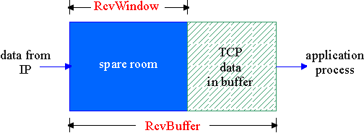
TCP Flow Control
Receive side of TCP connection has a receive buffer:
Flow control:
sender won’t overflow
receiver’s buffer by
transmitting too much,
too fast
Speed-matching service: matching the send rate to the receiving app’s drain rate
App process may be slow at reading from buffer

Slide 22
TCP Flow Control
Rcvr advertises spare room by including value of RcvWindow in segments
Sender limits unACKed data to RcvWindow
guarantees receive buffer doesn’t overflow
(Suppose TCP receiver discards out-of-order segments)
Spare room in buffer
= RcvWindow
= RcvBuffer-[LastByteRcvd - LastByteRead]

Slide 23
Principles of Congestion Control
Congestion:
Informally: “too many sources sending too much data too fast for network to handle”
Different from flow control!
Manifestations:
lost packets (buffer overflow at routers)
long delays (queueing in router buffers)

Slide 24
Approaches towards Congestion Control
Two broad approaches towards congestion control
End-end congestion control:
no explicit feedback from network
congestion inferred from end-system observed loss, delay
approach taken by TCP
Network-assisted congestion control:
routers provide feedback to end systems
single bit indicating congestion (SNA, DECbit, TCP/IP ECN, ATM)
explicit rate sender should send at

Slide 25
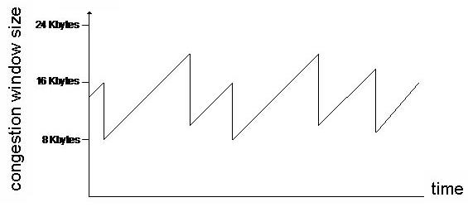
TCP Congestion Control: Additive Increase, Multiplicative Decrease
Approach: increase transmission rate (window size), probing for usable bandwidth, until loss occurs
Additive increase: increase cwnd every RTT until loss detected
Multiplicative decrease: cut cwnd after loss
Saw tooth
behavior: probing
for bandwidth
Notes:
Basic idea

Slide 26
TCP Congestion Control
Sender limits transmission:
LastByteSent-LastByteAcked
≤ cwnd
Roughly,
cwnd is dynamic, function of perceived network congestion
How does sender perceive congestion?
loss event = timeout or 3 duplicate acks
TCP sender reduces rate (cwnd) after loss event
cwnd
rate =
Bytes/sec
RTT
Notes:
AIMD: Additive Increase, Multiplicative Decrease

Slide 27
TCP Slow Start
When connection begins, cwnd = 1 MSS
Example: MSS = 500 bytes & RTT = 200 msec
Initial rate = 2.5 kBps
Available bandwidth may be >> MSS/RTT
Desirable to quickly ramp up to respectable rate
When connection begins, increase rate exponentially fast until first loss event
Notes:
Restart next monday

Slide 28
TCP Slow Start
When connection begins, increase rate exponentially until first loss event:
Double cwnd every RTT
Done by incrementing cwnd for every ACK received
Summary: initial rate is slow but ramps up exponentially fast
Host A
Host B
one segment
RTT
two segments
four segments
time

Slide 29
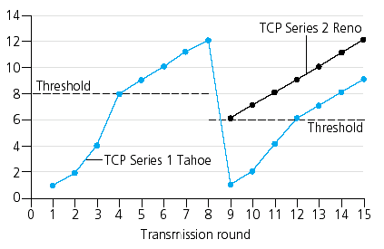
Congestion Avoidance
Q: When should the exponential increase switch to linear?
A: When cwnd gets to 1/2 of its value before timeout
Implementation:
Variable Threshold
At loss event, Threshold is set to 1/2 of cwnd just before loss event
How to increase cwnd linearly: cwnd (new) = cwnd + mss*mss/cwnd

Slide 30
Congestion Control
After 3 duplicated ACKs:
cwnd is cut in half
window then grows linearly
Of course, retransmit segment (i.e., fast recovery/retransmit)
But after timeout event:
cwnd instead set to 1 MSS
window then grows exponentially
to a threshold, then grows linearly
Philosophy:
3 dup ACKs indicates network capable of delivering some segments
timeout indicates a “more alarming” congestion scenario

Slide 31
Summary: TCP Congestion Control
When cwnd is below Threshold, sender in slow-start phase, window grows exponentially
When cwnd is above Threshold, sender is in congestion-avoidance phase, window grows linearly
When a triple duplicate ACK occurs, Threshold set to cwnd/2 and cwnd set to Threshold
When timeout occurs, Threshold set to cwnd/2 and cwnd is set to 1 MSS

Slide 32
TCP Sender Congestion Control
State | Event | TCP Sender Action | Commentary
Slow Start (SS) | ACK receipt for previously unacked data | cwnd = cwnd + MSS, If (cwnd > Threshold) set state to “Congestion Avoidance” | Resulting in a doubling of CongWin every RTT
Congestion Avoidance (CA) | ACK receipt for previously unacked data | cwnd = cwnd+ MSS * (MSS/cwnd) | Additive increase, resulting in increase of CongWin by 1 MSS every RTT

Slide 33
TCP Sender Congestion Control
State | Event | TCP Sender Action | Commentary
SS or CA | Loss event detected by triple duplicate ACK | Threshold = cwnd/2, cwnd = Threshold, Set state to “Congestion Avoidance” | Fast recovery, implementing multiplicative decrease. CongWin will not drop below 1 MSS.
SS or CA | Timeout | Threshold = cwnd/2, cwnd= 1 MSS, Set state to “Slow Start” | Enter slow start
SS or CA | Duplicate ACK | Increment duplicate ACK count for segment being acked | CongWin and Threshold not changed

Slide 34
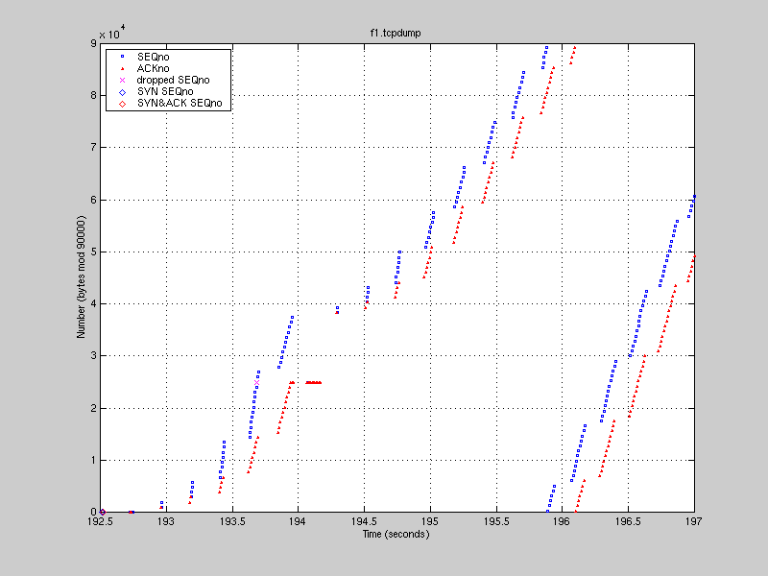
TCP Congestion Control
Slow start
Segment lost
Repeated acks

Slide 35
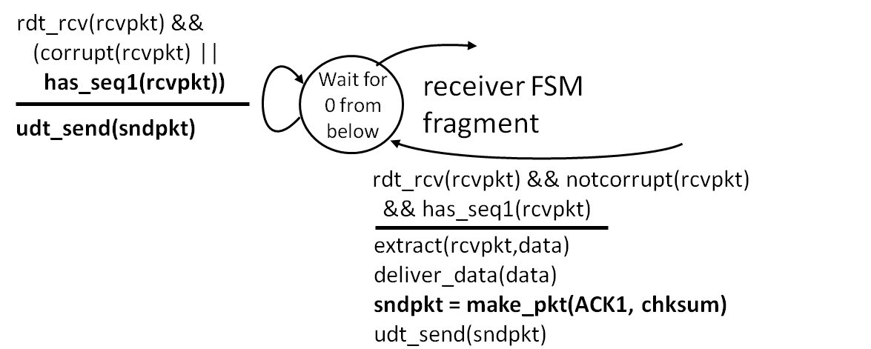
Homework 2.1
Objective 1: Able to understand the RDT3.0 reliable data transfer protocol
Key points:
The protocol consists of two finite state machines (FSM), one for the sender, the other for the receiver
The basic mechanisms that make reliable data transfer include checksum, receiver feedback, sender retransmission, duplicate detection (both for data packet at the receiver and for the ACK at the sender), countdown timer
The protocol specification is described in terms of the FSM, which consists of the states at the sender and the receiver, and for each FSM, all possible events, and the corresponding actions, as well as the state transitions.
Problem. Consider the rdt3.0 protocol we have studied. The partial finite state machine for the receiver is shown (it is in fact identical to that of the rdt2.2 protocol):
Let’s say a student in the class studied the protocol and decided to change the protocol such that on receiving a duplicate or corrupt packet, no action is taken. What do you think about this modification of the rdt3.0 protocol? Is the new protocol going to be functioning correctly (i.e., can it ensure reliable data transfer under the same assumption of the original RDT3.0 protocol)? Please elaborate, that is, if you think the modified protocol still works, explain why omitting sending the ack when receiving a duplicate or corrupt packet does not matter, and on the other hand, if you think the protocol would stop working, describe a specific scenario that would violate the reliable data transfer guarantee.

Slide 36
Homework 2.2
Objective 2: Able to understand the three-way handshake TCP connection mechanism
Key points:
TCP connection establishment mechanism relies on the use of two flags SYN and ACK, and an initial sequence number, one from each direction
SYN flag is turned on only for the very first message (i.e., connection request), while ACK is off
The second message (connection confirmation) has SYN off and ACK flag on. All remaining messages has ACK on (and SYN off)
Problem. A process at host A wants to establish a TCP connection with another process at host B. Assuming that host A chooses to use 1628 as the initial sequence number, and host B chooses to use 3217 as the initial sequence number for this connection, show the segments involved with the connection establishment process. You must include the following information for each such segment: (1) sequence number, (2) acknowledgement number (if applicable), (3) the SYN flag bit status, and (4) the ACK flag bit status.

Slide 37
Homework 2.3
Objective 3: Able to understand the TCP reliable data transfer mechanism
Key points:
TCP operates on top of IP’s unreliable service
TCP connection can be imaged to be streaming a sequence of bytes of payload, where each byte has a consecutive sequence number
TCP uses pipelined segments, that is, sent multiple segments before stops for acknowledgment
TCP uses cumulative acks, that is, the ack for # would mean that all bytes that have sequence number #-1 have been received
TCP uses single retransmission timer
Problem: Host A and B are communicating over a TCP connection, and host B has already received from A all bytes up through byte 126. Suppose Host A then sends two segments to Host B back-to-back. The first and second segments contain 70 and 50 bytes of data, respectively. In the first segment, the sequence number is 127, the source port number is 302, and the destination port number is 80. Host B sends an ack whenever it receives a segment from Host A.
In the second segment sent from A to B, what are the sequence number, source port number, and destination port number?
If the first segment arrives before the second segment, in the ack of the first arriving segment, what is the ack number, the source port number, and the destination port number?
If the second segment arrives before the first segment, in the ack of the first arriving segment, what is the ack number?
Suppose the two segments sent by A arrive in order at B. The 1st ack is lost and the 2nd ack arrives after the 1st timeout interval. Draw a timing diagram showing these segments and all other segments and acks sent. (Assume there is no additional packet loss.) For each segment in your figure, provide the sequence number and the number of bytes of data; for each ack that you add, provide the ack number

Slide 38
Homework 2.4
Objective 4: Able to understand TCP congestion control
Key points:
Initially, explore the network capacity aggressively from 1 segment (exponentially, double the window for every roundtrip time)
It uses a threshold parameter sshred to cap the exponential growth on transmission window (i.e., throughput)
The mechanism considers two different events as an indication for congestion: timeout (more serious) and triple duplicate ACK (less serious). On either event, cut ssthred to half of the previous value
On timeout: start from 1 segment
On 3 ACKs: start from new ssthred
Problem: Consider the figure here and answer the following questions.
Identify the intervals of time when TCP slow start is operating
Identify the intervals of time when TCP congestion avoidance is operating
After the 16th transmission round, is segment loss detected by a triple duplicate ACK or by a timeout?
After the 22nd transmission round, is segment loss detected by a triple duplicate ACK or by a timeout?
What is the initial value of ssthresh at the 1st transmission round?
What is the value of ssthresh at the 18th transmission round?
What is the value of ssthresh at the 24th transmission round?
During what transmission round is the 70th segment sent?
Assuming a packet loss is detected after the 26th round by the receipt of a triple duplicate ACK, what will be the values of the congestion window size and of ssthresh?

