Slide 1
CIS454/554 Data Comm. Networks
Lecture 7
Wenbing Zhao
(Part of the slides are based on Drs. Kurose & Ross’s slides for their Computer Networking book)

Slide 2
Outline
Reliable data transfer (continued)
Pipelining protocols
UDP

Slide 3
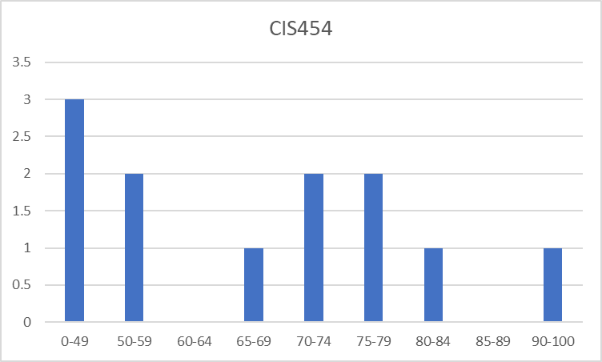
CIS454 Quiz#1 Result
Max: 100, Min: 30, Mean: 64.6
Q1: 33.4/50, Q2: 5.4/10, Q3: 15.75/20, Q4: 10/20
6/12/2023
Wenbing Zhao

Slide 4
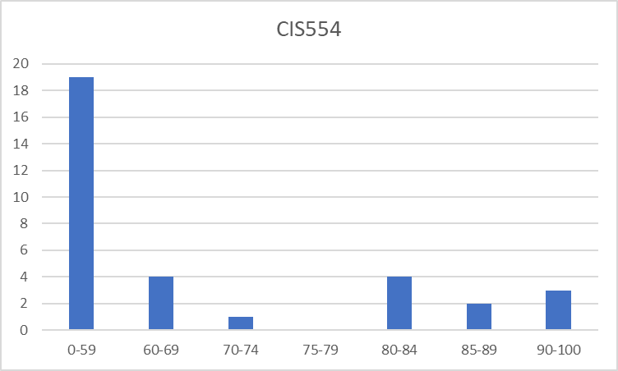
CIS554 MWF Quiz#1 Result
Max: 100, Min: 12, Mean: 55.9
Q1: 30/50, Q2: 4.5/10, Q3: 11/20, Q4: 10/20
6/12/2023
Wenbing Zhao

Slide 5
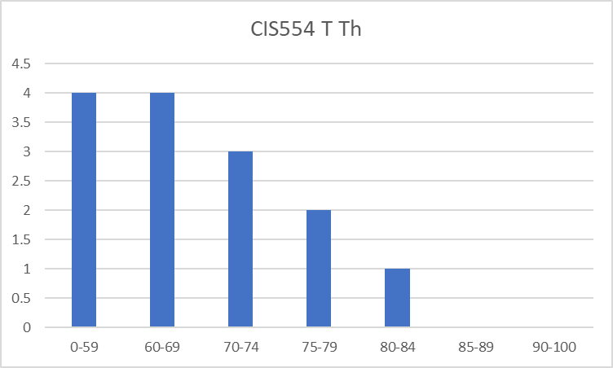
CIS554 T Th Quiz#1 Result
Max: 84, Min: 40, Mean: 65.1
Q1: 34.5/50, Q2: 5/10, Q3: 14.6/20, Q4: 11/20
6/12/2023
Wenbing Zhao

Slide 6
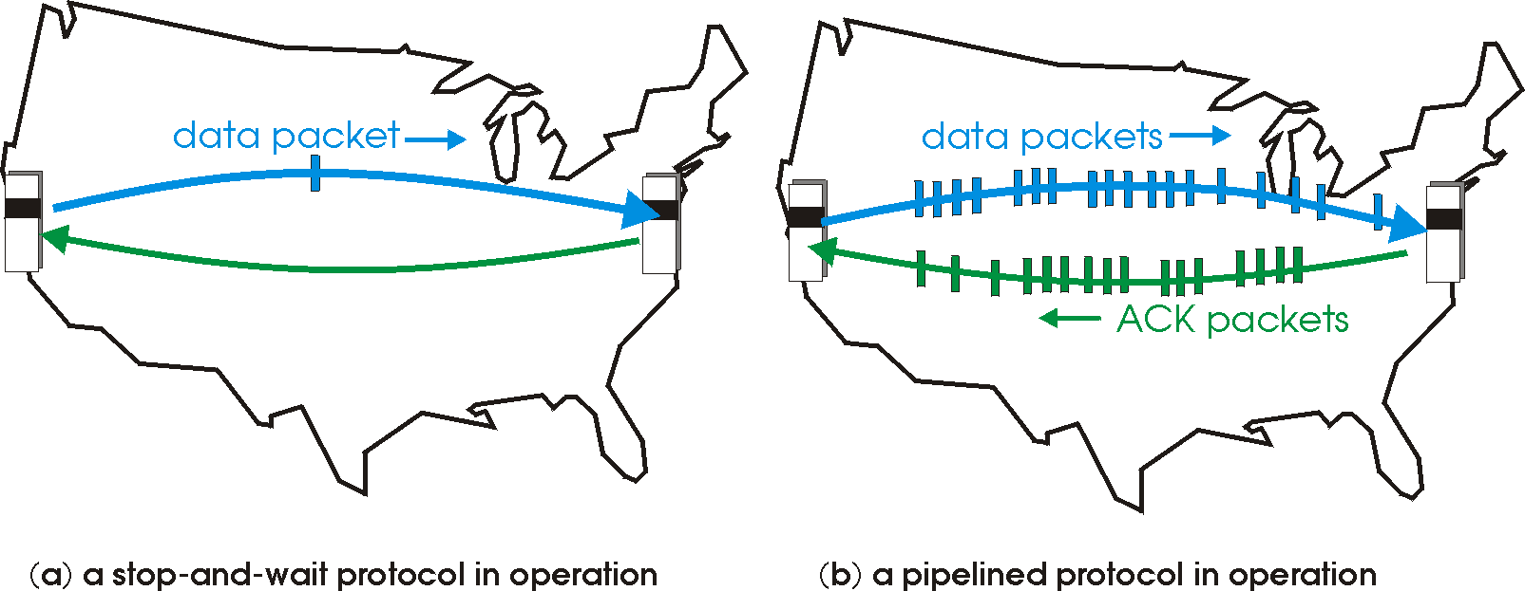
Pipelined Protocols
Pipelining: sender allows multiple, “in-flight”, yet-to-be-acknowledged pkts
range of sequence numbers must be increased
buffering at sender and/or receiver
Two generic forms of pipelined protocols: go-back-N, selective repeat

Slide 7
Pipelining: Increased Utilization
sender
receiver
first packet bit transmitted, t = 0
last bit transmitted, t = L / R
first packet bit arrives
RTT
last packet bit arrives, send ACK
last bit of 2nd packet arrives, send ACK
last bit of 3rd packet arrives, send ACK
ACK arrives, send next
packet, t = RTT + L / R
Increase utilization
by a factor of 3!

Slide 8
Pipelining Protocols
Go-back-N: big picture:
Sender can have up to N unacked packets in pipeline
Rcvr only sends cumulative acks
Doesn’t accept packet if there’s a gap
Sender has timer for oldest unacked packet
If timer expires, retransmit all unacked packets
Selective Repeat: big pic
Sender can have up to N unacked packets in pipeline
Rcvr acks individual packets
Sender maintains timer for each unacked packet
When timer expires, retransmit only unack packet

Slide 9
Go-Back-N
Sender:
k-bit seq # in pkt header
“window” of up to N consecutive unack’ed pkts allowed
ACK(n): ACKs all pkts up to, including seq # n - “cumulative ACK”
may receive duplicate ACKs (see receiver)
timer for oldest in-flight pkt
timeout(n): retransmit pkt n and all higher seq # pkts in window
Notes:
The black bars as not usable sequence numbers are due to the windows size limit, NOT due to non-sequential receive concern!

Slide 10
GBN: Sender Extended FSM
rdt_send(data)
if (nextseqnum < base+N) {
sndpkt[nextseqnum] = make_pkt(nextseqnum,data,chksum)
udt_send(sndpkt[nextseqnum])
if (base == nextseqnum) // start timer if first unacked pkt
start_timer
nextseqnum++
}
else
refuse_data(data)
Λ
base=1
nextseqnum=1
timeout
Wait
start_timer
udt_send(sndpkt[base])
udt_send(sndpkt[base+1])
…
udt_send(sndpkt[nextseqnum-1)
rdt_rcv(rcvpkt)
&& corrupt(rcvpkt)
rdt_rcv(rcvpkt) &&
notcorrupt(rcvpkt)
base = getacknum(rcvpkt)+1
If (base == nextseqnum) // no more unacked pkts
stop_timer
else
start_timer

Slide 11
GBN: Receiver Extended FSM
default
udt_send(sndpkt)
rdt_rcv(rcvpkt)
&& notcurrupt(rcvpkt)
&& hasseqnum(rcvpkt,expectedseqnum)
Λ
Wait
extract(rcvpkt,data)
deliver_data(data)
sndpkt = make_pkt(expectedseqnum,ACK,chksum)
udt_send(sndpkt)
expectedseqnum++
expectedseqnum=1
sndpkt =
make_pkt(expectedseqnum,ACK,chksum)
ACK-only: always send ACK for correctly-received pkt with highest in-order seq #
may generate duplicate ACKs
need only remember expectedseqnum
out-of-order pkt:
discard (don’t buffer) -> no receiver buffering!
Re-ACK pkt with highest in-order seq #

Slide 12
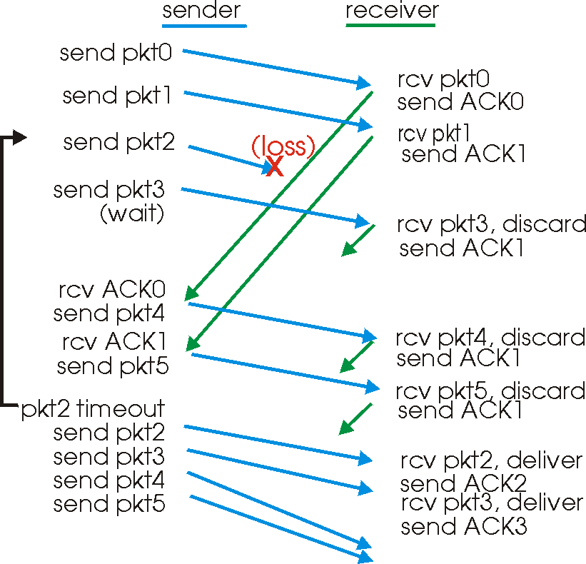
GBN in action

Slide 13
Selective Repeat
Receiver individually acknowledges all correctly received pkts
Buffers pkts, as needed, for eventual in-order delivery to upper layer
Sender only resends pkts for which ACK not received
Sender timer for each unacked pkt
Sender window
N consecutive seq #’s
Again limits seq #s of sent, unacked pkts

Slide 14
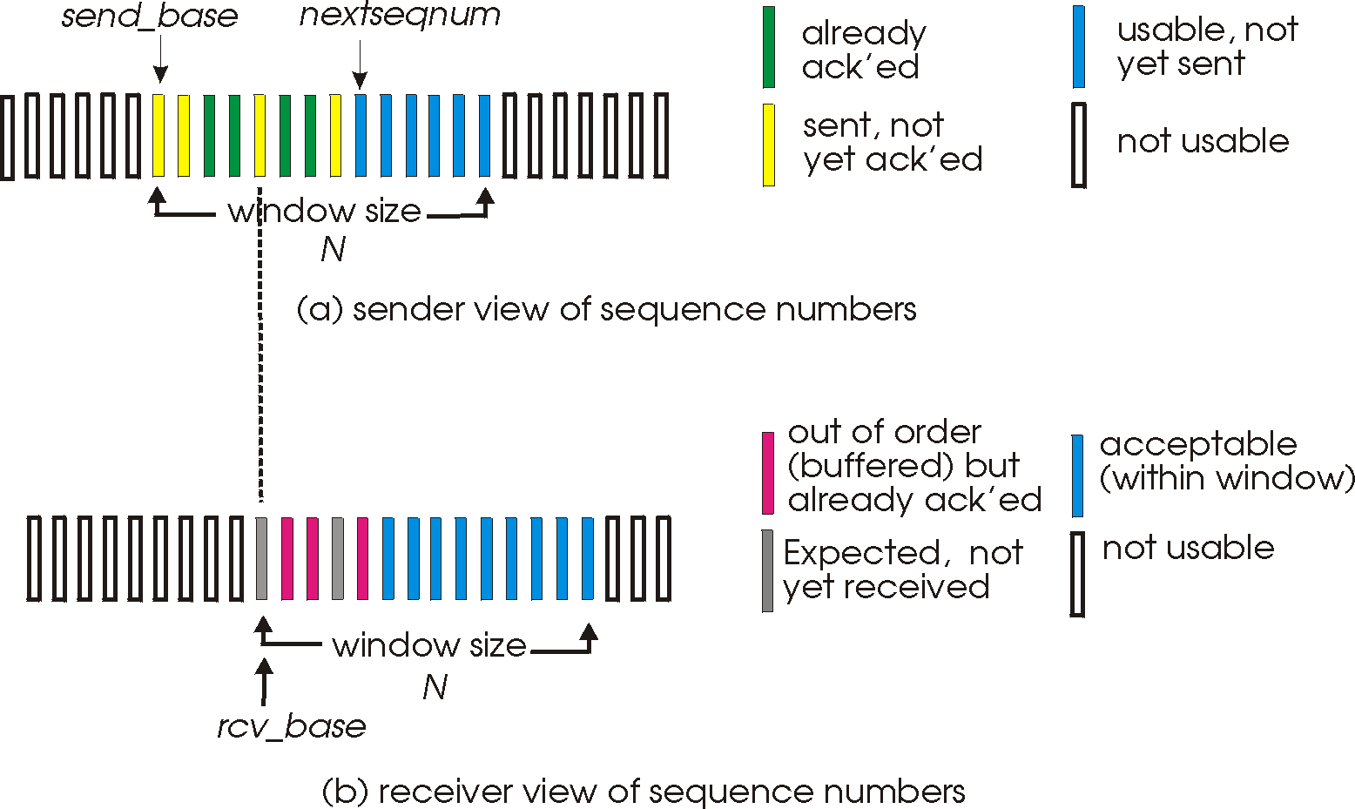
Selective Repeat: Sender, Receiver Windows

Slide 15
Selective Repeat
Sender
Receiver
data from above :
if next available seq # in window, send pkt
timeout(n):
resend pkt n, restart timer
ACK(n) in [sendbase,sendbase+N-1]:
mark pkt n as received
if n smallest unACKed pkt, advance window base to next unACKed seq #
pkt n in [rcvbase, rcvbase+N-1]
send ACK(n)
out-of-order: buffer
in-order: deliver (also deliver buffered, in-order pkts), advance window to next not-yet-received pkt
pkt n in [rcvbase-N,rcvbase-1]
ACK(n)
otherwise:
ignore

Slide 16
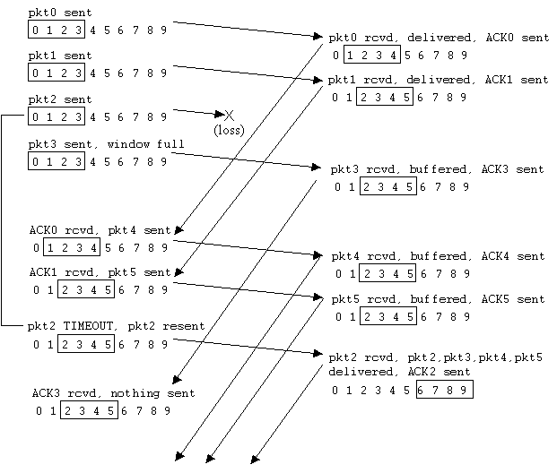
Selective Repeat In Action
Notes:
Stopped here 10/7/2014

Slide 17
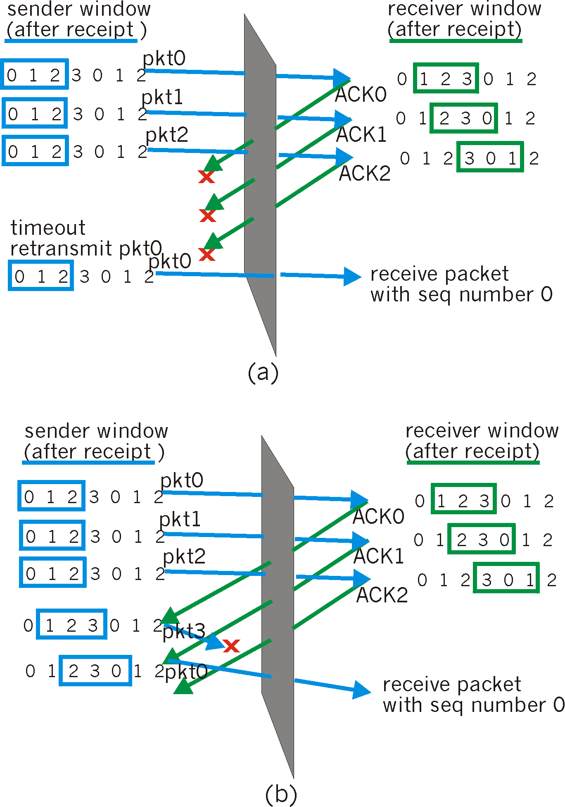
Selective Repeat: Dilemma
Example:
seq #’s: 0, 1, 2, 3
window size=3
receiver sees no difference in two scenarios!
incorrectly passes duplicate data as new in (a)
Q: what relationship between seq # size and window size?

Slide 18
Non-Sequential Receive Problem
The problem is caused by the overlap of sequence number between the new receiving window and the old receiving window
0
1
2
3
4
5
6
0
1
2
3
4
5
6
7
0
1
2
3
4
5
6
7
0
1
2
3
4
5
6
7
0
1
2
3
4
5
6
7
Overlap
Overlap
Notes:
Note: number buffers at receiver needs = w

Slide 19
Non-Sequential Receive Problem
Solution:
make sure no overlap when receiver advances its window
Make window size w =1/2 range of seq numbers
0
1
2
3
0
1
2
3
4
5
6
7
0
1
2
3
4
5
6
7
0
1
2
3
4
5
6
7
0
1
2
3
4
5
6
7
No Overlap

Slide 20
UDP: User Datagram Protocol
“No frills,” “bare bones” Internet transport protocol
“Best effort” service, UDP segments may be:
Lost
Delivered out of order to app
Connectionless:
No handshaking between UDP sender, receiver
Each UDP segment handled independently of others
Notes:
Stop here 2/27/12

Slide 21
Why is There a UDP?
No connection establishment (which can add delay)
Simple: no connection state at sender and receiver
Small segment header
No congestion control: UDP can blast away as fast as desired

Slide 22
UDP
Often used for streaming multimedia apps
Loss tolerant
Rate sensitive
Other UDP uses
DNS
SNMP
Reliable transfer over UDP: add reliability at application layer
32 bits
Length, in
bytes of UDP
segment,
including
header
source port #
dest port #
length
checksum
Application
data
(message)
UDP segment format
Notes:
Simple Network Management Protocol (SNMP)

Slide 23
UDP Checksum
Goal: detect “errors” (e.g., flipped bits) in transmitted segment
Sender:
treat segment contents as sequence of 16-bit integers
checksum: addition (1’s complement sum) of segment contents
sender puts checksum value into UDP checksum field
Receiver:
compute checksum of received segment
check if computed checksum equals checksum field value:
NO - error detected
YES - no error detected. But maybe errors nonetheless?
Notes:
Technical details for checksum computation not required

Slide 24
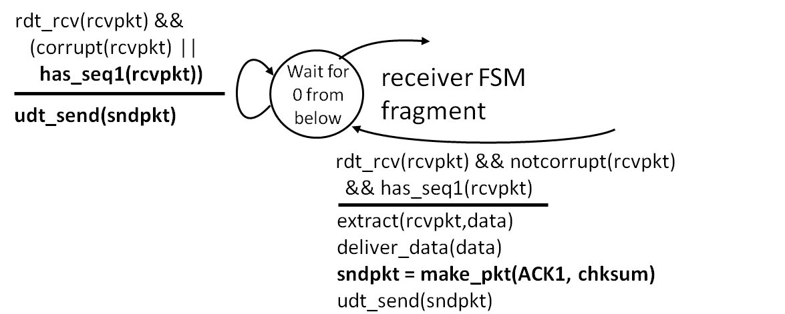
Homework 2.1
Objective 1: Able to understand the RDT3.0 reliable data transfer protocol
Key points:
The protocol consists of two finite state machines (FSM), one for the sender, the other for the receiver
The basic mechanisms that make reliable data transfer include checksum, receiver feedback, sender retransmission, duplicate detection (both for data packet at the receiver and for the ACK at the sender), countdown timer
The protocol specification is described in terms of the FSM, which consists of the states at the sender and the receiver, and for each FSM, all possible events, and the corresponding actions, as well as the state transitions.
Problem. Consider the rdt3.0 protocol we have studied. The partial finite state machine for the receiver is shown (it is in fact identical to that of the rdt2.2 protocol):
Let’s say a student in the class studied the protocol and decided to change the protocol such that on receiving a duplicate or corrupt packet, no action is taken. What do you think about this modification of the rdt3.0 protocol? Is the new protocol going to be functioning correctly (i.e., can it ensure reliable data transfer under the same assumption of the original RDT3.0 protocol)? Please elaborate, that is, if you think the modified protocol still works, explain why omitting sending the ack when receiving a duplicate or corrupt packet does not matter, and on the other hand, if you think the protocol would stop working, describe a specific scenario that would violate the reliable data transfer guarantee.
EEC-484/584: Computer Networks
Wenbing Zhao

