Slide 1
CIS454/554 Data Comm. Networks
Lecture 9
Wenbing Zhao
(Part of the slides are based on Drs. Kurose & Ross’s slides for their Computer Networking book)

Slide 2
Outline
Quiz#2 result
Introduction to network layer
Routing and forwarding, etc.
Router architecture
Routing algorithm
Link state routing
Distance vector routing

Slide 3
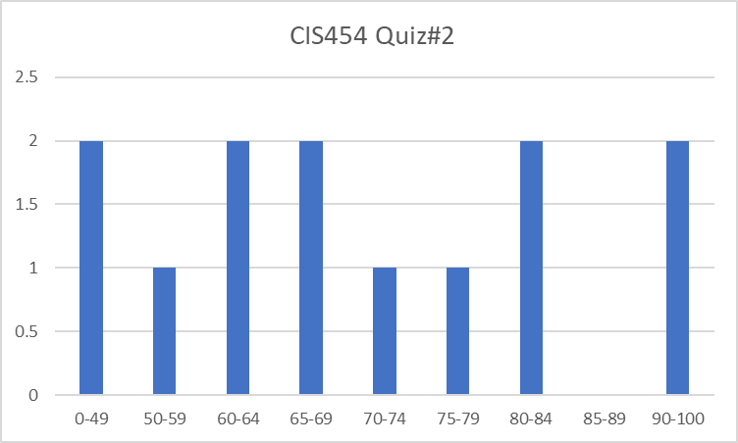
CIS454 Quiz#2 Result
Max: 100, Min: 45, Mean: 68.9
Q1: 37.5/50, Q2: 6/10, Q3: 16.2/20, Q4: 9.2/15

Slide 4
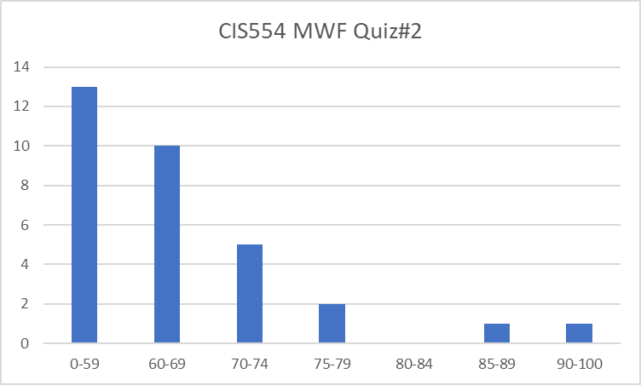
CIS554 MWF Quiz#2 Result
Max: 100, Min: 40, Mean: 61.1
Q1: 28.9/50, Q2: 5.2/15, Q3: 18.1/20, Q4: 8.9/15

Slide 5
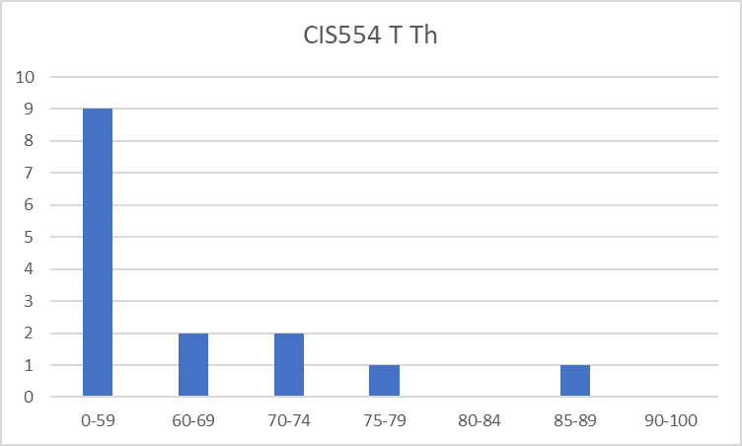
CIS554 TTh Quiz#2 Result
Max: 85, Min: 25, Mean: 51
Q1: 28.7/50, Q2: 3.3/15, Q3: 10.7/20, Q4: 8.3/15

Slide 6
Network Layer
Main concern: end-to-end transmission
Perhaps over many hops at intermediate nodes
Services provided to transport layer
Transport segment from sending to receiving host
On sending side encapsulates segments into datagrams
On receiving side, delivers segments to transport layer
Network layer protocols in every host, router
Router examines header fields in all IP datagrams passing through it
application
transport
network
data link
physical
network
data link
physical
network
data link
physical
network
data link
physical
network
data link
physical
network
data link
physical
network
data link
physical
network
data link
physical
network
data link
physical
application
transport
network
data link
physical

Slide 7
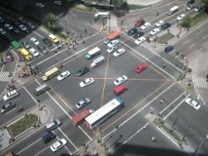
Two Key Network-Layer Functions
Routing: determine route taken by packets from source to destination
Forwarding: move packets from router’s input to appropriate router output
Analogy:
Routing: process of planning trip from source to destination
Forwarding: process of getting through single intersection

Slide 8
Interplay between Routing & Forwarding
routing algorithm
Forwarding table is
also referred to as routing table
local forwarding table
header value
output link
0100
0101
0111
1001
3
2
2
1
value in arriving
packet’s header
0111
1
3
2

Slide 9
Network Service Model
Q: What service model for “channel” transporting datagrams from sender to receiver?
Example services for a flow of datagrams:
In-order datagram delivery
Guaranteed minimum bandwidth to flow
Restrictions on changes in inter-packet spacing
No guarantee whatsoever
Example services for individual datagrams:
Guaranteed delivery
Guaranteed delivery with less than 40 msec delay
Best effort

Slide 10
Network Layer Connection and Connection-less Service
Datagram network provides network-layer connectionless service
Virtual Circuit network provides network-layer connection-oriented service (omitted)

Slide 11
Datagram Networks
No call setup at network layer
Routers: no state about end-to-end connections
no network-level concept of “connection”
Packets forwarded using destination host address
packets between same source-dest pair may take different paths
application
transport
network
data link
physical
application
transport
network
data link
physical
1. Send data
2. Receive data

Slide 12
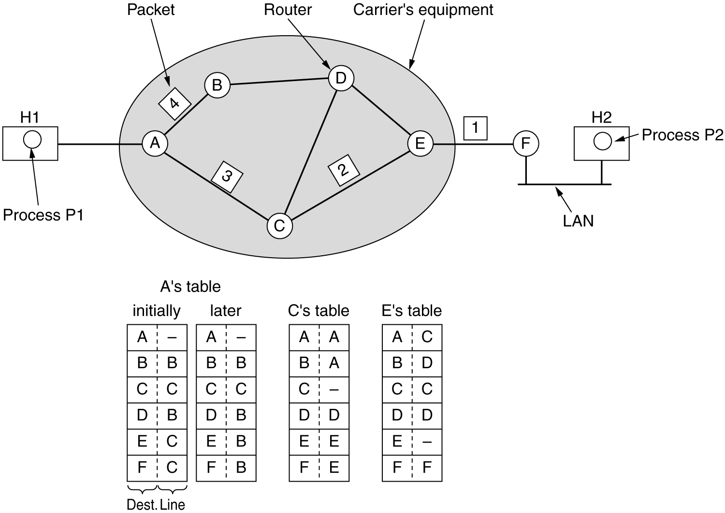
Routing within a Datagram Subnet
Router has forwarding table telling which outgoing line to use for each possible destination router
Each datagram has full destination address
When packet arrives, router looks up outgoing line to use and transmits packet

Slide 13
Datagram or VC Network: Why?
Internet (datagram)
data exchange among computers
“elastic” service, no strict timing requirement
“smart” end systems (computers)
can adapt, perform control, error recovery
simple inside network, complexity at “edge”
ATM (VC)
evolved from telephony
human conversation:
strict timing, reliability requirements
need for guaranteed service
“dumb” end systems
telephones
complexity inside network

Slide 14
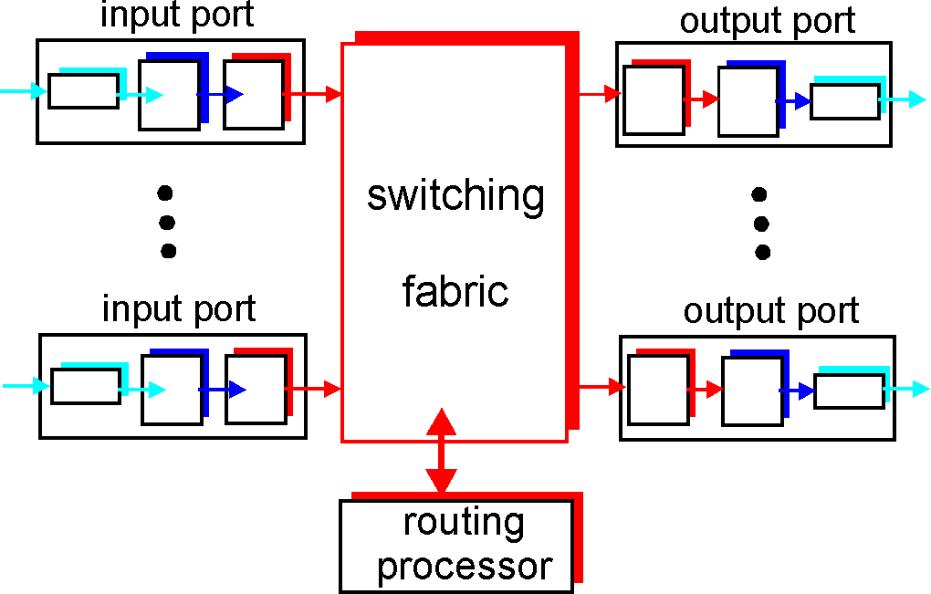
What’s in a Router?
Run routing algorithms/protocol (RIP, OSPF, BGP)
Forwarding datagrams from incoming to outgoing link

Slide 15
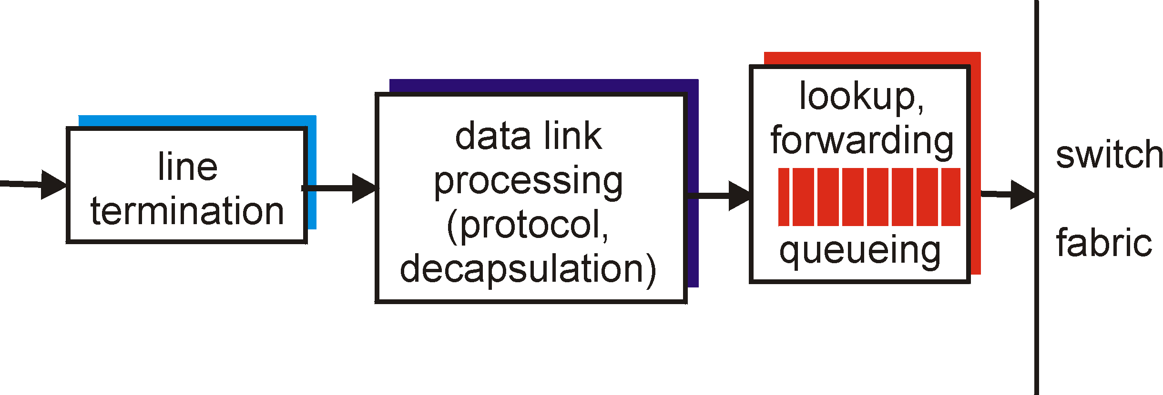
Input Port Functions
Physical layer:
bit-level reception
Data link layer:
e.g., Ethernet
Decentralized switching:
given datagram dest., lookup output port using forwarding table in input port memory
queuing: newly arrived datagrams might be queued before processing

Slide 16
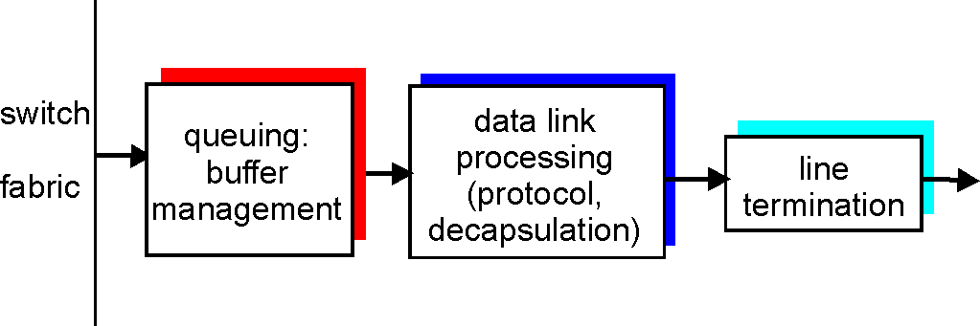
Output Ports
Buffering required when datagrams arrive from fabric faster than the transmission rate
Scheduling discipline chooses among queued datagrams for transmission

Slide 17
Routing Algorithms
Routing algorithm: algorithm that finds least-cost path
Least-cost in what sense?
Number of hops, geographical distance, least queueing and transmission delay
Desirable properties
Correctness, simplicity
Robustness to faults
Stability – converge to equilibrium

Slide 18
Routing Algorithm Classification
Static or dynamic?
Non-adaptive (static) - Route computed in advance, off-line, downloaded to routers
Adaptive (dynamic) - Route based on measurements or estimates of current traffic and topology

Slide 19
Routing Algorithm Classification
Global or decentralized information?
Global:
all routers have complete topology & link cost info
“link state” algorithms
Decentralized:
router knows physically-connected neighbors, link costs to neighbors
iterative process of computation, exchange of info with neighbors
“distance vector” algorithms

Slide 20
Link State Routing
Basic idea
Assumes net topology & link costs known to all nodes
Accomplished via “link state broadcast”
All nodes have same info
Computes least cost paths from one node (‘source”) to all other nodes, using Dijkstra’s Algorithm
Gives forwarding table for that node

Slide 21
Dijkstra’s Algorithm
Each node labeled with distance from source node along best known path
Initially, no paths known so all nodes labeled with infinity
As algorithm proceeds, labels may change reflecting shortest path
Label may be tentative or permanent, initially, all tentative
When label represents shortest path from source to node, label becomes permanent

Slide 22
Compute Shortest Path from A to D
Start with node A as the initial working node
Examine each of the nodes adjacent to A, i.e., B and G, relabeling them with the distance to A
Examine all the tentatively labeled nodes in the whole graph and make the one with the smallest label permanent, i.e., B. B is the new working node
Notes:
Steps computing the shortest path from A to D, using Dijkstra’s algorithm. The arrows indicate the working node.
We start out by marking node A as permanent, indicated by a filled-in circle. Then we examine, in turn, each of the nodes adjacent to A (the working node), relabeling each one with the distance to A. Whenever a node is relabeled, we also label it with the node from which the probe was made so that we can reconstruct the final path later. Having examined each of the nodes adjacent to A, we examine all the tentatively labeled nodes in the whole graph and make the one with the smallest label permanent. This one becomes the new working node.
Last two steps: C(9,B) permanent; D(10,H) permanent;

Slide 23
Compute Shortest Path from A to D
Notes:
Stopped here step3

Slide 24
Step | Permanently labeled | B | G | E | C | F | H | D
1 | A | 2,A | 6,A | ∞ | ∞ | ∞ | ∞ | ∞
2 | AB |  | 6,A | 4,B | 9,B | ∞ | ∞ | ∞
3 | ABE |  | 5,E |  | 9,B | 6,E | ∞ | ∞
4 | ABEG |  |  |  | 9,B | 6,E | 9,G | ∞
5 | ABEGF |  |  |  | 9,B |  | 8,F | ∞
6 | ABEGFH |  |  |  | 9,B |  |  | 10,H
7 | ABEGFHC |  |  |  |  |  |  | 10,H
8 | ABEGFHCD

Slide 25
Computation Results
C
B
A
E
F
D
G
H
Routing Table in A
Destination
link
B
C
D
E
F
G
H
(A,B)
(A,B)
(A,B)
(A,B)
(A,B)
(A,B)
(A,B)

Slide 26
Home#3.1
Objective 1: Able to understand how to use Dijkstra’s Algorithm to find the first the shortest path for a network
Key points
The algorithm works in rounds
In each round, a new path is found, as the result, the distance previously labeled may have to be updated, that is, a previous longer path might now become shorter via this new path
The algorithm terms once all nodes in the network have been considered
Problem: Given the subnet shown below, using the Dijkstra’s Algorithm, determine the shortest path tree from node u and its routing table
5
v
3
w
2
5
u
2
1
z
3
1
2
x
y
1

