Slide 1
CIS454/554 Data Comm. Networks
Lecture 12
Wenbing Zhao
Cleveland State University

Slide 2
Outline
Data Link layer
Error Detection and Correction
Medium Access Control (MAC)
DLL
Data Link
7/3/2023

Slide 3
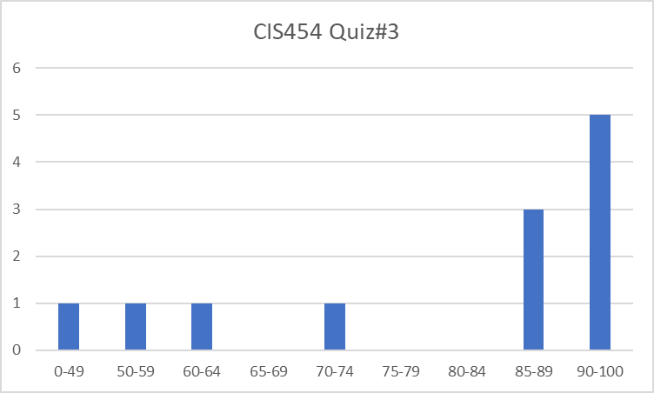
CIS454 Quiz#3 Result
Max: 100, Min: 17, Mean: 79.3
Q1: 38.75/50, Q2: 16.7/20, Q3: 14.75/20, Q4: 9.2/10
7/3/2023
Wenbing Zhao

Slide 4
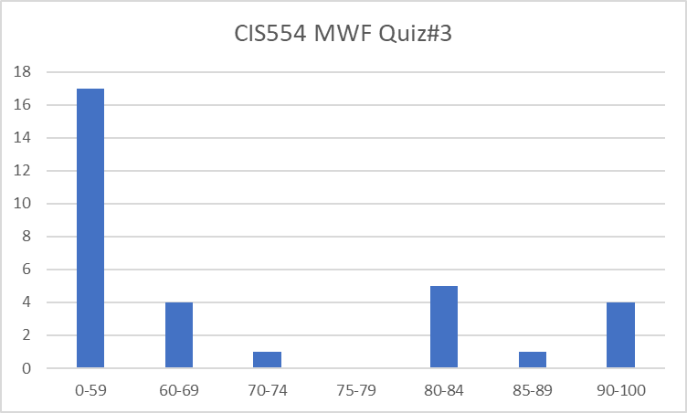
CIS554 MWF Quiz#3 Result
Max: 95, Min: 15, Mean: 54.2
Q1: 28/50, Q2: 10/20, Q3: 8.4/20, Q4: 7.8/10
7/3/2023
Wenbing Zhao

Slide 5
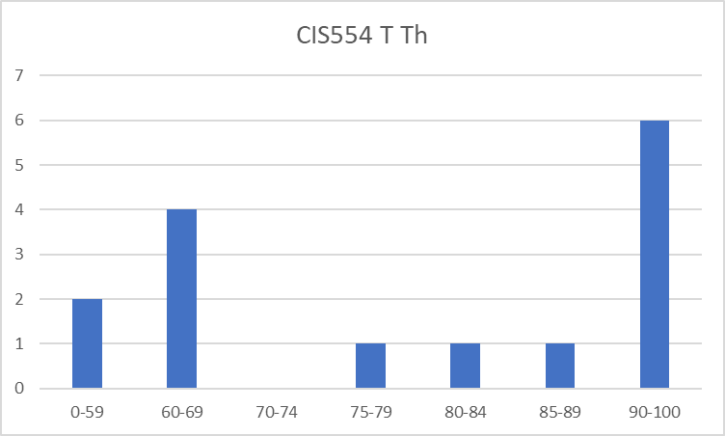
CIS554 TTh Quiz#3 Result
Max: 100, Min: 33, Mean: 76.8
Q1: 41.7/50, Q2: 11.9/20, Q3: 15.7/20, Q4: 7.5/10
7/3/2023
Wenbing Zhao

Slide 6
The Data Link Layer
Our goals:
understand principles behind data link layer services:
error detection, correction
sharing a broadcast channel: multiple access
link layer addressing
reliable data transfer, flow control: done!
instantiation and implementation of various link layer technologies

Slide 7
Link Layer: Introduction
Some terminology:
hosts and routers are nodes
communication channels that connect adjacent nodes along communication path are links
wired links
wireless links
LANs
layer-2 packet is a frame, encapsulates datagram
data-link layer has responsibility of
transferring datagram from one node
to adjacent node over a link

Slide 8
Link layer: context
transportation analogy
trip from Princeton to Lausanne
limo: Princeton to JFK
plane: JFK to Geneva
train: Geneva to Lausanne
tourist = datagram
transport segment = communication link
transportation mode = link layer protocol
travel agent = routing algorithm
datagram transferred by different link protocols over different links:
e.g., Ethernet on first link, frame relay on intermediate links, 802.11 on last link
each link protocol provides different services
e.g., may or may not provide rdt over link

Slide 9
Link Layer Services
framing, link access:
encapsulate datagram into frame, adding header, trailer
channel access if shared medium
“MAC” addresses used in frame headers to identify source, destination
different from IP address!
reliable delivery between adjacent nodes
we learned how to do this already
seldom used on low bit-error link (fiber, some twisted pair)

Slide 10
Link Layer Services
flow control:
pacing between adjacent sending and receiving nodes
error detection:
errors caused by signal attenuation, noise.
receiver detects presence of errors:
signals sender for retransmission or drops frame
error correction:
receiver identifies and corrects bit error(s) without resorting to retransmission
half-duplex and full-duplex
with half duplex, nodes at both ends of link can transmit, but not at same time

Slide 11
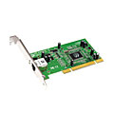
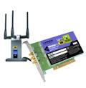
Where is the link layer implemented?
in each and every host
link layer implemented in “adaptor” (aka network interface card NIC)
Ethernet card, PCMCI card, 802.11 card
implements link, physical layer
attaches into host’s system buses
combination of hardware, software, firmware
host schematic
application
transport
network
link
cpu
memory
link
physical
host
bus
(e.g., PCI)
controller
physical
transmission
network adapter
card

Slide 12
Adaptors Communicating
datagram
datagram
controller
controller
sending host
receiving host
datagram
frame
receiving side
looks for errors, rdt, flow control, etc
extracts datagram, passes to upper layer at receiving side
sending side:
encapsulates datagram in frame
adds error checking bits, rdt, flow control, etc.

Slide 13
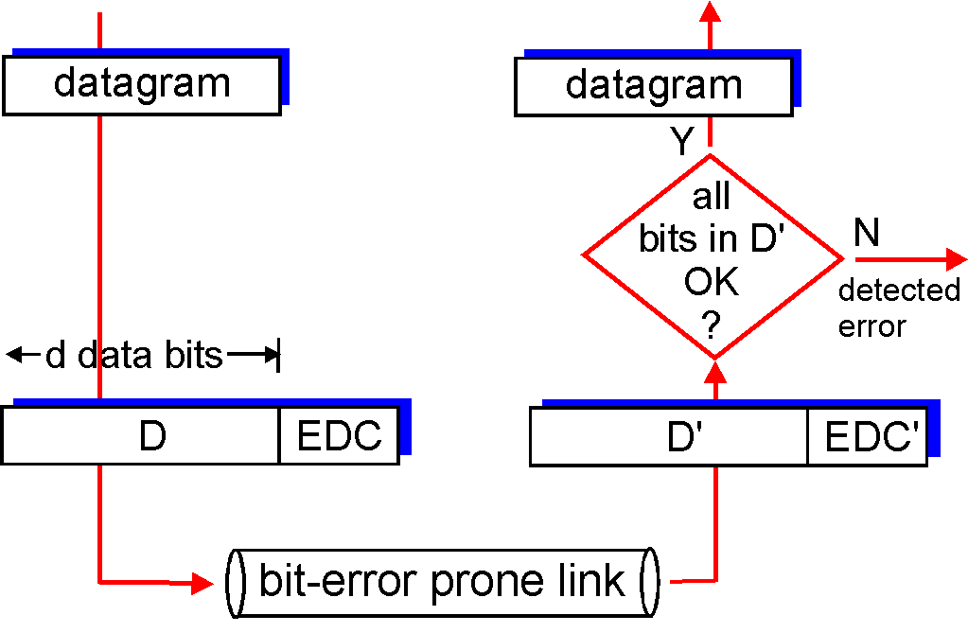
Error Detection
EDC= Error Detection and Correction bits (redundancy)
D = Data protected by error checking, may include header fields
Error detection not 100% reliable!
protocol may miss some errors, but rarely
larger EDC field yields better detection and correction
otherwise

Slide 14
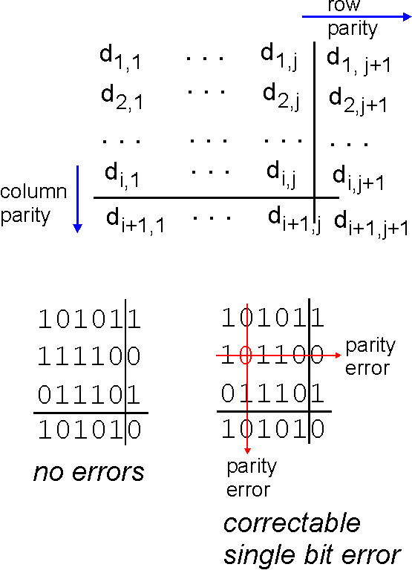
Parity Checking
Single Bit Parity:
Detect single bit errors
Two Dimensional Bit Parity:
Detect and correct single bit errors
Example: Given 1011010
With even parity ⇒ 10110100
With odd parity ⇒ 10110101
0
0

Slide 15
Checksumming: Cyclic Redundancy Check
view data bits, D, as a binary number
choose r+1 bit pattern (generator), G
goal: choose r CRC bits, R, such that
<D,R> exactly divisible by G (modulo 2)
receiver knows G, divides <D,R> by G. If non-zero remainder: error detected!
can detect all burst errors less than r+1 bits
widely used in practice (Ethernet, 802.11 WiFi)
Notes:
Start here on wed

Slide 16
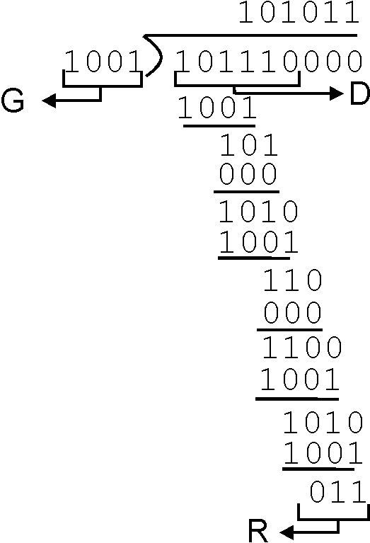
CRC Example
Want:
D.2^{r} XOR R = nG
equivalently:
D.2^{r} = nG XOR R
equivalently:
if we divide D.2^{r} by G, want remainder R
D.2^{r}
G
R = remainder[ ]

Slide 17
Multiple Access Links and Protocols
Two types of “links”:
point-to-point
PPP for dial-up access
point-to-point link between Ethernet switch and host
broadcast (shared wire or medium)
old-fashioned Ethernet
802.11 wireless LAN
humans at a
cocktail party
(shared air, acoustical)
shared wire (e.g.,
cabled Ethernet)
shared RF
(e.g., 802.11 WiFi)
shared RF
(satellite)

Slide 18
Multiple Access protocols
Single shared broadcast channel
Two or more simultaneous transmissions by nodes: interference
Collision if node receives two or more signals at the same time
Multiple access protocol
Distributed algorithm that determines how nodes share channel, i.e., determine when node can transmit
Communication about channel sharing must use channel itself!
No out-of-band channel for coordination

Slide 19
MAC Protocols: Classification
Channel Partitioning
divide channel into smaller “pieces” (time slots, frequency, code)
allocate piece to node for exclusive use
Random Access
channel not divided, allow collisions
“recover” from collisions

Slide 20
Channel Partitioning MAC protocols: TDMA
TDMA: time division multiple access
access to channel in "rounds"
each station gets fixed length slot (length = pkt trans time) in each round
unused slots go idle
example: 6-station LAN, 1,3,4 have pkt, slots 2,5,6 idle
6-slot
frame
1
3
4
1
3
4

Slide 21
Channel Partitioning MAC protocols: FDMA
FDMA: frequency division multiple access
channel spectrum divided into frequency bands
each station assigned fixed frequency band
unused transmission time in frequency bands go idle
example: 6-station LAN, 1,3,4 have pkt, frequency bands 2,5,6 idle
time
frequency bands
FDM cable

Slide 22
Random Access Protocols
When node has packet to send
transmit at full channel data rate R.
no a priori coordination among nodes
two or more transmitting nodes ➜ “collision”,
random access MAC protocol specifies:
how to detect collisions
how to recover from collisions (e.g., via delayed retransmissions)
Examples of random access MAC protocols:
ALOHA
slotted ALOHA
CSMA, CSMA/CD, CSMA/CA

Slide 23
CSMA (Carrier Sense Multiple Access)
CSMA: listen before transmit:
If channel sensed idle: transmit entire frame
If channel sensed busy, defer transmission
human analogy: don’t interrupt others!

Slide 24
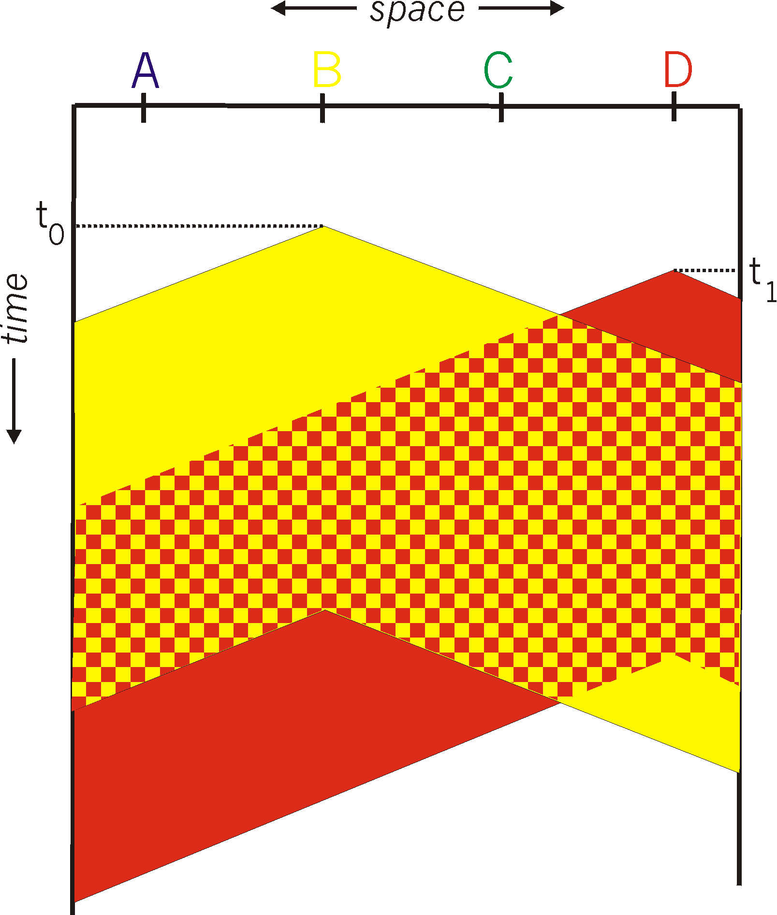
CSMA collisions
spatial layout of nodes
collisions can still occur:
propagation delay means
two nodes may not hear
each other’s transmission
collision:
entire packet transmission
time wasted
note:
role of distance & propagation delay in determining collision probability

Slide 25
CSMA/CD (Collision Detection)
CSMA/CD: carrier sensing, deferral as in CSMA
collisions detected within short time
colliding transmissions aborted, reducing channel wastage
collision detection:
easy in wired LANs: measure signal strengths, compare transmitted, received signals
difficult in wireless LANs: received signal strength overwhelmed by local transmission strength

Slide 26
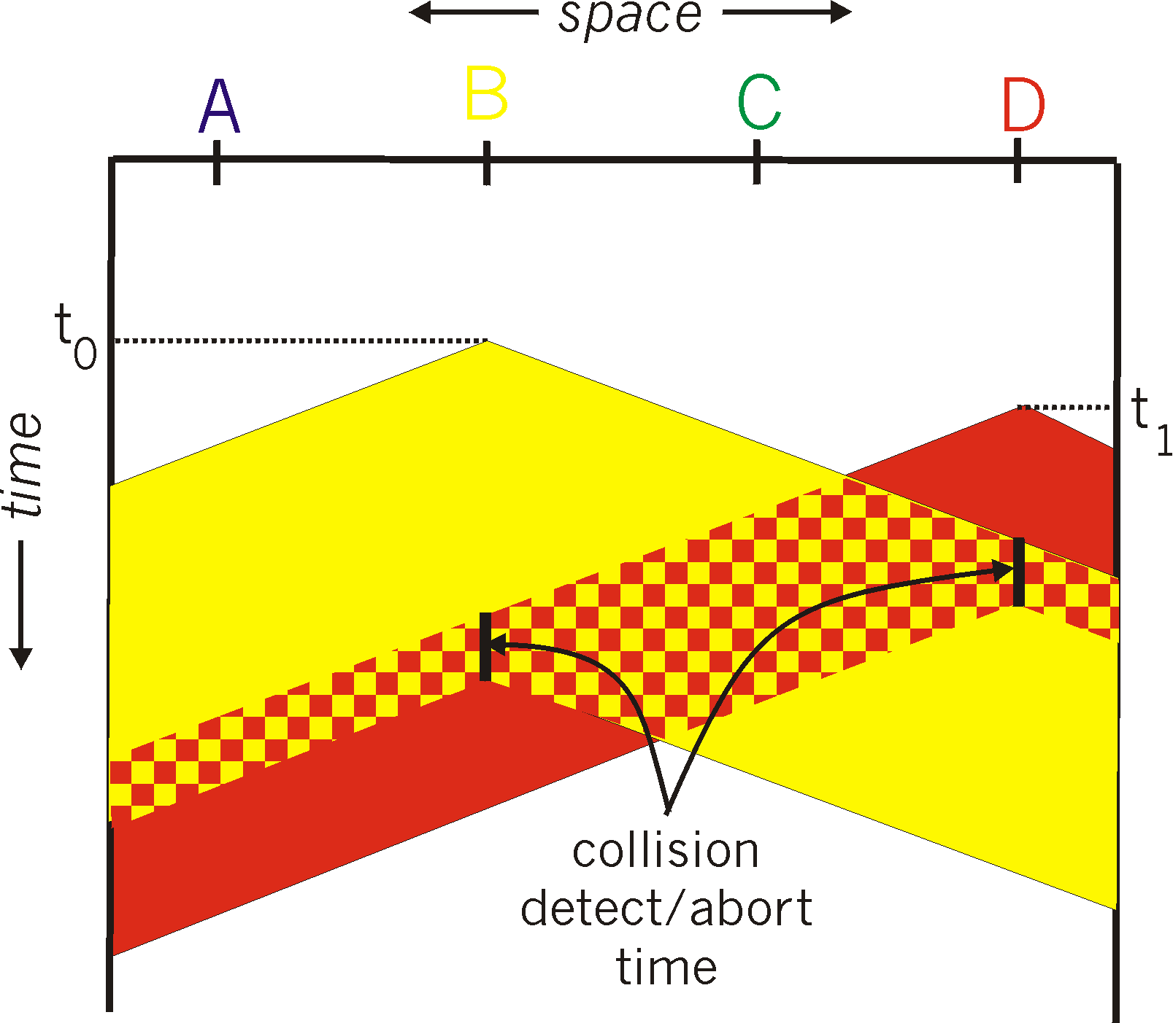
CSMA/CD Collision Detection

Slide 27
Homework#4.1
Objective 1: Understand Error Detection Mechanisms in Datalink Layer
Important concepts/knowledge (please elaborate each)
Error detection principle
Parity checking mechanism, parity bit
Cyclic redundancy check (CRC) mechanism, CRC generator, modulo 2 division
Problem 1: If even parity is used, and a station A wants to transmit 1101101 to B, which parity bit should A append to its frame?
Problem 2: A bit stream 10011101 is to be transmitted using the standard CRC method described in the text. The generator polynomial is 1001. Show the actual bit string transmitted. Suppose the third bit from the left is inverted during transmission. Show that this error is detected at the receiver's end.

Slide 28
Homework#4.2
Objective 2: Understand Multiple Access Links and Protocols
Important concepts/knowledge (please elaborate each)
Types of data links
The multiple access (MAC) problem, collision, collision recovery
Classification of MAC protocols: channel partitioning (TDMA, FDMA), random access
Problem: For multi access control, there are two approaches, those based on channel partitioning, and those based on random access. In packet switching, there are two rather similar approaches as well, namely, circuit switching and package switching. Discuss the similarities and differences in these two problem domains and the corresponding approaches.

Slide 29
Homework#4.3
Objective 3: Understand Random Access Protocols
Important concepts/knowledge (please elaborate each)
CSMA, Collision detection, CSMA/CD
Problem 1: Consider two stations, A and B, in a datalink network. A is 1km away from B. The signal propagation speed is 200,000 km/second. The datalink has a bandwidth of 100Mbps. The packet size is fixed at 1024 Bytes. Answer the following questions:
What is the transmission time for each packet?
What is the propagation delay between A and B?
Problem 2: To detect a collision, a station must first receive the collision signal from the place of collision, and it takes a small amount of time for the station to determine that indeed a collision has occurred based on the collision signal received. Assume that the latter is 1 microsecond. Answer the following questions (assuming the condition from problem 1 still applies):
If A and B happen to transmit a packet at the same time, how long does it take for A (or B) to receive the collision signal since the start of the transmission of the packet?
If CSMA/CD is used, how much time can the station save compared against CSMA?

